Slide 1
Green industrial policy in the voting booth:
The electoral effects of the Inflation Reduction Act
Aidan Miao (UCL)
Jared J Finnegan (UCL)
Julius J Andersson (SSE)
The Next Era of Climate Policies Workshop
Stockholm School of Economics
25 November 2024

Slide 2
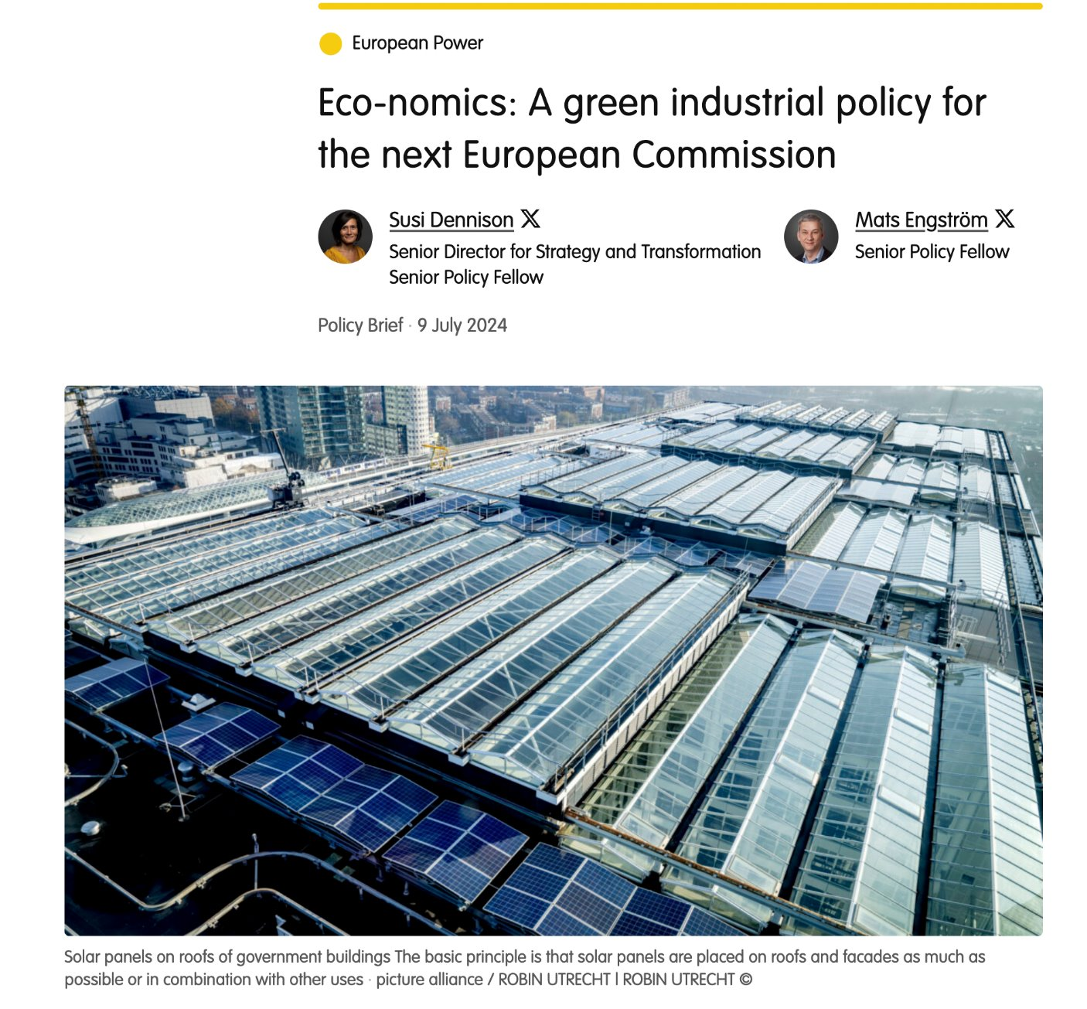
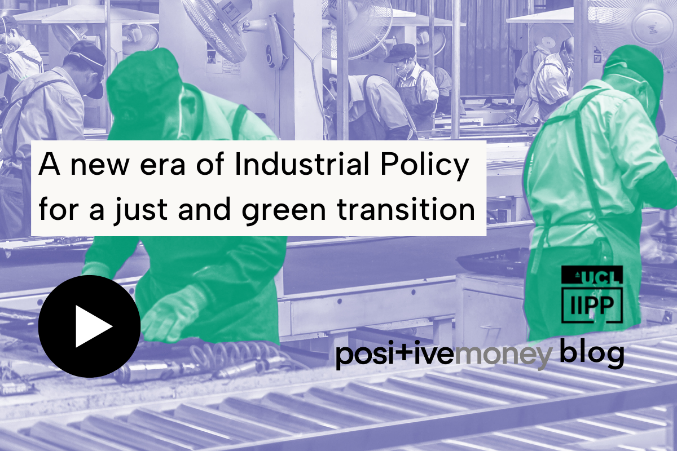
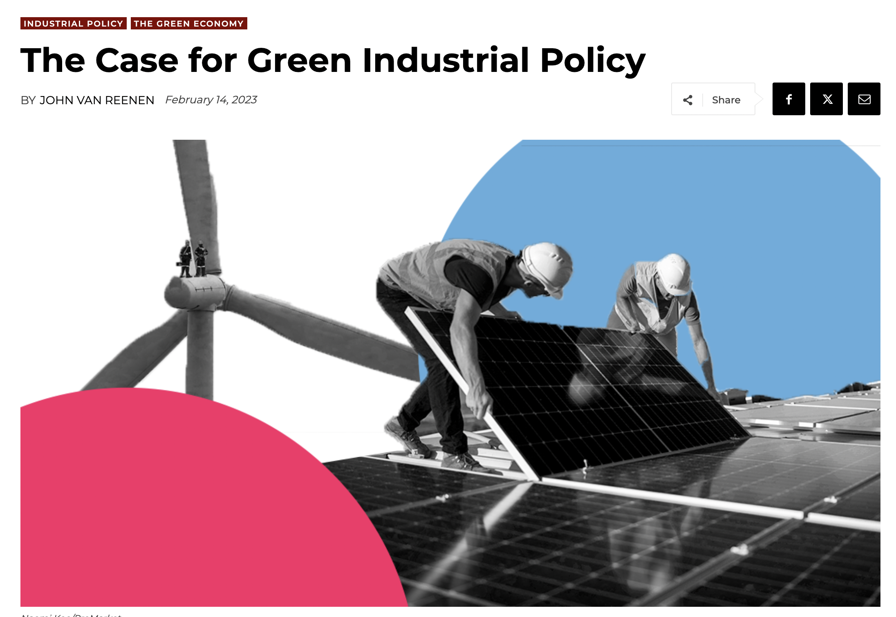
Shift in climate policymaking
Shift in climate policymaking away from conventional measures that target GHG reductions alone (e.g. carbon pricing)
Climate policy being integrated with economic policy
Emphasis on reductions + economic and social benefits
Rise of green industrial policy and just transitions
  ‘Compensatory climate policies’
Theme of this workshop

Slide 3

Green industrial policy (GIP)
Dual objectives
  Environmental = GHG reductions
  Economic = jobs, innovation, growth, competitiveness
State takes an active role in setting priorities, creating/shaping markets, guiding investments
  Instruments: Subsidies, loans, public procurement, local content requirements, regulations and standards

Slide 4
Why is this shift happening?
Changing economic paradigms regarding state intervention
  ‘Common sense’ economic ideas are changing about role of state in the market
  ‘Hands off’ neoliberalism out of fashion, esp in the West
Geopolitical rivalry as catalyst for 'reindustrialization'
  The West trying to slow / stop rise of China
  Prevent China from taking lead in advanced green technology and sectors
Political exhaustion with conventional climate policies
  Politics of imposing high costs on households and business very difficult given current moment:
    high inflation / cost of living
    low growth
    foreign economic competition
    energy price spike as result of Ukraine war
    rise of far right
    protests and backlash (gilets jaunes, farmers)

Slide 5
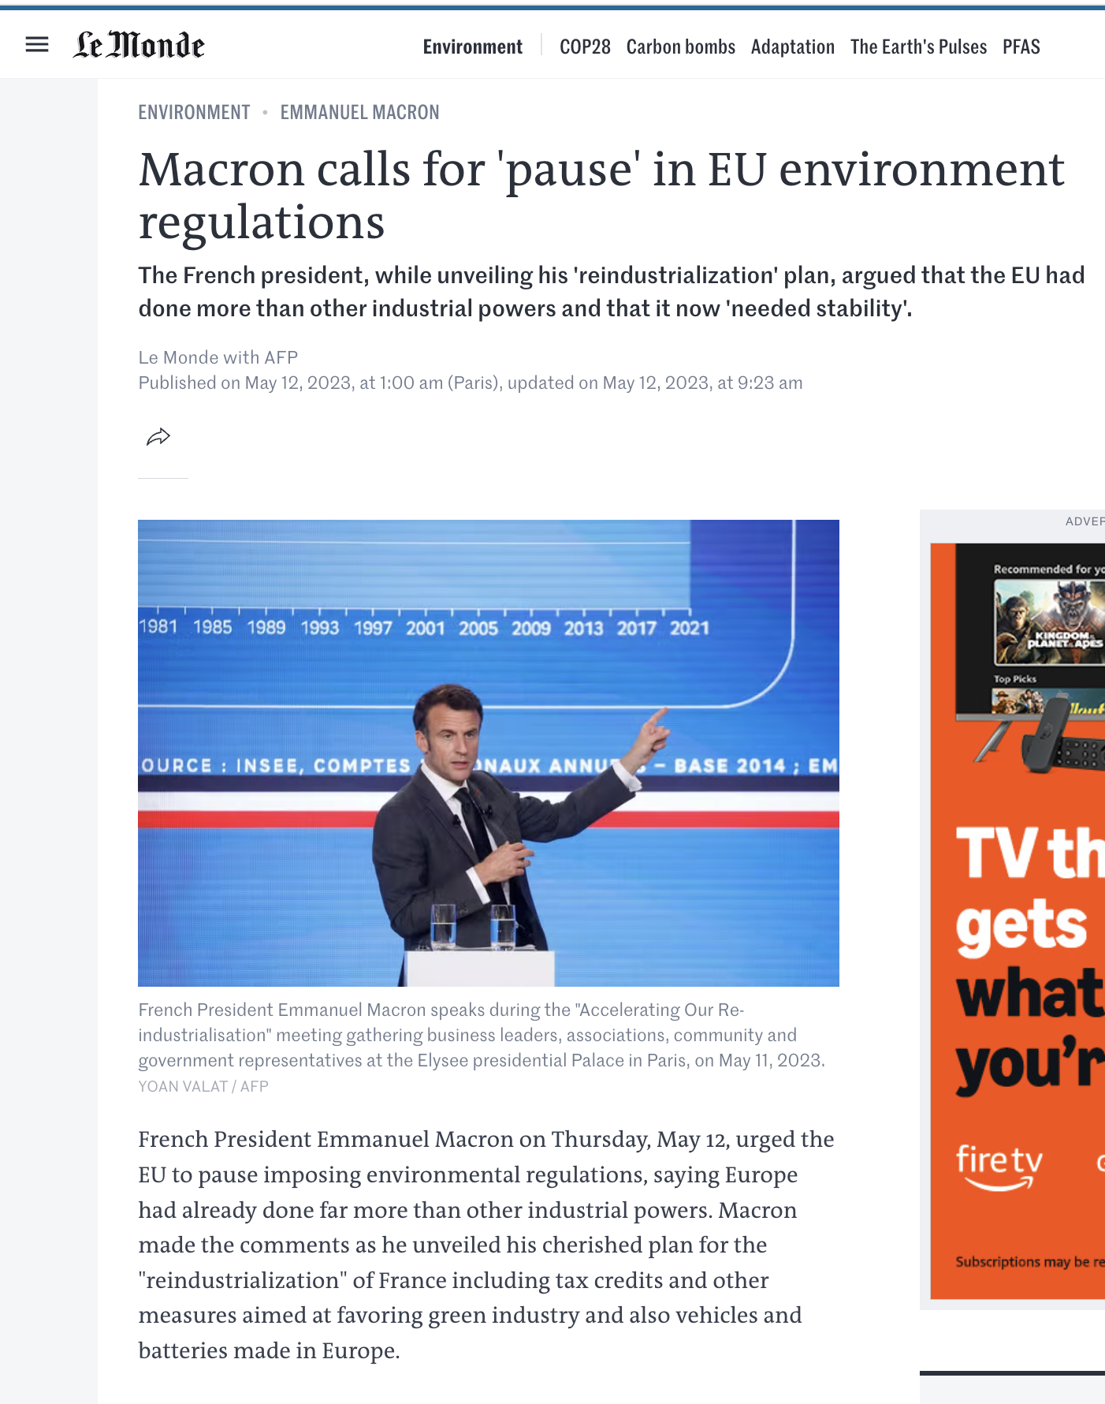
Notes:
Even some in EU are calling for pause to more stringent measures

Slide 6

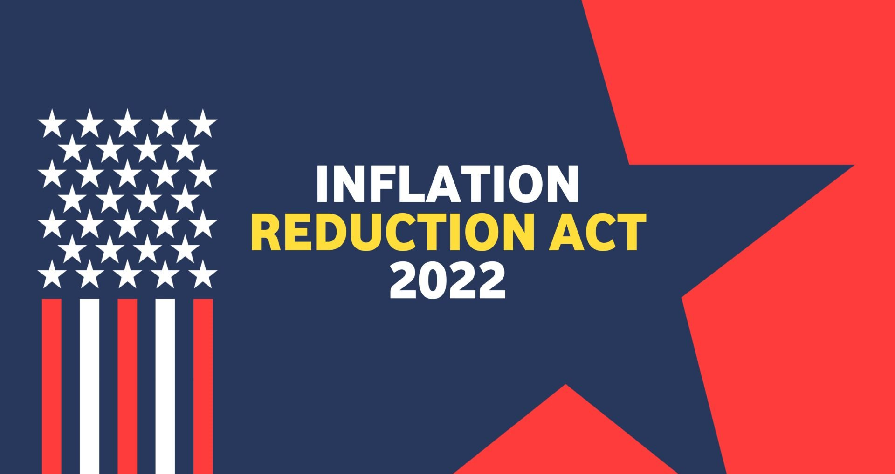


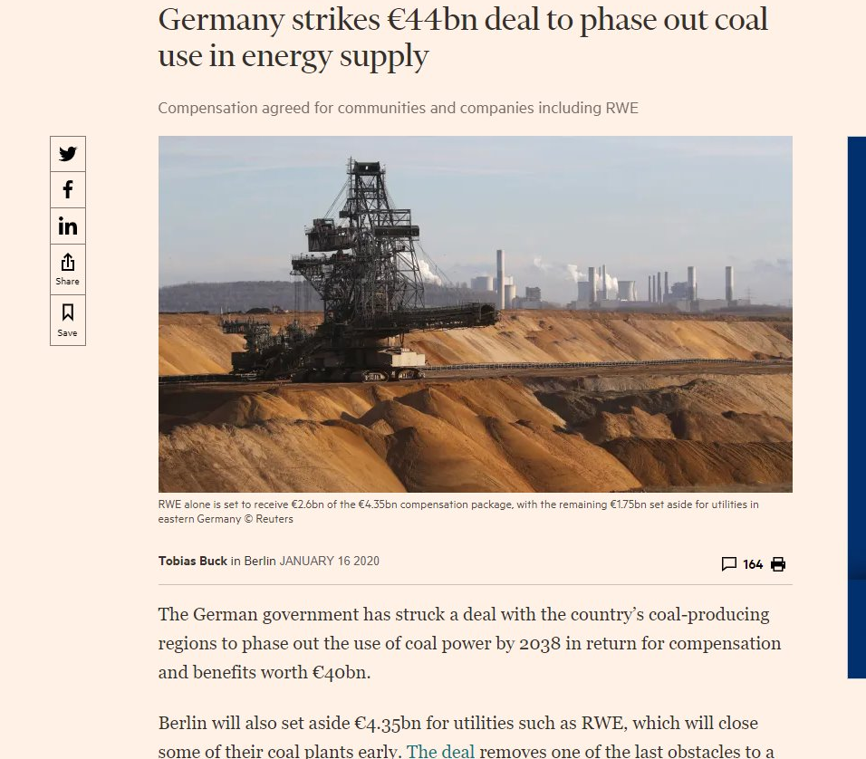

The next era of climate policies?

Slide 7
Political promise of green industrial policy
Conventional climate policy generates short-term, concentrated, and visible costs for long-term, diffuse, invisible, and global benefits
GIP can generate short- and medium-term concentrated and visible benefits and few, if any, short-term costs
Hope is that this distributive profile increases political support
If so, GIP can be a vote winner for incumbents that want to do something about climate change and revitalize domestic industry
Positive policy feedback can kick in and generate long lasting support for party responsible for GIP
Our goal is to test these arguments

Slide 8
Retrospective voting model and GIP
Voters base decision on past performance of incumbents, esp economic conditions
Voters motivated by both egoistic (pocketbook) and sociotropic concerns
GIP can appeal to voters’ pocketbook concerns (mechanism 1)
  Increased employment directly benefits workers that get new jobs
  Indirectly affects other businesses through multiplier effect
  In both cases, people are directly made better off
  Reward incumbent

Slide 9
Retrospective voting model and GIP
Sociotropic mechanism 2
  Voters concerned about their family, friends, and wider community
  Even if not directly affected by GIP, voters like it because it improves their community
  Reward incumbent
Sociotropic mechanism 3
  Voters hold pro-environmental attitudes and want the government to act on climate change
  Even if they do not directly benefit, they see government doing something on climate
  Reward incumbent

Slide 10
Countervailing winds
Ignorance
  For retrospective voting to work, voters need to attribute benefits to government policy
  If they are unaware of GIP, may not link benefits to incumbent
NIMBYism
  Green infrastructure could annoy people and make them punish incumbent (e.g., wind turbines)
Partisan polarization
  If polarization is high, voters may not reward incumbent from opposing party, even if they benefit from policy
Benefits not materialized
  If election takes place too soon after policy adoption, benefits may not have materialized

Slide 11
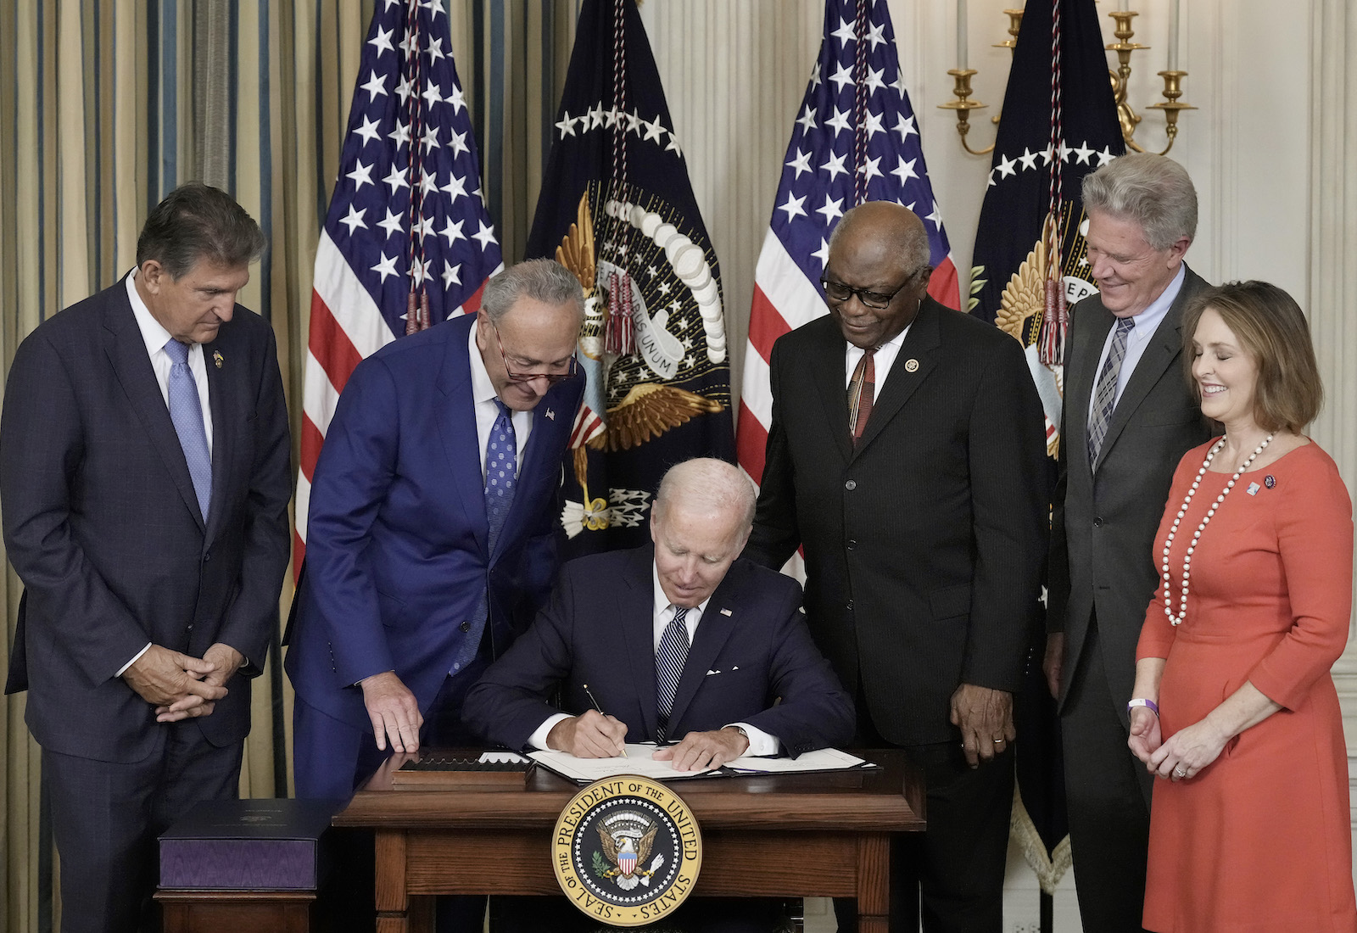
The case of the Inflation Reduction Act (IRA)
Did it increase votes for the Democrats?

Slide 12
The case of the Inflation Reduction Act (IRA)
Adopted in August 2022 with provisions related to climate change, healthcare and corporate taxation
Climate provisions – tax credits and direct expenditure
Tax credits
  Household adoption of solar, EVs, heat pumps, insulation
  Business investment in clean electricity and storage, CCS, nuclear power, low-carbon liquid fuels, and manufacturing components for clean industries
  Business can earn bonus credits for satisfying conditions related to labor, local content, and location
Direct expenditure
  $121 billion in grants and loans for energy efficiency, industrial decarbonization, reducing emissions from agriculture, replacing emissions-intensive infrastructure, and other programs

Slide 13
The case of the Inflation Reduction Act (IRA)
Cost of tax credits
  Official estimate - $271 billion
  Since they are uncapped, it depends on demand; cost could be as high as $1 trillion
Paid for by:
  Corporate alternative minimum tax of 15% on firms with earnings over $1 billion
  1% excise tax on stock repurchases
  Excise tax on drugmakers that fail to enter into drug pricing agreement
Distributive politics
  Short-term financial benefits for businesses and households that receive tax credits
  Medium-term benefits for individuals in communities that receive investment
  No short-term costs on voters
  Modest short-term costs for large corporations
  Largest costs may be debt financed (if it is not repealed)

Slide 14
Four channels IRA can influence voters
Private sector investment in a community increases economic wellbeing. Voters reward incumbent for pocketbook and/or sociotropic reasons.
Voters benefit from consumer tax credits and reward incumbent
Federal expenditure benefits community; voters reward incumbent
Voters are concerned about climate change and reward incumbent for adopting climate policy

Slide 15
Research design and data
Focus on first channel - private sector investments
  Provides variation in treatment that we can measure at county level
  Data on federal spending and household credits are aggregated at the state level and all states are treated
Compare vote outcomes in counties that receive investment vs those that do not
Gather IRA-related investment data from Clean Investment Monitor
  Includes all projects that are eligible for IRA tax credits
  Assume all projects after August 16, 2022 utilize credits and therefore linked to IRA
DV: Democratic vote share in presidential elections at county level (2000-2024)

Slide 16
Clean Investment Monitor data
(Aug 16, 2022 - Q2 2024)
Notes:
Over 7,500 projects from 2022 to Q2 2024
3,131 total counties

Slide 17
Clean Investment Monitor data
(Aug 16, 2022 - Q2 2024)
Notes:
Over 7,500 projects from 2022 to Q2 2024
3,131 total counties

Slide 18
Identification strategy
Key threat to inference is selection bias
  IRA-related private sector investments are not randomly distributed
Confounding if common factor drives both investment decisions and voting behaviour
To address this, try to create counterfactual – DiD framework with entropy balancing
Balance on predictors of treatment assignment and voting behaviour
  Treatment assignment: Corporate tax rates, transport links, land prices, unionization and sectoral composition of the local economy
  Voting behaviour: Unemployment, income, and demographics (age, sex, race, and education)
Key issue is when to balance
  We balance on 2019 values (close to passage of IRA but before COVID)
(Also potential migration into and out of treatment – still thinking through this)

Slide 19
DiD parallel trends

Slide 20
Results – basic DiD
Notes:
β1 (Effect of Post):
The difference in the average outcome for the control group between the post- and pre-treatment periods. Captures time trends unrelated to treatment.

Slide 21
Add entropy balancing
Use entropy balancing to create a better counterfactual
Balance on
  State
  Year
  Democratic vote share in 2016
  Population
  Demographic characteristics (age, race, education)
  Economic characteristics (sectors of employment, income, unionization, unemployment)
After balancing, treated and control groups are identical on observables

Slide 22
Results – DiD with entropy balancing

Slide 23
Next steps
Update 2024 election data
Update Clean Investment Monitor data to Q4 2024
Collect 2024 data for covariates
Balance on additional covariates for treatment assignment (solar resources, corporate tax rates)
Look at votes for congressional candidates
Heterogenous treatment effects
  Size of project (capital investment and labour intensity)
  Position of local politician on IRA
  Salience of IRA in county (conditions whether voters link project to IRA)

Slide 24
Thank you
Jared J Finnegan
j.finnegan@ucl.ac.uk

Slide 25
Entropy balancing covariates
Year
Democratic vote share in 2016
State
Population
% male
% male above 60
% female above 60
% white
% black
Education
% working in manufacturing
% working in transport
Median age
Median income
Unemployment rate
% of families in poverty
Age dependency ratio
Unionization (state level)
Right to work law (state level)
Public opinion on renewables
CHIPS investment

