Slide 1
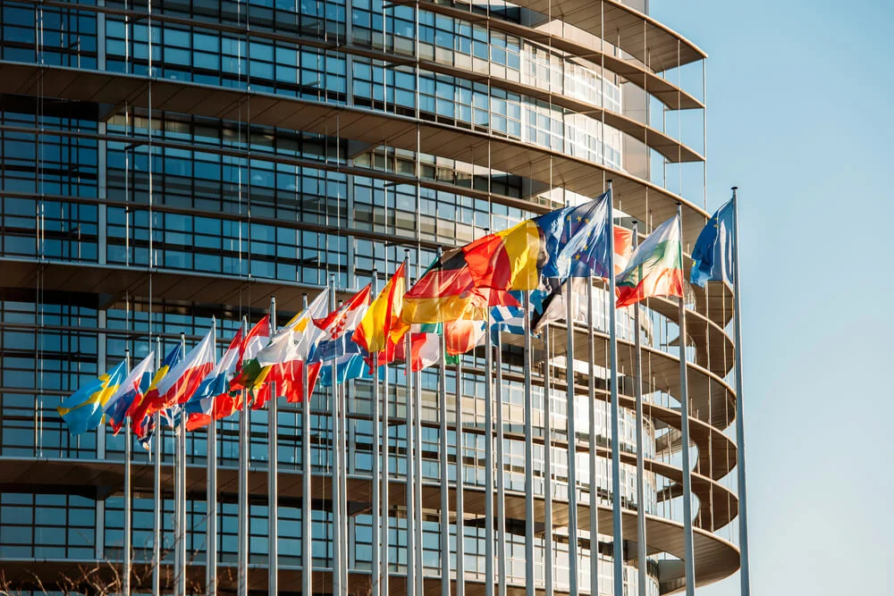
Economy, shadow fleet and access to technology.
Areas to put the pressure
Presenter: Vladyslav Vlasiuk
Advisor – Commissioner to the President of Ukraine on Sanctions Policy

Slide 2
Russia 2026 – at the threshold of bankruptcy
Budget deficit in first five months of 2026: ₽6 trillion
Planned for the whole 2026: ₽3.77 trillion
In January-May 2026, oil and gas revenues fell by 29,8% year-on-year
Military production is still growing (military equipment +32.6%), while civilian sectors are degrading.
The overall industrial production index turned negative in January-February 2026. The economy is actually based solely on military orders.
Russia's foreign trade balance decreased almost threefold – from $337 bln to $125 bln.
Russian treasury revenues have dropped by 40% compared to last year. A budget “hole” of over $80 billion has formed.

Slide 3
Areas where sanctions fall short
Cryptocurrency and alternative payments
Banking system
What shall be done:
target crypto exchanges facilitating sanctions evasion;
designate operators of alternative payment systems;
increase monitoring of digital asset transfers;
target Russian banks enabling the payments in the defence sector;
target foreign banks enabling sanctions circumvention.

Slide 4
Areas where sanctions fall short
Critical technology developments
What shall be done:
development of the anti-circumvention tool;
more effective cooperation with the producers in the compliance strategy context ;
stronger export controls.

Slide 5
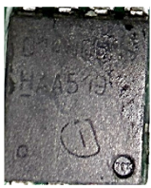
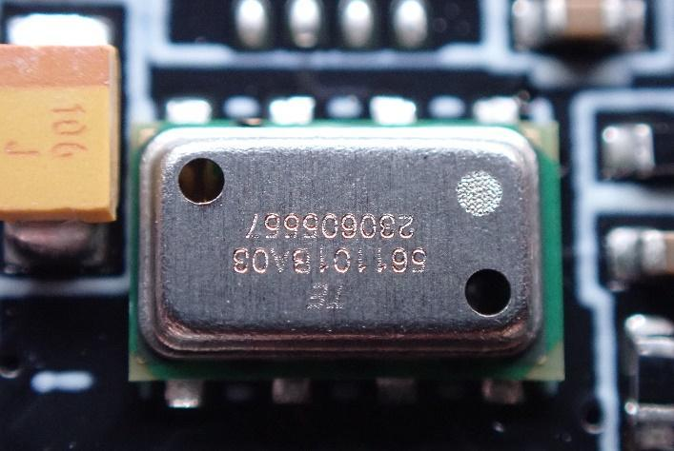
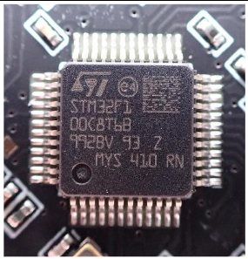
Control over the technology flow to Russia shall be tightened
Despite several successes, as the reduction of the Dutch components, there are still loopholes that help Russia to reach the components for its weapons.
European components
found in weapons in 2026
N-channel MOSFET by
Infineon Technology, Germany
Found in Geran-5 in January 2026
Barometric pressure sensor by
TE Connectivity, Ireland
Found in Parody UAV in June 2026
Microcontroller produced in 2024
STMicroelectronics, Switzerland
Found in Parody UAV in June 2026

Slide 6
Areas where sanctions fall short
Energy sector & shadow fleet
What shall be done:
imposition of a full-maritime services ban;
decisive physical measures against vessels and crews: detentions, arrests, confiscation;
closer interstate cooperation.

Slide 7
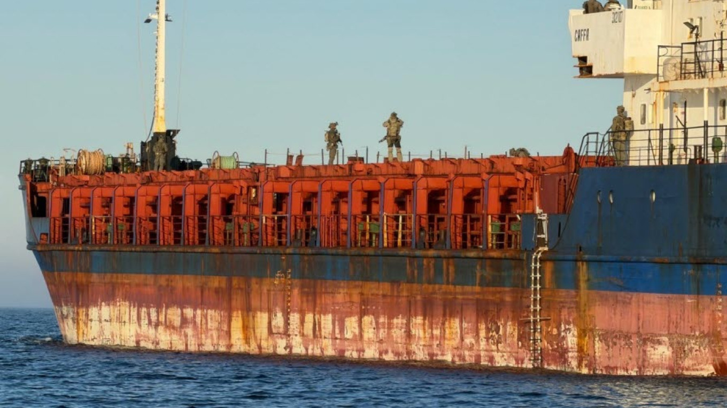
From sanctions to enforcement: increasing pressure on Russia’s shadow fleet
Coastal states should move to more active sanctions enforcement
Caffa case in Sweden demonstrates that sanctions become effective only when actively enforced.
International cooperation should be further strengthened to identify, investigate, and dismantle shadow fleet schemes
Joint investigations between Ukraine and European partners continue to expose shadow fleet networks. In May 2026, the Ukrainian-Finnish team uncovered a tugboat procurement scheme supporting Russia’s shadow fleet and identified the individuals involved.

Slide 8
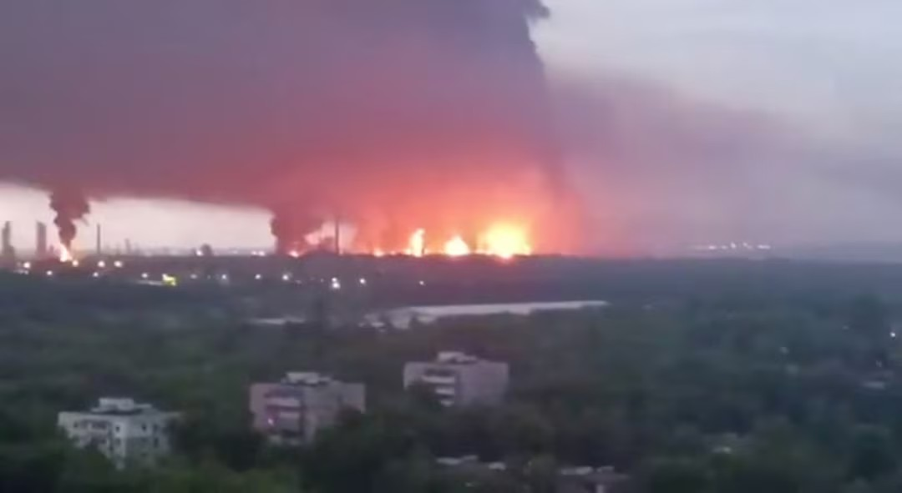
Kinetic sanctions against Russian energy
In 2026, 44 refineries and oil depots were affected, as well as 18 oil pumping stations.
The growth of sea freight of oil in 2026 is currently only 3% compared to 2025.
20 out of 27 refineries were subjected to kinetic sanctions.
The dynamics of oil product production decreased by 9% compared to 2025.
Ryazan oil refinery

