Slide 1

Swedfund Project Accelerator: Ukraine Project Summary
September 2025

Slide 2
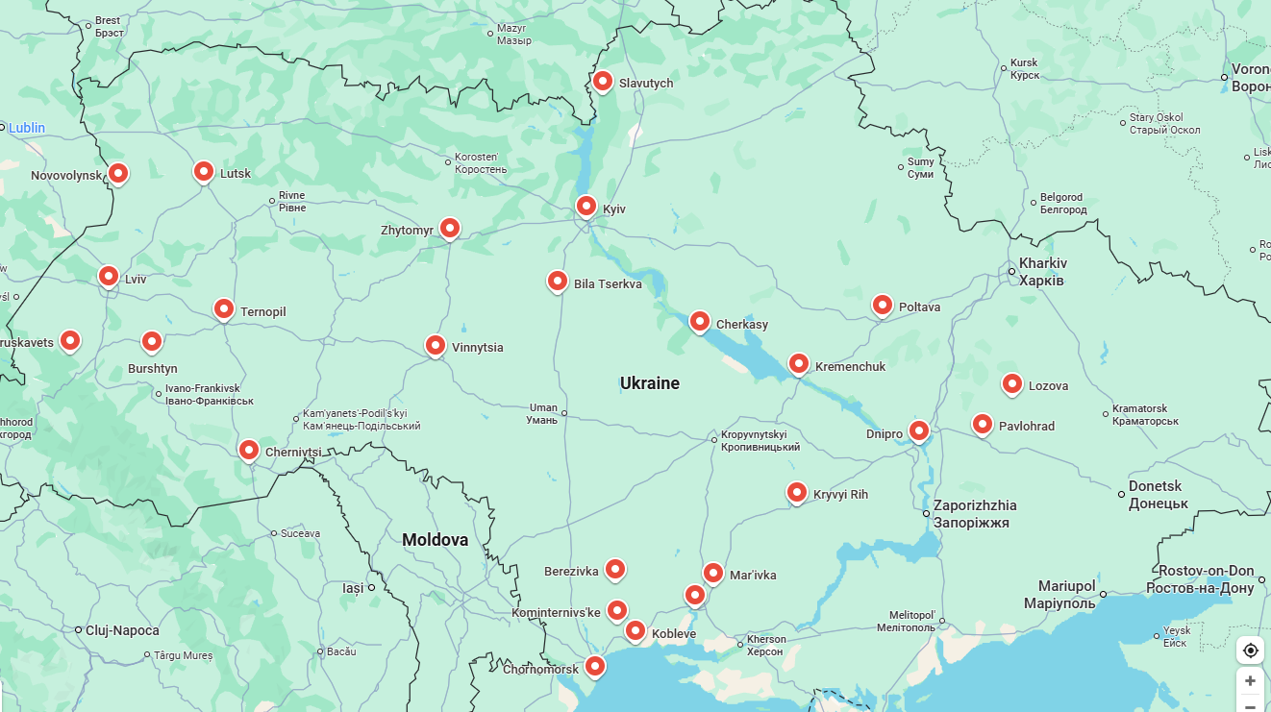
Current Project Locations in Ukraine

Slide 3
Current Energy Projects in Ukraine
Project location | Scope | Notes
Dnipro | Feasibility study to assess potential to recover industrial waste heat for use in the district heating system. | The feasibility study started in September 2024 and will be completed soon.
Berezivka and Mariivka | Feasibility study and ESIAs for two wind power plants. | The terms of reference for the consultancy assignment is being prepared. The procurement process will begin soon.
Mykolaiv | Feasibility study for modernising the CHP plant. | The feasibility study started in January 2025.
Lutsk Biomass Heat Production Plant | Feasibility study to develop either a biomass heat boiler or a biomass Combined Heat and Power (CHP) plant. | The consultant is underway.
Zhytomyr Waste to Energy | Support to develop a Waste to Energy facility producing heat and power by incinerating waste and biomass. | The terms of reference for the consultancy assignment is being prepared.
Chernivtsi Biomass Heat Production Plant | Feasibility study to assess a biomass heat production plant. | The consultant is underway.
Wind resource assessment 3 projects | Pre-feasibility / wind resource measurement campaign for 3 project sites. | The terms of reference for the consultancy assignment is being prepared.
Kryvyi Rih | Feasibility study and ESIA to modernize the energy supply system in Kryvyi Rih. | The terms of reference for the consultancy assignment is being prepared.
Ukrnafta CHP 1 | Feasibility study, E&S scoping, ESIA and possibly Owner's Engineer support for a new CHP plant. | The consultant is underway.
Ukrnafta CHP 2 + Solar and BESS | Feasibility study and E&S scoping for a new CHP plant in combination with large scale solar PV and BESS | Procurement of consultant is near final
Short term energy recovery | Detailed design for gas piston installations for heat and power | Procurement of consultant is near final
Biogas production | Feasibility study to prepare biogas production plant using agriculture waste | Preparations underway

Slide 4
Current Heathcare Projects in Ukraine
Project | Status
Lviv Unbroken Rehabilitation Center | The terms of reference for the consultancy assignment is being prepared.
Primula UCC Kiev | The terms of reference for the consultancy assignment is being prepared.

Slide 5
Current Water/Wastewater Projects in Ukraine (1 of 2)
Project | Recommended Short-Term Investments | Total CAPEX* and Implementation Timeframe
Kremenchuk Water Supply Project | New water intake and building refurbishment New water treatment plant | Total estimated CAPEX: 10.6M EUR Intake and building: 1.5 years for implementation Water treatment plant: 3 years for implementation
Kobleve Water and Wastewater Project | Renovation of water networks and wastewater collection system Renovation of groundwater wells Wastewater treatment plant and outlet | Total estimated CAPEX: 11.5M EUR Networks and groundwater wells: 1 year for implementation Wastewater treatment plant: 2.5 years for implementation
Truskavets Water and Wastewater Project | Rehabilitation of water source and water intake Construction of new water treatment plant New water meters Wastewater FS starting now | Total estimated CAPEX (water supply components): 10.2M EUR Water supply and intake: 1.5 years Water Treatment Plant: 2 years Water meters: 9 months
Dobroslav Wastewater Project | Network rehabilitation and extension New wastewater treatment plant | Total estimated CAPEX: 7.6M EUR 1-2 years implementation
Pavlograd Wastewater Project | New wastewater treatment plant | Total estimated CAPEX: 16.4M EUR 2 years implementation
Vinnytsia Wastewater Project | Rehabilitated wastewater treatment plant Biogas production Heat recovery from treated wastewater | Total estimated CAPEX: 76M EUR (which includes: 42M EUR for WWTP reconstruction, 14M EUR heat pumps and heat network, 20M EUR for biogas production)
*Some CAPEX figures are based on draft deliverables and are subject to change

Slide 6
Current Water/Wastewater Projects in Ukraine (2 of 2)
Cost estimates for the projects below can be shared once the work has progressed further.
Project location | Scope | Notes
Burshtyn, Ivano-Frankivsk region | Feasibility study for the water supply and wastewater system. | The feasibility study started in June 2024. Wastewater was added to the scope as an addendum, so the timeline is now extended. Draft feasibility study to be delivered in June 2025.
Novovolynsk | Feasibility study for the wastewater collection system and wastewater treatment plant. | The feasibility study started in January 2025.
Chornomorsk | Feasibility study for the wastewater collection and treatment system, as well as for the water supply system. | The feasibility study started in January 2025.
Lozova | Feasibility study for the water and wastewater systems in Lozova. | The feasibility study started in September 2025.
Bila Tserkva | Feasibility study for the wastewater treatment plant and collection system. | The consultancy assignment is under procurement.
Poltava | Feasibility study for the wastewater treatment and collection system. | The consultancy assignment is under procurement.

