Slide 1
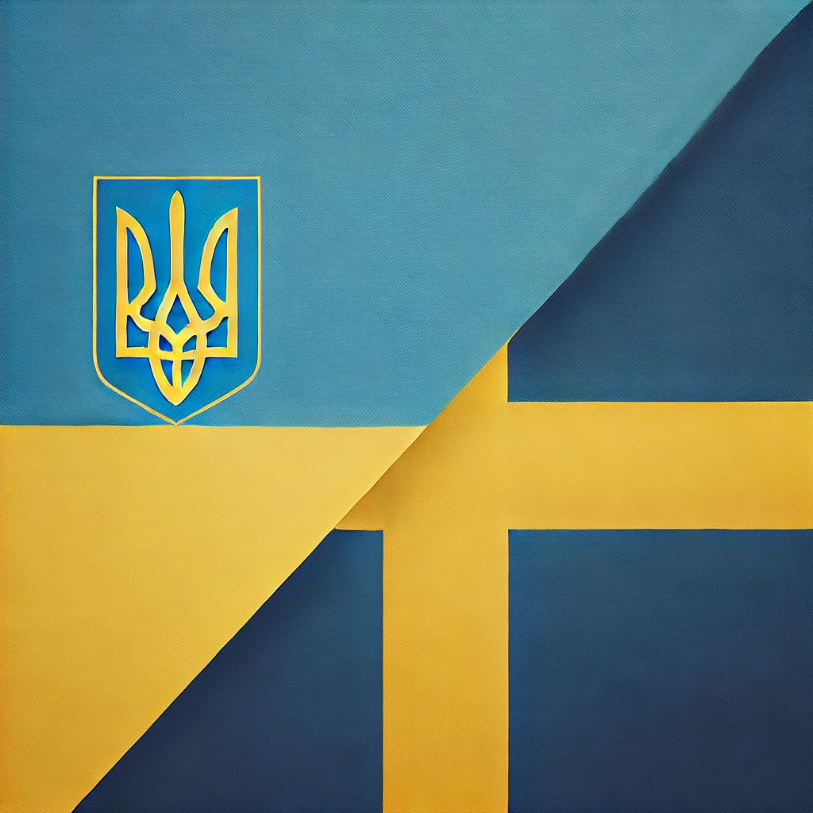



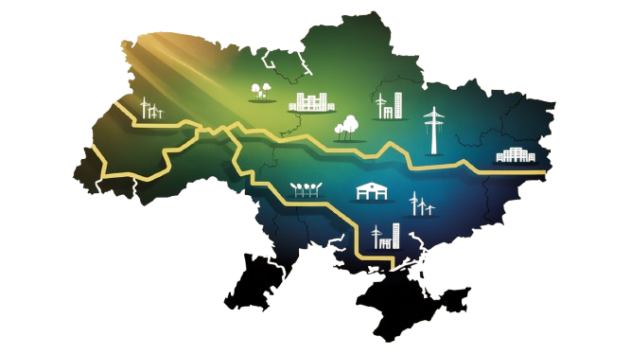
OSCHADBANK
RECOVERY of UKRAINE
October, 2025

Slide 2
UKRAINE’S MACROECONOMIC
INDICATORS (2020–2024)
Volatile GDP Performance: Ukraine's GDP contracted by ~30% in 2022, followed by ~5–6% recovery in 2023. Continued growth expected in 2024–2025 despite war-related constraints.
High and Fluctuating Inflation: Annual inflation peaked post-invasion but is easing gradually. IMF projects 2025 inflation around 12.6%.
Current Account and Budget Deficit: The current account deficit widened to ~8.1% of GDP in 2024. Budget deficit reached 17.6% of GDP, excluding grants.
Foreign Direct Investment (FDI): Net FDI inflows recovered to USD 4.2B in 2023, totaling ~USD 8.3B since 2022. Structural risks still deter major capital inflows.
Mounting Infrastructure Damage: War-related damages to infrastructure and capital stock are estimated at ~USD 155B (87% of 2023 GDP), complicating recovery and investment.
Notes:
Ukraine’s macroeconomic landscape from 2020 to 2024 has been profoundly shaped by the full-scale invasion and its ongoing consequences. After a steep GDP collapse in 2022 (~30%), the economy began a cautious recovery, with around 5–6% growth in 2023 and projected stabilization through 2025.
Inflation surged post-invasion but is now on a downward path, projected at 12.6% in 2025. Budgetary strains are acute, with the 2024 fiscal deficit reaching nearly 18% of GDP, driven by defense and recovery costs. The current account gap is also widening, increasingly filled by grants and external borrowing.
Investment flows remain modest relative to needs. While FDI rebounded to over $4 billion in 2023, long-term confidence hinges on structural reforms and reconstruction security. Infrastructure losses approaching $155 billion significantly constrain productive capacity.
This period has underscored the need for sustained external support, reform momentum, and adaptive fiscal and monetary policy to navigate uncertainty and rebuild resilience.

Slide 3




MACROECONOMIC OVERVIEW: RECOVERY AMID WAR
Ukraine’s Economic Trends in H1 2025
Gradual Economic Recovery
Real GDP is expected to grow by 3.1% in 2025, driven mainly by private consumption. However, growth remains below potential due to war-related disruptions and limited investment activity.
Labor and Capacity Constraints
Labor shortages, particularly of qualified personnel, and destruction of production capacities continue to restrict supply-side recovery.
Inflation Peak Reached
Annual CPI inflation reached 15.9% in May but is expected to decline during the summer, enabling a shift toward monetary easing.
Consumer Demand as Main Driver
Despite real income slowdown, resilient household consumption and strong fiscal defense spending support GDP growth.
Notes:
Despite the ongoing full-scale war, Ukraine’s economy demonstrates a remarkable capacity for recovery. In 2025, GDP growth is projected at 3.1%, a sign of resilience led by strong consumer demand and government spending on defense procurement.
However, structural issues persist. Labor shortages and damaged infrastructure limit production expansion, while inflation—peaking at 15.9% in May—is expected to decline as supply chains stabilize and harvest season impacts food prices.
This economic snapshot reflects both Ukraine’s determination and the persistent hurdles it faces in wartime, as policymakers balance stability, inflation control, and fiscal defense priorities.

Slide 4




EXTERNAL SUPPORT & FX RESERVES
Robust Foreign Aid Inflows
Ukraine received $18B in external financial support in the first five months of 2025. Total aid for the year is expected to reach $55B, largely from the EU’s ERA and Ukraine Facility mechanisms.
Record-High FX Reserves
FX reserves hit $44.5B in June 2025 and are forecasted to rise to $58B by year-end, surpassing IMF adequacy benchmarks and supporting currency market stability.
Strategic Dependence on External Support
Continued macro-financial stability relies heavily on timely disbursement of IMF and EU tranches. Compliance with IMF and Ukraine Facility conditions remains critical.
Frozen Russian Assets in Focus
Ukraine advocates for the confiscation of immobilized Russian assets as a potential funding source for defense and reconstruction.
Notes:
International support continues to play a foundational role in Ukraine’s macroeconomic resilience. In the first half of 2025 alone, Ukraine secured $18 billion in grants and concessional loans, with the full-year total expected to reach $55 billion.
This inflow has allowed the National Bank of Ukraine to raise foreign exchange reserves to an impressive $44.5 billion by June. The reserves are projected to further strengthen to $58 billion by year-end, well above the IMF’s adequacy criteria. These buffers enable the NBU to conduct smooth FX interventions and manage external vulnerabilities.
Still, these achievements hinge on Ukraine’s timely fulfillment of structural reform commitments under IMF and EU frameworks. The pursuit of confiscated Russian assets remains a vital long-term financing strategy for reconstruction and defense expenditures.

Slide 5




BANKING SECTOR: RESILIENT AND EXPANDING
Strong Credit Growth
Retail credit rose 34% YoY, while corporate lending expanded by 29%. Lending portfolios are growing across all bank groups, driven by competition and investment demand.
Profitability Under Pressure
Banks remain profitable, but net interest margins slightly declined due to rising funding costs. ROE stands at ~25% post-tax in early 2025.
Sustained Credit Quality
Loan portfolios maintain high quality with default rates in business lending falling below 3%. Risk provisioning is moderate and stable.
Mortgage and SME Lending Initiatives
Mortgage growth is modest, supported mainly by state program 'eOselya'. SME lending surges, with syndicated loans and sectoral strategies boosting access to finance.
Notes:
Ukraine’s banking sector has emerged as a cornerstone of post-invasion recovery, expanding its role as a financier of both households and businesses. Retail lending surged 34% year-over-year, supported by strong consumer demand and stable income flows. Corporate loans grew 29%, with SME credit and energy sector financing leading the momentum.
Banks remain operationally efficient, but rising deposit costs—particularly for corporate clients—have narrowed net interest margins. Nevertheless, return on equity remains solid at around 25% after taxes.
Risk metrics continue to improve, with non-performing loan ratios decreasing and provisioning levels remaining prudent. Strategic initiatives such as syndicated lending and support for defense and green projects are helping diversify credit offerings and deepen financial intermediation.

Slide 6
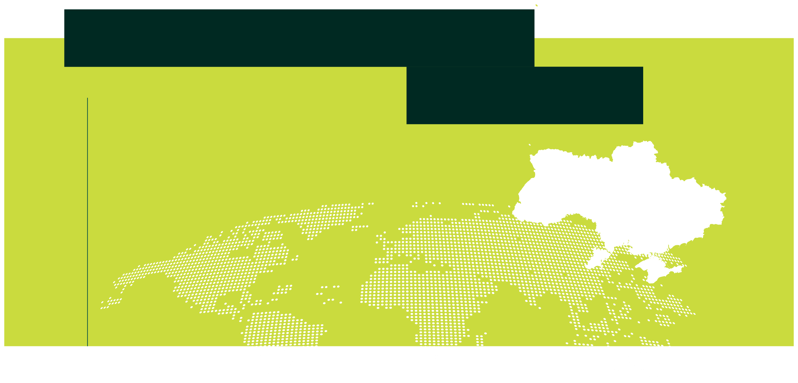

BANKS PLAY A CRITICAL ROLE IN UKRAINE’S RECOVERY
Maintaining financial stability and trust
Lending to households, SMEs and reconstruction projects
Mobilization of domestic savings
Implementing of preferential programs
Bridge to the world financial system
Digitalization and financial inclusion
LUTSK
KYIV
LVIV
ODESA
KHERSON
MYKOLAIV
AR KRYM

Slide 7
In war, most banks freeze. We moved forward.

Slide 8
THE OSCHADBANK response
Area | Global Banks in War | Oschadbank in War
Lending | Freeze, reduce exposure | Expand, create new programs
Risk policy | Stricter, conservative | Adaptive, smart liberalization
Clients | Focus on safest segments | Focus on vulnerable + SMEs
Staff | Cut, reduce salaries | Retain, reallocate, help, pay more
Communication | Minimize public exposure | Full transparency and presence
Strategy horizon | Days/weeks | Multi-year wartime strategy
Role | Bystander | State co-pilot

Slide 9
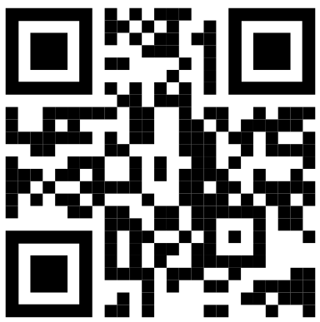
OSCHADBANK — THE LARGEST
UNIVERSAL BANK
No.1
USD 10.5 billion
Total assets, August 2025
Growth of loan portfolio of business clients during 2022-2024
USD 445 million
For green finance, AGRI, veterans and export-oriented SMEs
Profit before tax in 2024
USD 382 million
Support to SMEs near front line
Profit before tax in January – August 2025
By amount of cooperation with IFIs within risk sharing and grant facilities
250k
SME customers
1.150
Branch network, the largest in Ukraine

Slide 10
15%
of economy
financing by
OSCHADBANK
20% of OSCHADBANK loans to SMEs near frontline (100-150 km)

Slide 11
ASSETS GROWTH
As of September 1, 2025
Net loan portfolio by segment
CORPORATE
SME
RETAIL
+15%
+4%
+10%
+41%
+21%
+22%
+7%
+34%
+53%
+30%
+6%
-5%
+71%
+81%
-16%
Net loan portfolio (total)
UAH, bn
+7.2%
+11%
+7.1%
+25%
+18%
Focus on supporting the Ukrainian economy, which is based on a careful risk management policy

Slide 12
MARKET POSITION AND SHARE IN FINANCING
1st PLACE
Energy
Defense Industry Complex
Municipalities
Financial Services and Insurance
Motor Vehicles
Metallurgy
Electronics, Telecommunications, Software
Wholesale and Retail Trade
Agro-industrial Complex, Food Products, Beverages
Construction and Real Estate
Manufacturing
Pharmaceuticals
32.5% Restricted 57%
20.9% 29.3% 35.4% 58.3%
8.7%
2.2%
12.4% 4.9%
10.6%
2nd PLACE
3rd PLACE
4th PLACE

Slide 13
CORPORATE BUSINESS PORTFOLIO STRUCTURE
by sectors
30%
13% 2%
Energy
Agribusiness & Food Trade
Municipalities
Defense Industry
12%
Other sectors Construction
& Real Estate
11.5% 4.6%
17% 9.9%
Oil & Gas
Trade

Slide 14
GROWTH OF
CORPORATE LOAN PORTFOLIO
CORPORATE
LOAN
PORTFOLIO
2022-2024
USD billion
Trade Food Trade
+64% +125%
1.14 1.42 1.38 1.64 1.71
2021
2022
2023
2024
2025
2021
2022
Manufacturing
×8.4
2023
Defense Industry
+149%
Oil & Chemical Industry
+12%
2024
2025
\7 months
Agribusiness
×12.7

Slide 15


PRIORITY INVESTMENT SECTORS
Energy infrastructure
wind,solar, hydro,nuclear, gas-piston generation
Industrial construction
oilrefining, foodprocessing
Residential & commercial
development
housing, hotels,malls, logistics centers
Infrastructure projects
railways, roads
Agribusiness
generation, machinery,
production facilities, transport
Defense industry
Municipal projects
socialinfrastructure,airports, decentralized generation

Slide 16


EXPERIENCE IN INVESTMENT PROJECTS
Expansion of Energy Capacities – $0.62 bn
Electricity transmission system operation Wind generation
Gas-piston generation
Solar power
Hydropower
Nuclear sector
Construction of Industrial Facilities – $0.09 bn
Oil refining
Food processing
Residential & Commercial Construction – $0.05 bn
Residential complexes,hotels
Shopping & entertainment centers Logistics centers
Infrastructure Projects – $0.30 bn
Railways Roads
Agricultural Sector – $0.13 bn
Own generation
Production facilities & equipment Agricultural and motor transport
Defense Industry – $0.29 bn Municipal Projects – $0.24 bn
Social infrastructure facilities
Infrastructure projects, incl. airport terminals Decentralized generation

Slide 17




OSCHADBANK
support t0 BUSINESS
GOVERNMENT of UKRAINE (risk sharing, grant facilities, subsidized loans)
IFIs support to SMEs in Ukraine (risk sharing, grant facilities, technical support)
PRIORITIES
Processing and manufacturing
Export-oriented
Relocated
De-occupied regions
Green finance
LOCAL PARTNERS (distributors of machinery, equipment, seeds, plant protection)
MUNICIPALITIES (compensation of % to local businesses)
IFI – International Financial Institutions

Slide 18
WHY OSCHADBANK?
REPUTATION and authority from the State of Ukraine
EXPERTISE of grant programs to SMEs
WIDE NETWORK of branches and transparency servicing
HUGE CLIENT BASE quick partner awareness and distribution
AUTOMATION of the process of application verification

Slide 19
SWEDISH COMPANIES OPERATING IN UKRAINE
Resilience, Commitment, and Key Business Sectors
Over 80 Swedish Companies Active: A diverse array of over 80 Swedish enterprises are actively engaged in Ukraine, spanning critical sectors such as machinery, healthcare, telecommunications, retail, and food processing. Notable names include ABB, Electrolux, Volvo, Ericsson, Scania, and Chumak, each contributing to the local economy and workforce.
Strong Presence in Reconstruction-Relevant Sectors: Swedish firms are strategically positioned in sectors essential for Ukraine's post-war recovery, including infrastructure development, agritech innovations, pharmaceuticals, and sustainable energy solutions. Their involvement is crucial for rebuilding and modernizing the economy.
Diplomatic & Trade Support from Sweden: The Swedish government plays a proactive role in fostering bilateral trade relations through initiatives like the Swedish Business Sector’s Recovery Engagement and various grant programs. These efforts are designed to bolster Swedish investments and support Ukraine's economic resilience.
Chumak: A Case Study of Resilience: Chumak, a prominent food processing company with Swedish origins, exemplifies the enduring commitment of Swedish businesses in Ukraine. Its operations in southern Ukraine persist despite ongoing conflict, showcasing the potential for sustainable investment and the importance of local partnerships.
Notes:
Swedish companies have shown remarkable resilience by continuing their operations in Ukraine amidst challenging circumstances. With over 80 businesses still active, this reflects a strong belief in Ukraine's long-term market potential and economic recovery.
Key players such as ABB, Volvo, Ericsson, Electrolux, and Scania are not only embedded in vital sectors like infrastructure, energy, food processing, and healthcare but also bring advanced technology and international standards to the local market.
The Swedish government actively supports these efforts through grants, export assistance, and diplomatic initiatives aimed at strengthening economic ties. Business networks like the Swedish Business Association and Sweden-Ukraine Business Action are crucial in facilitating partnerships, sharing insights, and coordinating investment strategies.
Chumak serves as a compelling case study of this commitment. As a food company with Swedish roots, its ongoing operations in southern Ukraine, even during conflict, highlight the tangible benefits of long-term Swedish investment and the potential for growth in the region.

Slide 20
INVESTMENTS OPPORTUNITIES IN UKRAINE
Strategic Sectors for Swedish Business Engagement
Infrastructure & Reconstruction: Rebuilding roads, bridges, rail, water systems, and public buildings opens major procurement and PPP opportunities, especially via donor-funded projects.
Renewables & Energy Security: Solar, wind, and grid modernization projects are priorities. Ukraine seeks partnerships to decentralize and rebuild its energy systems.
Agriculture & Food Processing: As a major global grain exporter, Ukraine needs investment in logistics, storage, agritech, and resilient food chains after war disruption.
Health, MedTech, and Pharmaceuticals: There is urgent demand for healthcare infrastructure, equipment, and digital health services to replace war-damaged facilities.
IT, Cybersecurity, and Digital Finance: Ukraine is strong in software talent and is a growth market for fintech, digital infrastructure, and cross-border digital services.
Notes:
Ukraine’s reconstruction and growth open exceptional opportunities for strategic investment across sectors. International donors and the Ukrainian government are prioritizing infrastructure, energy, and health — areas where Swedish firms have competitive strengths.
The agriculture sector, once a breadbasket of Europe, now needs logistics, storage, and modern agritech to bounce back. Sweden’s experience in sustainable farming and food processing is highly relevant.
Energy is not just about recovery — it's about transformation. From decentralization to renewables, Ukraine seeks long-term partnerships to rebuild more resilient, green systems.
Digital sectors also offer compelling openings. Ukraine’s IT workforce, even during war, has proven reliable, and the demand for digital finance and cybersecurity is rising. There is room for Swedish firms to provide infrastructure, expertise, and services.
These opportunities are not without risk — but the rewards and long-term value for first movers can be significant. Now is the time to explore.

Slide 21
BANKING SYSTEM SUPPORT FOR INVESTORS
Financial Infrastructure & Risk Mitigation Tools in Ukraine
Financing & Credit Facilities: Ukrainian and partner banks can provide working capital, project loans, and syndicated financing for reconstruction and private ventures.
Currency Operations & Hedging: Banks facilitate foreign exchange transactions and can offer hedging tools to mitigate currency volatility and inflation risk.
Public Procurement Integration: Banking infrastructure is aligned with donor-funded project disbursement systems, easing access to government and international tenders.
Guarantees & Risk Sharing: With support from IFIs and the state, banks participate in credit guarantee schemes that reduce risk for foreign investors.
Digital Services & Advisory: Modern fintech platforms and advisory support on compliance, taxation, and local regulations streamline cross-border investment.
Notes:
Ukraine’s banking system is a critical enabler for foreign investment, especially in a war-affected economy. It acts as a financial bridge between international capital and domestic development priorities.
Local banks — in collaboration with international financial institutions — offer tailored financing solutions. Whether for infrastructure PPPs or SME investments, investors can access working capital, credit lines, and co-financing arrangements.
Currency operations remain essential in an environment of volatility. Ukrainian banks support conversion and hedging mechanisms, while digital services simplify transactions and compliance.
Perhaps most importantly, risk-sharing mechanisms backed by the government and global institutions reduce the financial exposure of foreign investors. Credit guarantees, subsidized rates, and public procurement channels create a more predictable investment environment.
For Swedish firms seeking to engage deeply in Ukraine’s rebuilding, partnering with reliable banks is both a necessity and a strategic advantage.

Slide 22
BUILDING THE FUTURE TOGETHER
Final Thoughts and Call to Action
Time to Lead, Not Wait: Early movers secure strategic advantages. The groundwork for investment is laid — through reforms, donor funding, and banking stability.
Swedish Expertise Meets Ukrainian Need: Swedish know-how in green tech, industrial design, healthcare, and fintech perfectly aligns with Ukraine’s recovery sectors.
Risk Can Be Managed Strategically: Public-private support frameworks are in place — including guarantees, phased models, and donor alignment. The risk is real but reducible.
Engage With Local Ecosystem: Use Swedish-Ukrainian business networks, diplomatic channels, and financial partners to navigate the local terrain with confidence.
Build Long-Term Partnerships: Ukraine isn’t a one-off market. Reconstruction will span a decade or more — with long-term ROI for those who stay committed.
Notes:
Swedish companies stand at a defining moment. Ukraine's transformation offers not only a market opportunity but a generational partnership. Those who engage early — and wisely — will help shape Ukraine’s future while securing long-term value.
Sweden brings the right tools: sustainability leadership, high-quality industrial output, ethical business practices, and a proven track record of cooperation. Ukraine brings a resilient economy, urgent rebuilding needs, and a growing network of partners ready to engage.
Together, we can move beyond aid to sustainable investment. This isn’t just about rebuilding — it’s about redefining what a strategic, values-based economic partnership looks like in the 21st century.
Let’s lead — together.

Slide 23
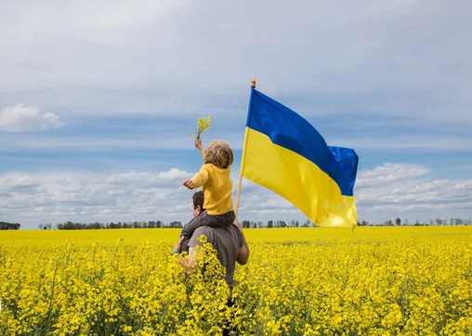
GLORY to UKRAINE

Slide 24
ANNEXES

Slide 25
PROFITABILITY INDICATORS
As of September 1, 2025
Net interest income
Profit (before tax)
x
Net interest margin
UAH, bn
15.6
19.9
UAH, bn
7.5%
7.1%
8.1%
4.2%
6.4%
6.7%
Net non-interest operating income*
The rate of return on equity
* Net commission income and currency trading result
48.6%
UAH, bn
5.79

Slide 26
CREDIT RATINGS
LT FC/LC IDR ST FC IDR
National long-term
CCC/CCC+ CCC-
A
A+(ukr)(stable)
Fitch
LT FC/LC bank deposit
BCA
Caa3
Ca
Moody ’s

Slide 27
COOPERATION WITH MARKET LEADERS
Oil & Chemical Industry Agribusiness Trade | including food trade Manufacturing Defense sector contracts

Slide 28
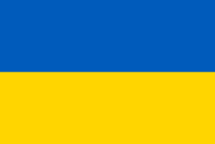
PRIORITIES 2025
KEEP FOCUS ON:
STRATEGIC PARTNERS
Processing and manufacturing
Export-oriented
Relocated
De-occupied regions
Green finance
International Companies
State/ Municipalities
International FIs
Local partners

