Slide 1
From Code to Kilowatt Hours: The Role of Deep Tech and AI in Transformation of the Baltic Energy Landscape
Dzintars JAUNZEMS
Advisor, Latvijas Banka
Assist. Professor, Institute of Energy Systems and Environment, RTU
08.05.2025.

Slide 2
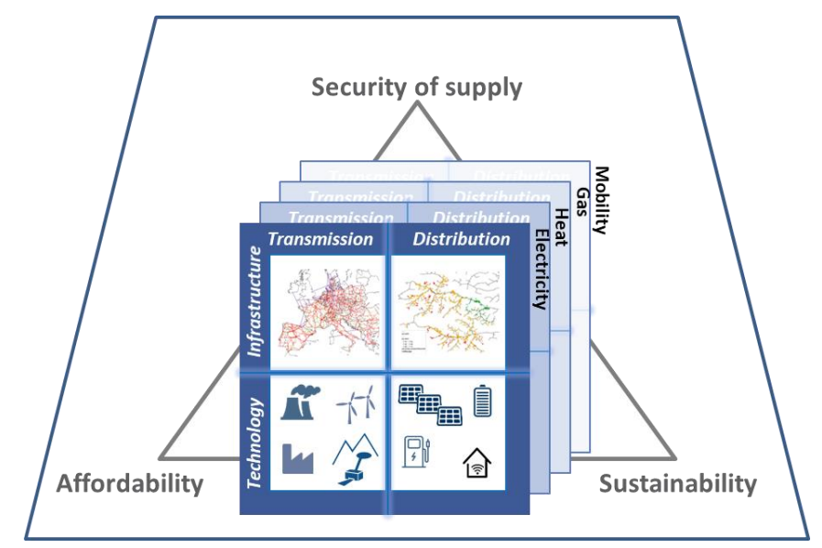
Energy system development & deployment & transition
Scale effects:
Multi-level, comprehensive, large, and parallel infrastructure
Sector-coupling
Long-term effects:
Path dependency
Lock-in
s
Source: 20200429_D2.1_ScenarioFramework_final.pdf
Notes:
+H2 infrastructure

Slide 3
Brief overview and Current State of the Energy Sector in the Baltic Region

Slide 4
Numerous changes in a very short period. The energy system is just one small aspect of it all.
Lithuania, TWh
Estonia, TWh
Latvia, TWh
Source: Eurostat - https://doi.org/10.2908/NRG_BAL_C
Notes:
Gross available energy means the overall supply of energy for all activities on the territory of the country. It includes energy needs for energy transformation (including generating electricity from combustible fuels), support operations of the energy sector itself, transmission and distribution losses, final energy consumption (industry, transport, households, services, agriculture, ...) and the use of fossil fuel products for non-energy purposes (e.g. in the chemical industry). It also includes fuel purchased within the country that is used elsewhere (e.g. international aviation, international maritime bunkers and, in the case of road transport “fuel tourism”). Glossary:Gross available energy - Statistics Explained - Eurostat

Slide 5
From Phase 0 - The Baltic States under Soviet rule; to Phase 4 – open electricity and natural gas market. Russian invasion of Ukraine, no electricity & natural gas import from Russia, synchronization with EU electrical grid.
Lithuania, TWh
Estonia, TWh
Latvia, TWh
Phase 0
Phase 4
Source: Eurostat - https://doi.org/10.2908/NRG_BAL_C
Notes:
Gross available energy means the overall supply of energy for all activities on the territory of the country. It includes energy needs for energy transformation (including generating electricity from combustible fuels), support operations of the energy sector itself, transmission and distribution losses, final energy consumption (industry, transport, households, services, agriculture, ...) and the use of fossil fuel products for non-energy purposes (e.g. in the chemical industry). It also includes fuel purchased within the country that is used elsewhere (e.g. international aviation, international maritime bunkers and, in the case of road transport “fuel tourism”). Glossary:Gross available energy - Statistics Explained - Eurostat

Slide 6
LT and EE are leading in Baltics on new renewable electricity capacities. Due to large hydro-power capacities, Latvia – due to hydro PP, had better start point.
Lithuania, MW
Estonia, MW
Latvia, MW
IRENA (2025), Renewable Capacity Statistics 2025, International Renewable Energy Agency, Abu Dhabi.

Slide 7
Electricity does not dominate in total final consumption. The demand for heat and process heat is at least twice as high.
Lithuania (2022)
Estonia (2022)
Latvia (2022)
Source: Estonia - Countries & Regions – IEA Lithuania - Countries & Regions – IEA Latvia - Countries & Regions - IEA

Slide 8
Transformation of the Baltic Energy Landscape

Slide 9
Smart meters - remote and automated electricity metering
Lithuania
Estonia
Latvia
By 2026, for customers consuming more than 1,000 kWh/year
From 2026, customers with lower consumption
>85% households with smart meters
By now: >1 120 000 meters
As of 2025, Estonia has achieved 100% smart meter coverage
> 700 000 meters
Smart electricity meter roll-out completed on May, 2023
>1 000 000 meters
Notes:
THAT | Smart meters
ceer.eu/wp-content/uploads/2024/09/ACER-CEER_2024_MMR_Retail-1.pdf
Executive summary – Estonia 2023 – Analysis – IEA

Slide 10
(1) Some examples of AI & deep tech in Baltics energy system
Buildings
AI systems for real-time monitoring and control
AI-enhanced BMS & HVAC
District heating
Digital Twins
AI-driven systems to optimize heat distribution: monitor & control
Predictive analytics & machine learning algorithms to forecast demand and adjust supply accordingly
Renewable energy
Integration of AI for analysis (e.g. weather patterns, optimization, location etc.) to improve efficiency and predict maintenance needs
Source: 20200429_D2.1_ScenarioFramework_final.pdf

Slide 11
(2) Some examples of AI & deep tech in Baltics energy system
Electricity (DSOs)
Remote check of overhead lines (AI + ML)
Real-time monitoring with reduced number of sensors
Projections of generation & load, damages, development investment & network planning
Electricity (TSOs)
AI and sensor technologies to increase transmission capacity
Mobility
EV charging modes based on situation on the grid
AI to optimize routes and energy consumption
Source: 20200429_D2.1_ScenarioFramework_final.pdf

