Slide 1
"AI and the Future of Energy" – Introduction
SITE-Energiforsk ENERGY TALK 2025

Slide 2
The Energy Sector at a Crossroads
Global energy demand will rise by 25% by 2040
Energy systems are becoming more complex
  Decentralized: Energy is increasingly generated from distributed sources like rooftop solar, wind farms, and microgrids
  Variable: Renewable energy sources such as wind and solar are intermittent, making the supply less predictable
  Data-Intensive: Smart meters, Internet-of-things devices, etc. generate massive real-time operational data.
Managing this complexity requires more than engineering — it requires intelligence:
ARTIFICIAL INTELLIGENCE!

Slide 3




AI meets Energy: A Systemic Shift
Generation | Grids | Consumption | Markets
ML optimizes wind/solar using real-time forecasts | SOs/TSOs enable load balancing, fault detection, predictive maintenance | Smart systems reduce waste via user behavior | Algorithmic trading, price forecasting, demand automation
AI is transforming energy systems from reactive infrastructures into adaptive, self-learning networks.

Slide 4
A Data Explosion — and a Bottleneck
The prerequisite for the success of this transformation is data
  The richer the data, the smarter the algorithms; the smarter the algorithms, the more value we unlock
By 2030, energy devices will generate hundreds of petabytes of data daily (IEA)
  AI converts raw data into fast, granular, autonomous decisions
Yet, most data remains unused due to data ownership problems, regulations, capacity limits, interoperability, etc.

Slide 5
Further Challenges and Trade-offs
Who controls data and algorithms?
How to ensure transparency, accountability, and fairness?
Cybersecurity of AI-managed infrastructure
Energy costs of AI (training models = high electricity use)
Need for regulatory frameworks, audits, and energy-aware AI design
These are not just technical or engineering questions — they are economic, institutional, and policy questions!
And today’s Energy Talk will address some of them

Slide 6
About SITE
Stockholm Institute of Transition Economics, founded in 1989
Ambition: to serve as a bridge between the academic community and policymakers
Main activities today
  Research: modern economics with a thematic focus on topics important to understand and provide advice on important issues in the region
    macro, energy, gender, environment, media and democracy, political economy, procurement, corruption, etc.
  Policy analysis and advice: evidence and research-based
  Outreach (seminars, conferences, FREE policy briefs, media,…)
  Education
  Institution building:
    FREE (Forum for Research on Eastern Europe and Emerging Economies) network

Slide 7
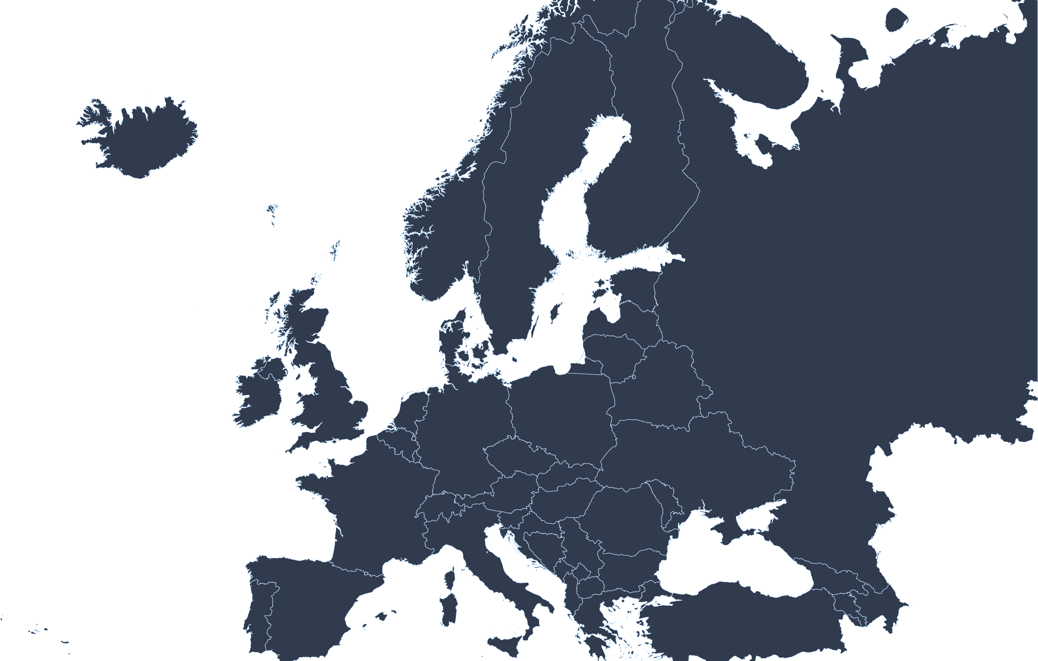

FREE Network
A joint initiative by SITE, BEROC, BICEPS, CenEA, ISET-PI, and KSE
SITE
BICEPS
BEROC
CenEA
KSE
ISET
Notes:
Located in the Eastern part of Europe
Sweden, Bielorussia, Ukraine, Georgia, Lativia

Slide 8
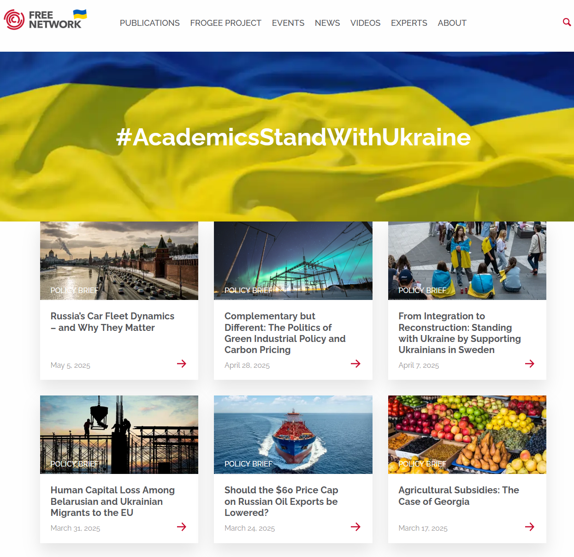

FREE Network (cont.)
FREE policy briefs
  Environmental & Energy Economics
  Gender Economics
  Labour economics
  Political Economy,
  Etc.
Projects: FROGEE, FREECE and FROMDEE
Learn more:

Slide 9

Energiforsk -
The Swedish Energy Research Centre
Mikael Karlsson
2025-05-08
Energy Talk

Slide 10

This is Energiforsk
Politically neutral
Non-profit company
Four owners
Notes:
We initiate research and development – identify current research areas and describe what needs to be done, how it should be done and how it can be financed. Here we offer both early feasibility study and program development.
We coordinate research and development – drive a research programme forward, including through calls for proposals and communication with applicants, contract writing, financial administration, follow-up and dissemination of results.
We offer specialist services in the energy field – we carry out consultancy work ourselves. This can involve surveys and analyses, evaluations, standardisation work, contract training and carrying out communication activities.
We disseminate results – reach out through strategic research communication and dissemination of results in various channels and via national and international arenas.
We collaborate both nationally and internationally – a large international network of people, organisations and business contacts.

Slide 11

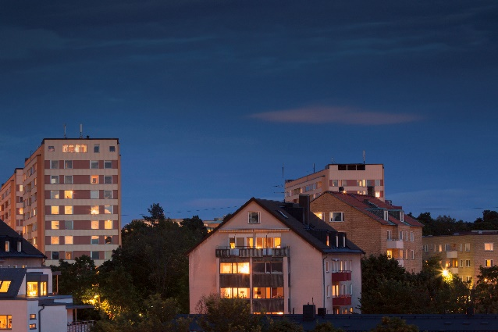
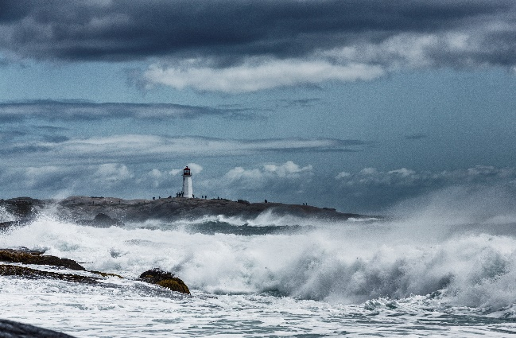

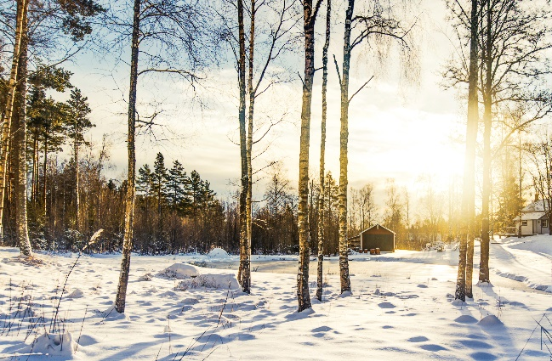
Employees
20
Research programs
50+
Seminars/
conferences
60+ per year
Research areas
6
Reports
100+
Owners
4
Strategic advicerary boards
6
Notes:
Our six research areas: Hydropower, Heating and cooling, Nuclear power, Security of electricity supply, Energy systems and Solar and wind
Owners: Energiföretagen Sverige, Svenska kraftnät, Energigas Sverige and Nordion Energi.
The research coordinator Energiforsk initiates, coordinates and conducts research and analysis in the energy field. We develop and disseminate new knowledge to contribute to a robust and sustainable energy system (that enables climate transition).

Slide 12

Energy and AI
Energiforsk in collaboration with AI Sweden and Powercircle arranged a conference on 11-12 November. The conference was sold out and much appreciated.
Examples of speakers/presenters:
Markus Wråke, CEO of Energiforsk
Åsa Pettersson, CEO of Energiföretagen
Niclas Sigholm, founder of Sigholm Teck
Sandra Elvin, National Security officer Microsoft
Johanna Lakso, VD Power Circle
Martin Svensson, CEO AI Sweden and member of the government's AI commission
Ambra Sannino, VP R&D Vattenfall
Jonas Birgersson, founder of Via Europa, Bredbandsbolaget, etc.
Lars Simonsson, Enterprise Architect, Göteborg Energi
And many more from energy companies, the military, start-up companies, Google, researchers, etc.
That gave birth to the idea of an AI-cluster?

Slide 13
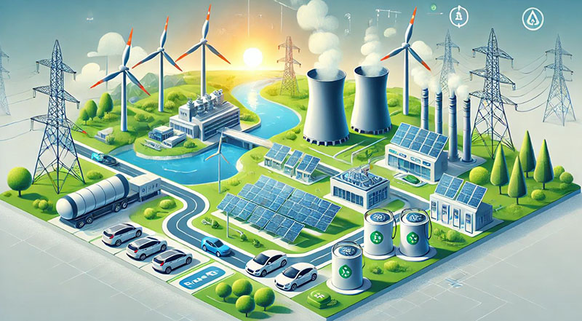
Energiforsk’s AI-cluster
Energiforsk's AI cluster disseminates research results and knowledge about artificial intelligence and advanced digital solutions linked to the energy sector. Members of the cluster participate for free at our digital events, get quick access to research results on AI and great opportunities to network.
https://energiforsk.se/program/energiforsks-ai-kluster/
Upcoming events (all areas)
https://energiforsk.se/evenemang/kommande/

Slide 14
Today’s Speakers
Dzintars Jaunziems, Advisor (for energy and climate policy) of Latvijas Banka, and Assistant Professor at Riga Technical University:
  "From Code to Kilowatts: AI & Deep Tech in the Baltics"
Andrii Starzhynskyi, Co-founder and CEO, a-Gnostics:
  "Powering Ukraine: AI at the Heart of Energy Innovation"
Björn Berg, CEO, Ngenic:
  "AI-Driven Energy Solutions in Practice“
Filip Kjellgren, Strategic Initiative Developer Energy, AI Sweden:
  "Visualization as a Tool to Democratise the Energy System"

