Slide 1


AI-Driven Energy Solutions in Practice

Slide 2

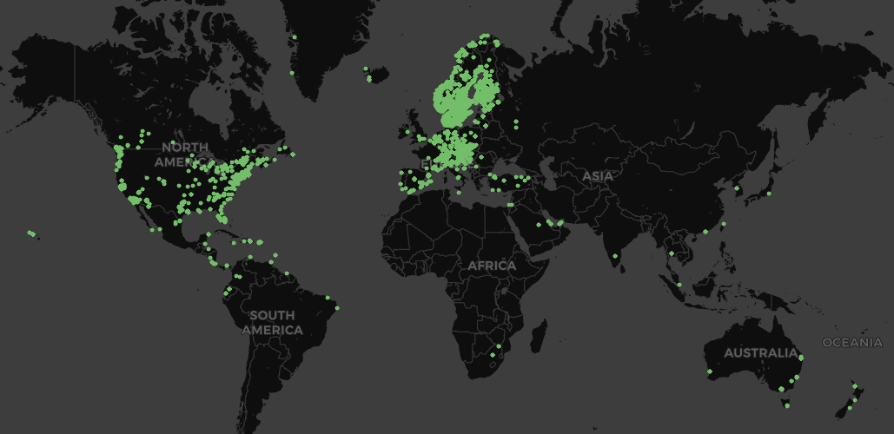
+50 000
Users
4,6
CSI
(Customer Satisfaction Index)
+30-50 MW Electricity
+50 MW District Heating
Available flexibility
Power tariff optimization
Makes the difficult easy
Your #1 - Energy digitalization partner
10X Data
+ 70 billion datapoints yearly,
avaliable through API
>5 degrees
Lower return temperature in district heating
20-30% lower spot price
compared to average purchase price
>20 % increased grid capacity
in existing grid
Energy optimization as a Service
>20 % less energy used
Pioneers - 1:st​
ML algorithm for energy optimization
2010
Notes:
Förklara produktnamnen

Slide 3

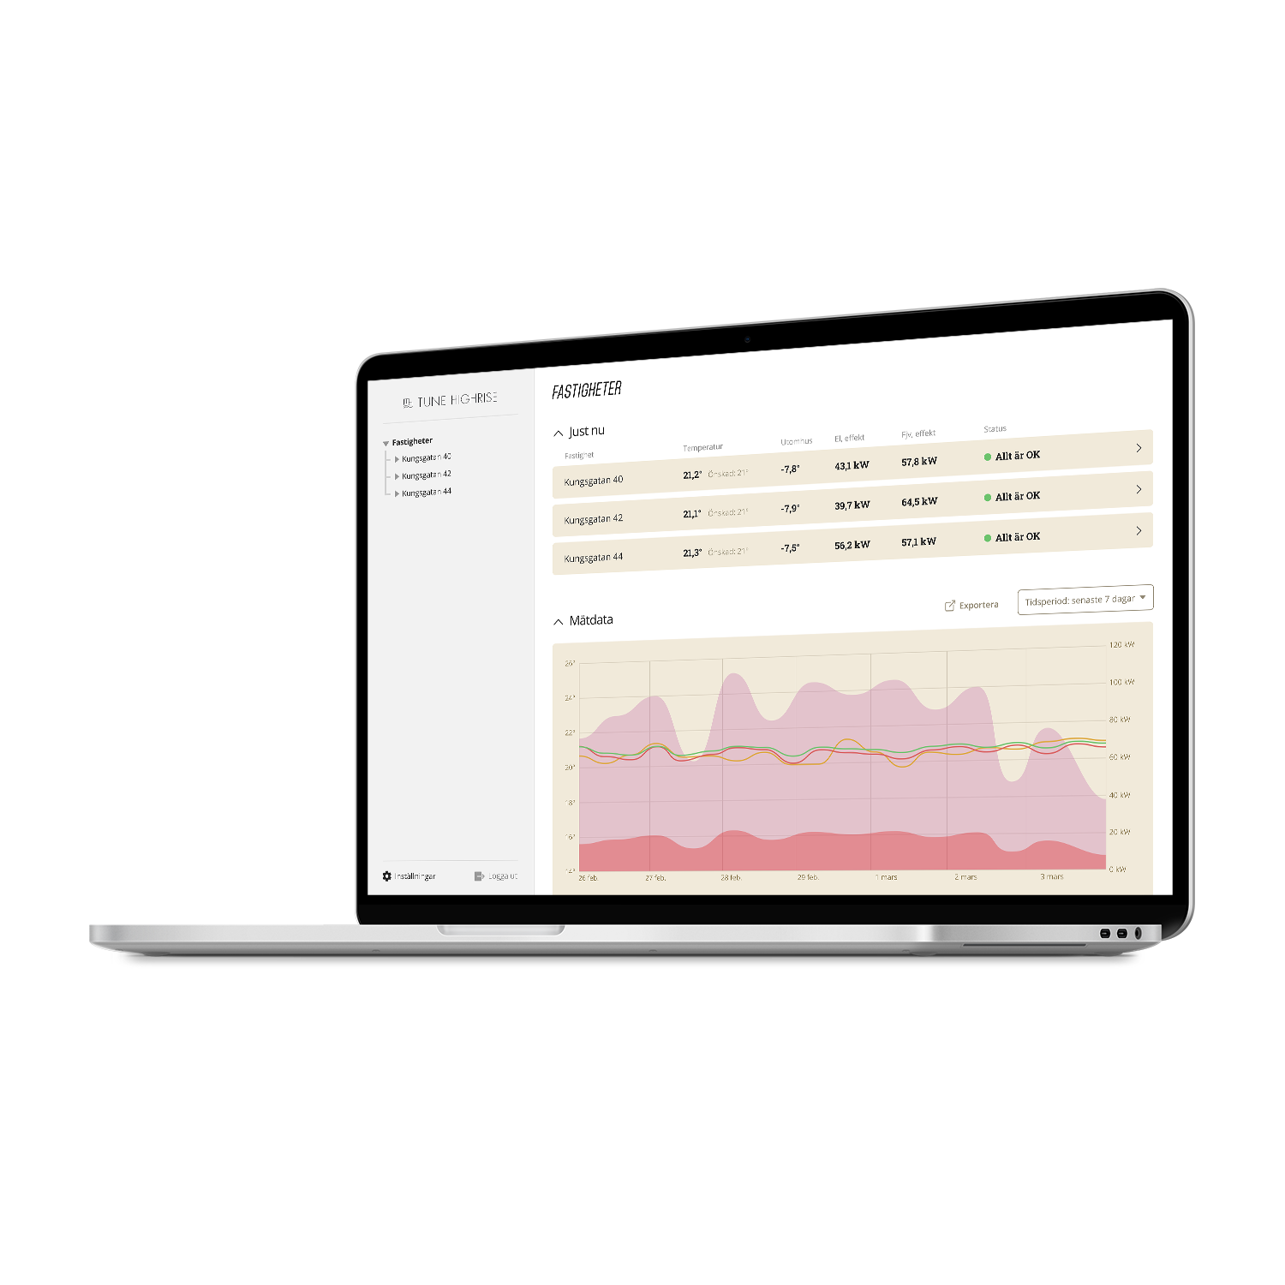
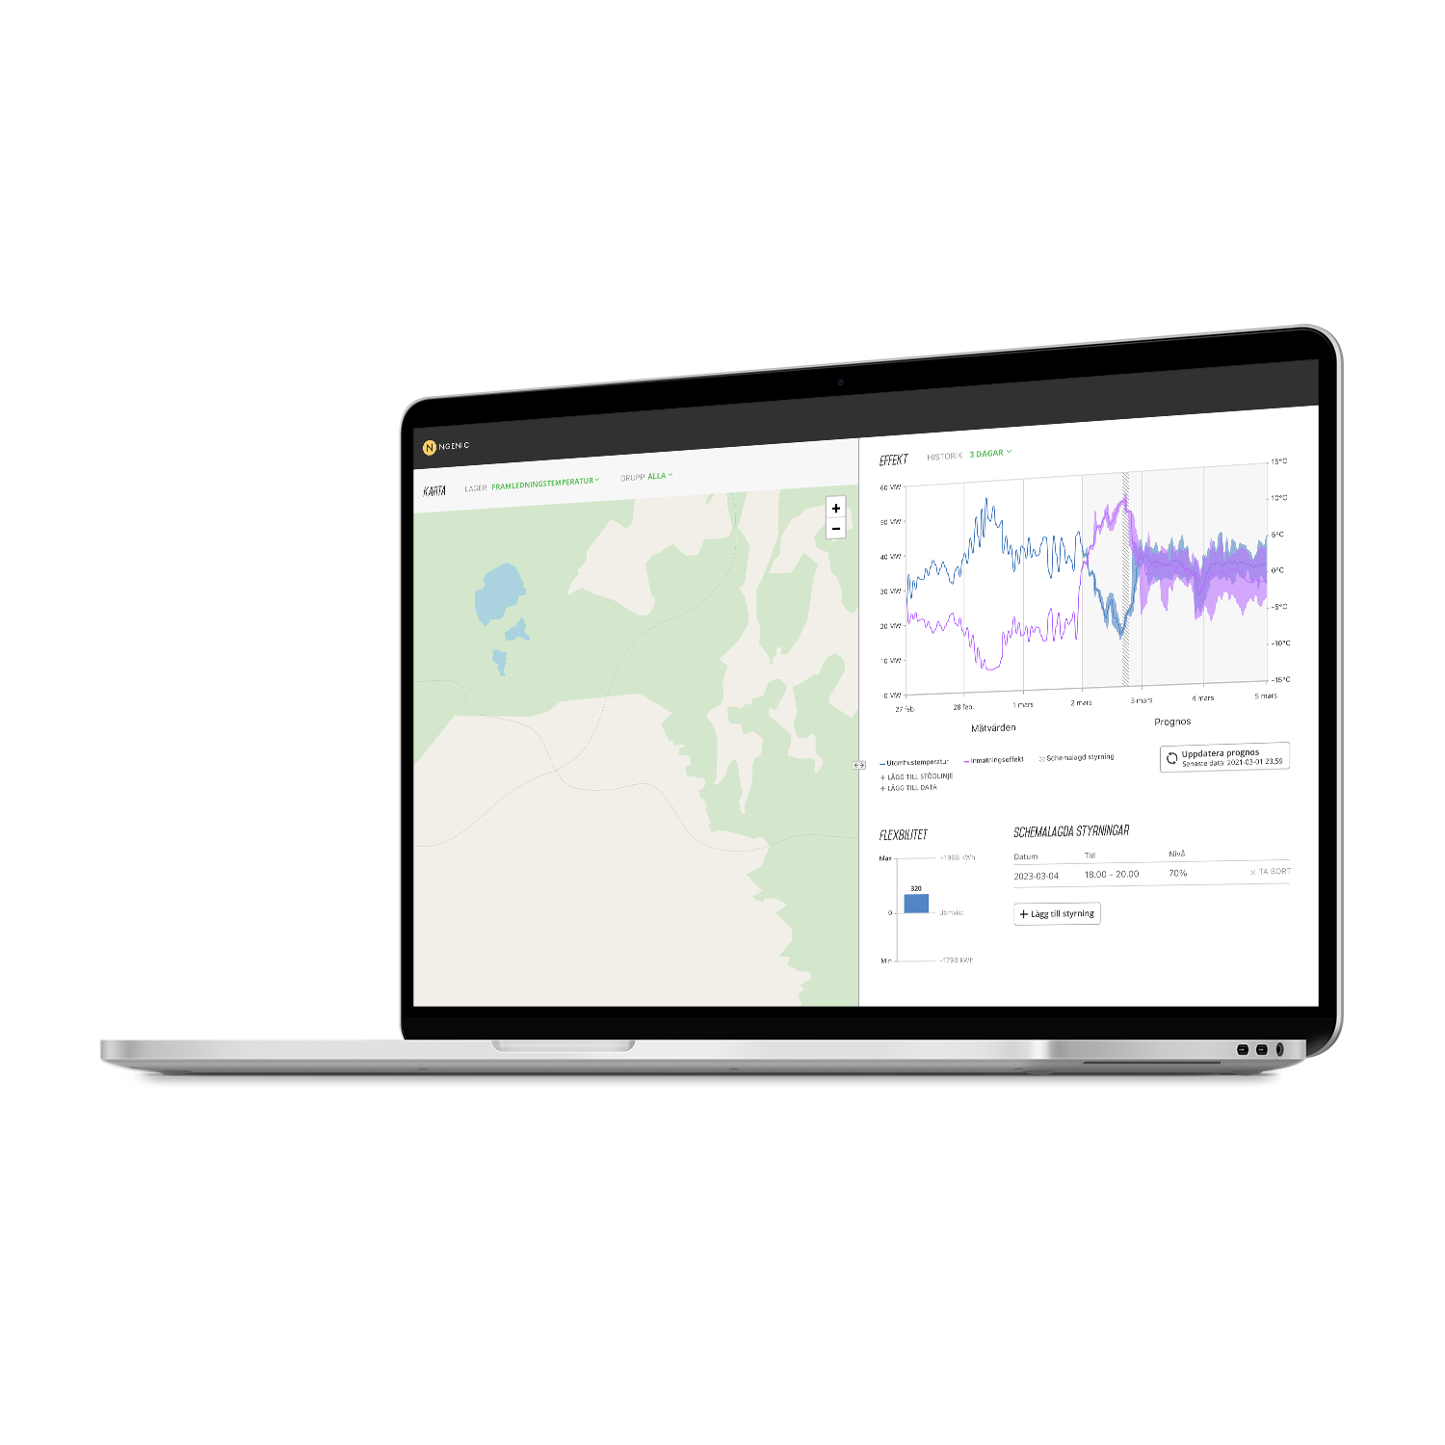
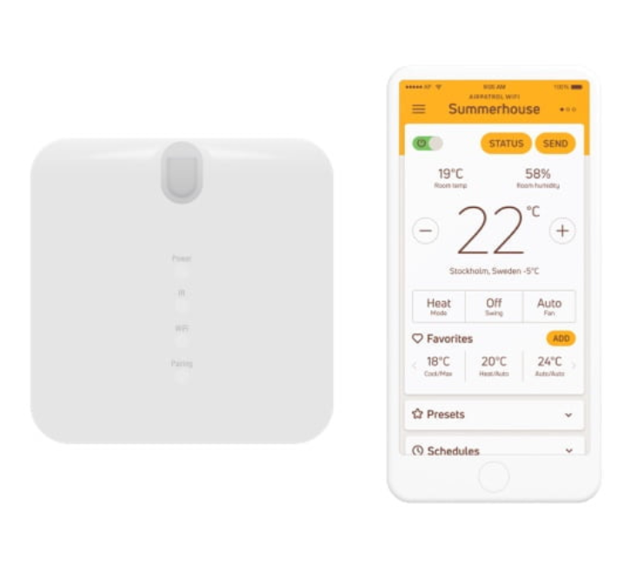

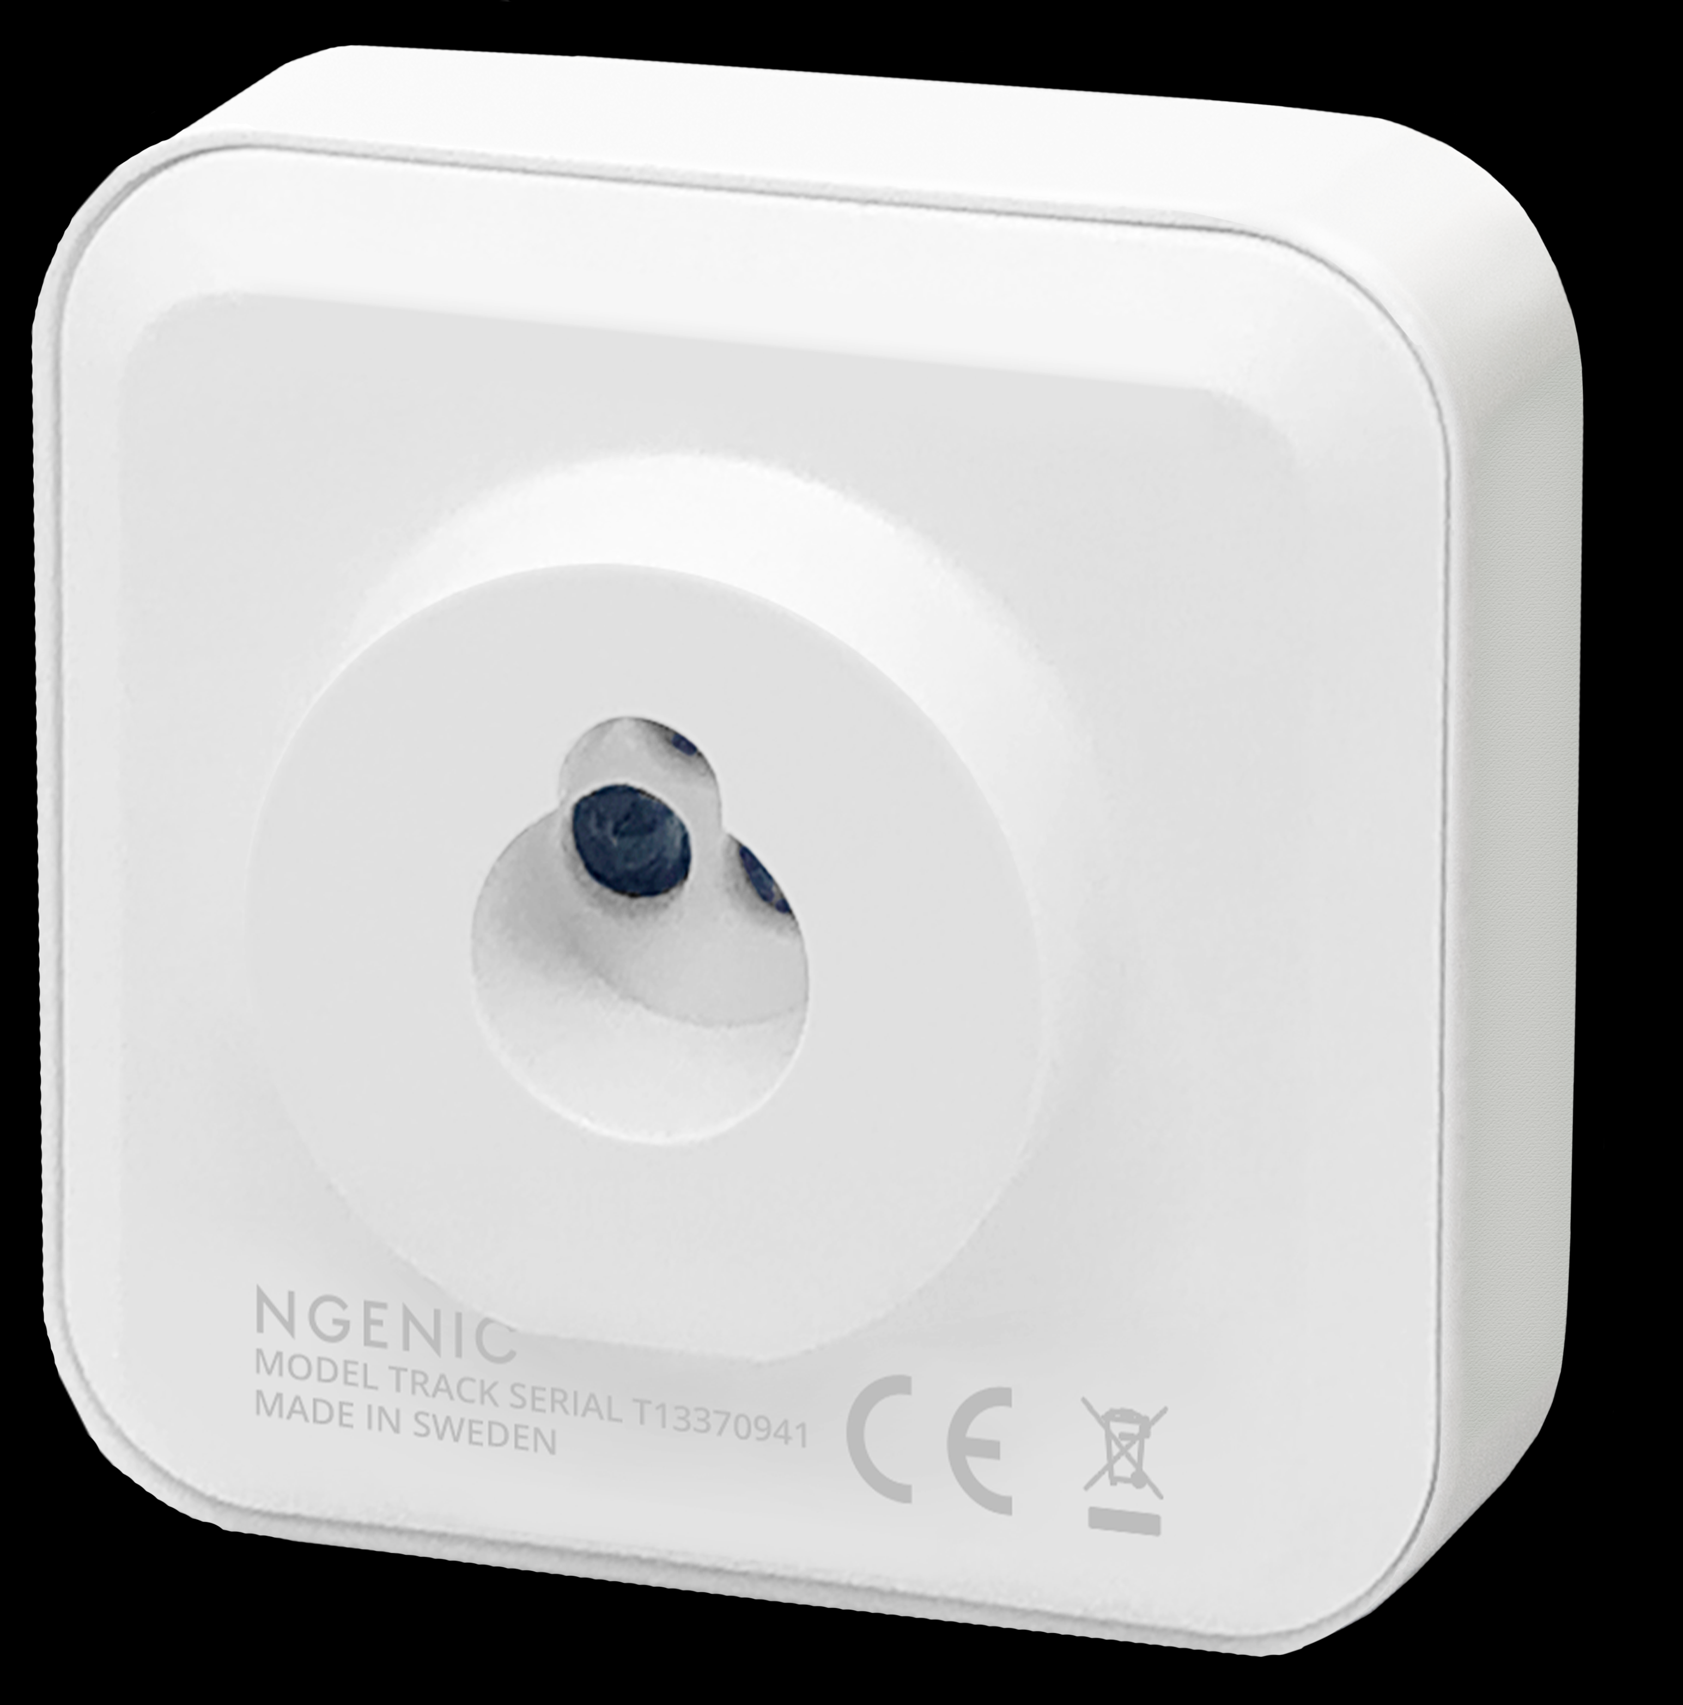




ProduCTS AND SERVICES
Services
Heating optimization
Real-time energy monitoring
Estate optimization
A/C control and optimization
Grid optimization
Energy visualization

Slide 4
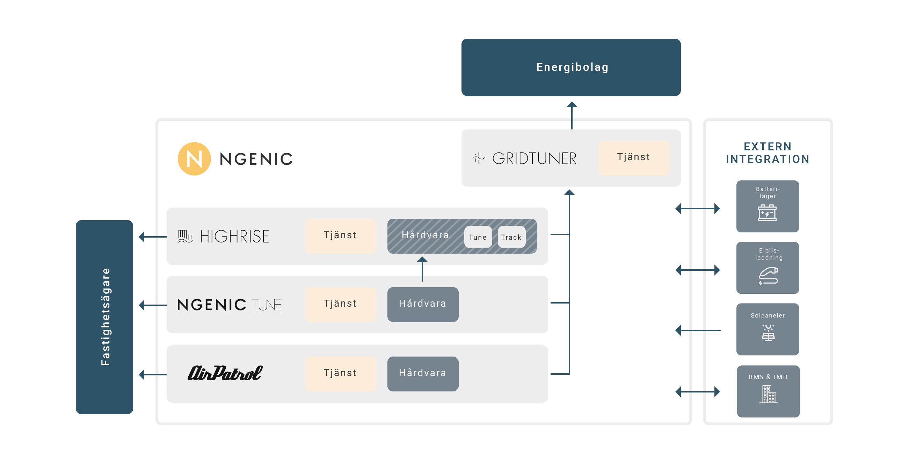





Ngenic core: IOT, EDGE Computing, INTEGRATION, BIG DATA & AI…
A uniQUE data platform for optimization and TRADING of energY
Real-time platform
Plug-n-Play
Cost effective due to edge-computing.
Scalability and integration towards all hardware, both offline and online
Unique combination of cost of energy AND energy efficieny, simultaneously.
Notes:
Förklara produktnamnen

Slide 5


Superior Energy optimization WITH AI
CUSTOMER EXAMPLE, GODEL*
23 % Total energy reduction (kWh)
24 % Energy reduction (kWh) with spot price optimization
20 % Energy reduction (kWh) without spot price optimization
120 085 kWh Total savings: ~4 MSEK on the total customer base
*50 of 500 customers with Ngenic Tune installed were evaluated by comparing (weather compensated) consumption 12 months before and 12 months after installation. See https://www.bramiljoval.se/artiklar/20-procent-elbesparing-hos-villaagare-med-smart-termostat/
Notes:
Ta bort denna

Slide 6

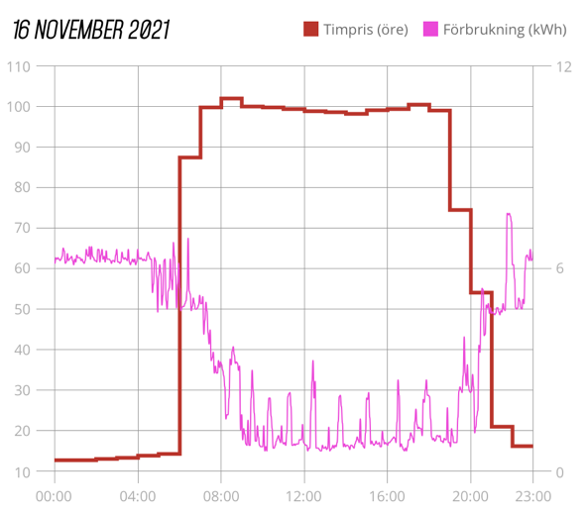
SPOT PRICE OptimiZation
Ngenic TuNe
Heat pumps and electric boilers.
Fully automatic optimization.
NO comfort loss – increased comfort!
Energy savings >20 %, 300 EUR/year
Spot price optimization on top: 20-30 % lower average energy cost/kWh, 200-300 EUR/year

Slide 7
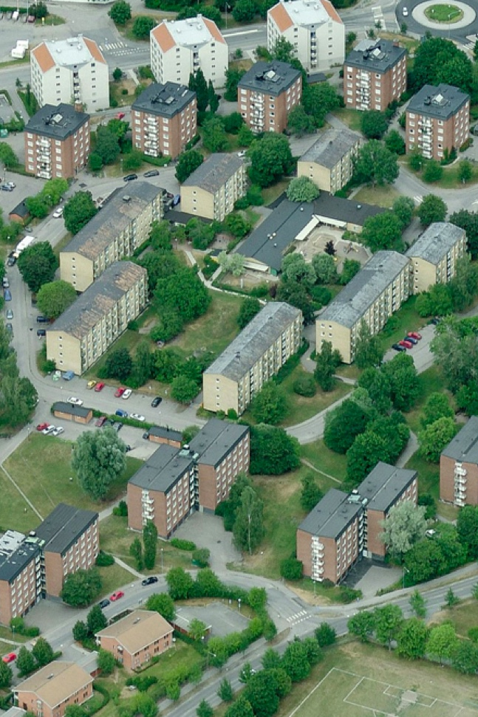
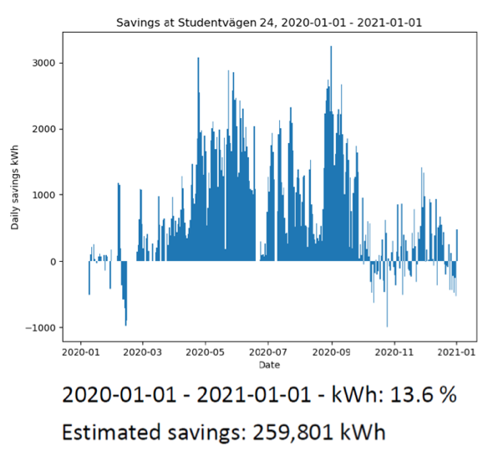
CUSTOMER Case Studentvägen
Tune Highrise
1100 apartments
260 000 kWh saved year one (13,6 %)
NO complaints on indoor climate after installation
ROI less than 1 year!

Slide 8
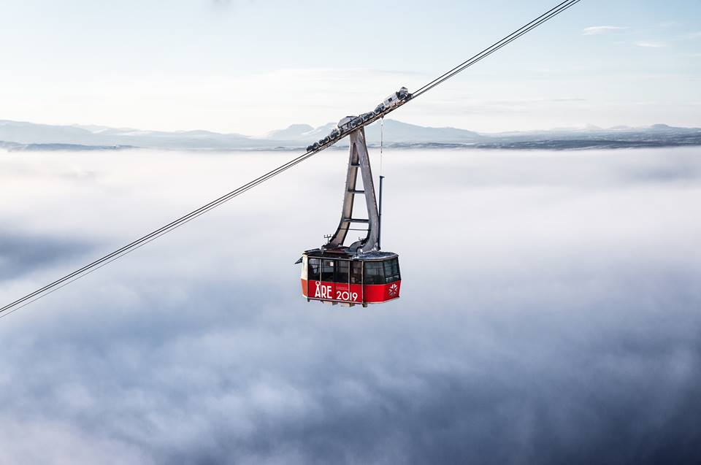


Thermo-S Are
FIRST digitIZED DISTRICT HEATING IN THE WORLD
20 % of POWER
50 % OF CUSTOMERS

Slide 9
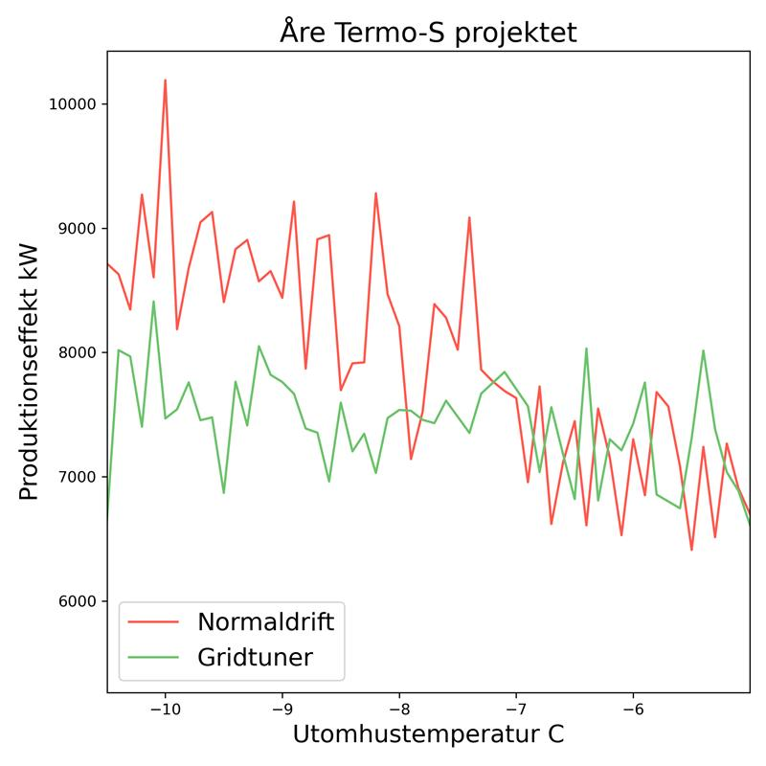
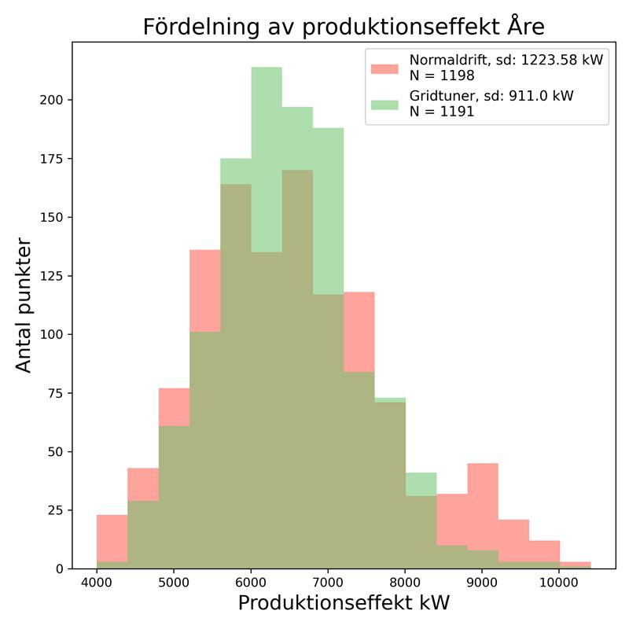
Gridtuner Åre – THE Thermo-s projeCT
Gridtuner INCREASES CAPACITY iN EXISTING infrastruCturE AND customer value, SIMULTANEOUSLY
+23% time in optimal efficiency
80 % less time with peak load
18→ 2 starts of peak load furnaces

Slide 10
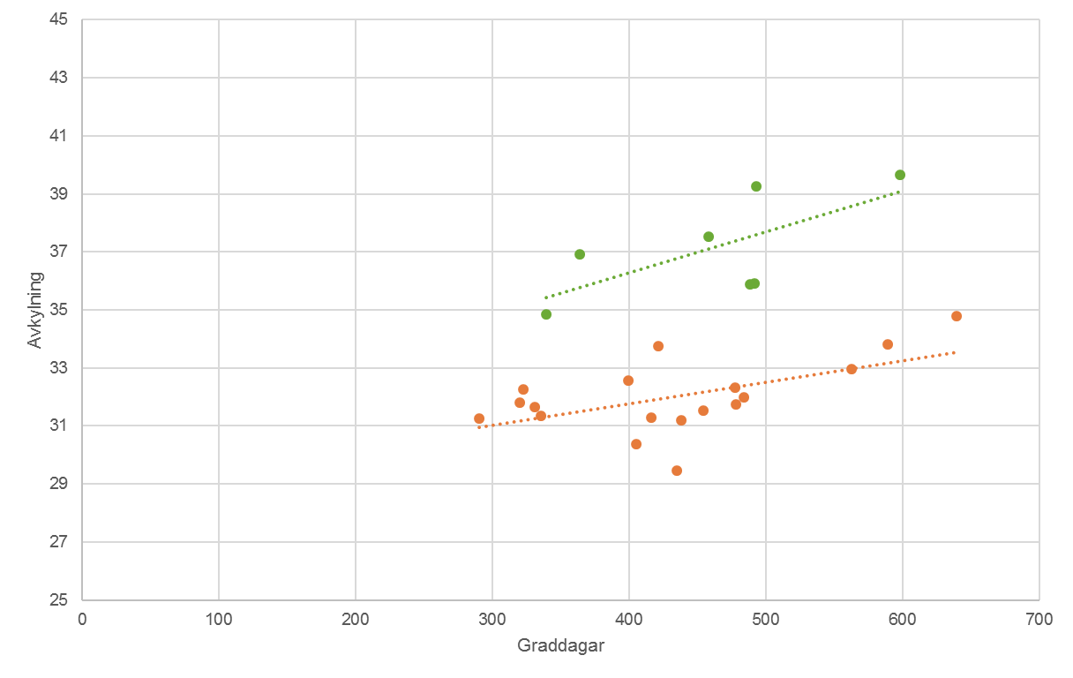

Increased cooling example 14 OF 15 sinGle family homes installeD
ReturN temperaturE LOWERED 5 – 8 DEGREES C
DeltaT with Tune
DeltaT without Tune
Avkylning
Graddagar

Slide 11
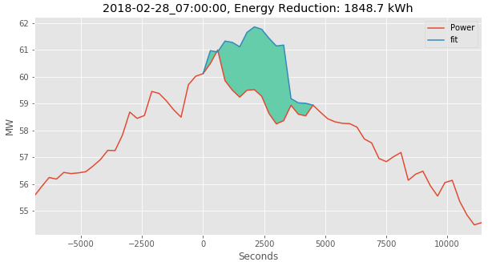
Gridtuner – PeAK SHAVING
360 Single family homes with NGENIC TUNE

Slide 12
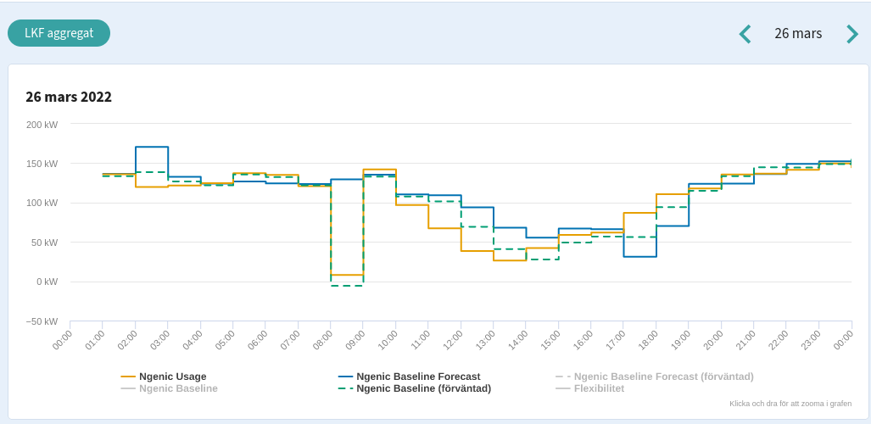
Gridtuner- local Capacity markETS INtegration
GRID EDGE CONTROL for ENERGY MARKET OPTIMIZATION – EON SWITCH MARKET

Slide 13
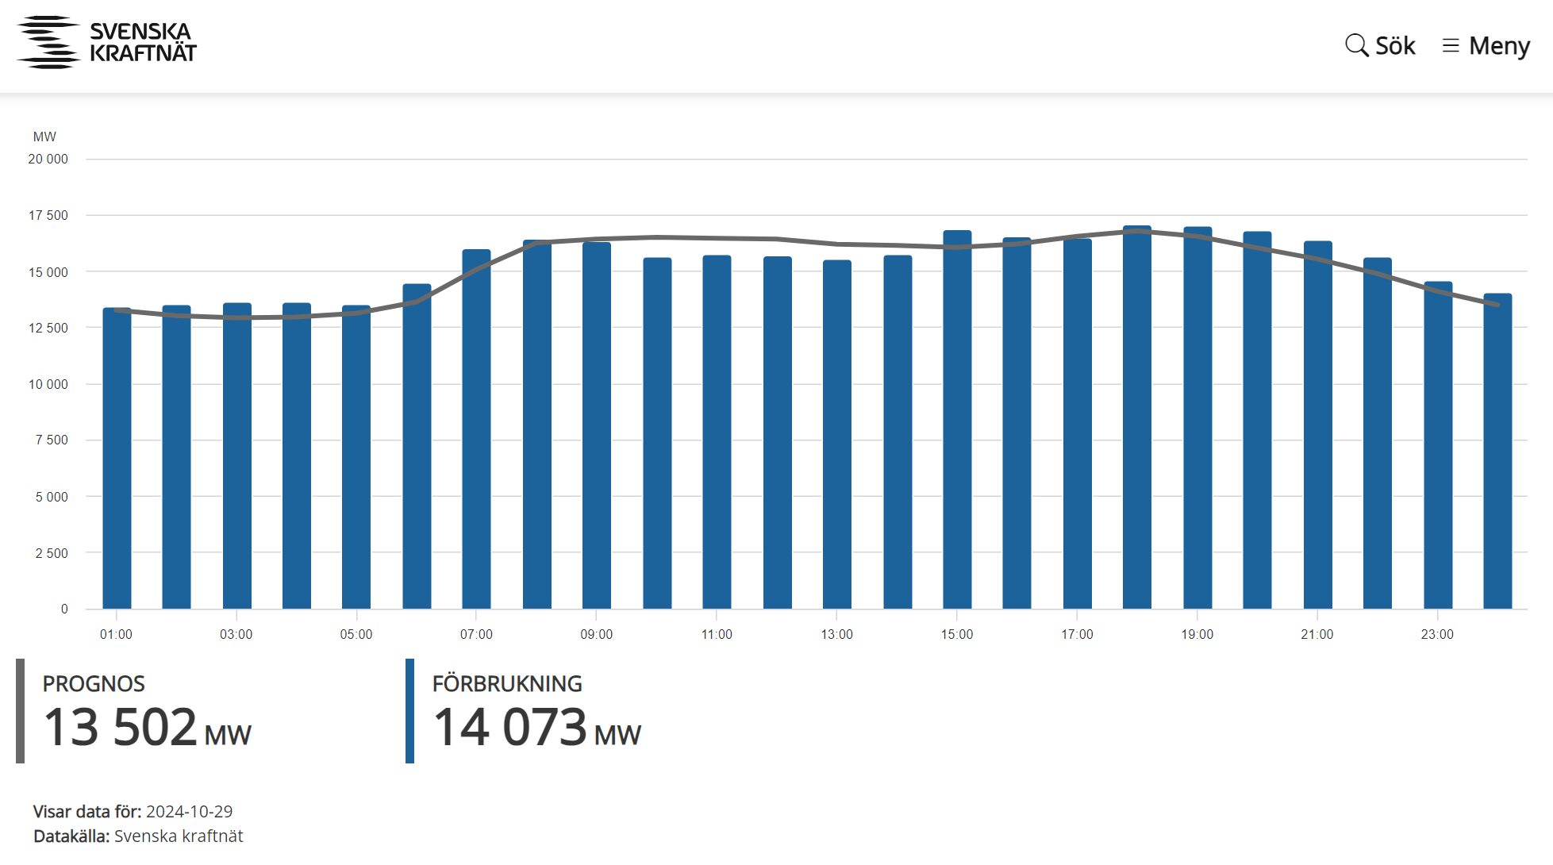
HOW IS AI CURRENTLY AFFECTING THE ENERGY MARKETS?
ENERGY MARKETS ARE NOT STABLE SYSTEMS, elforsk 13:95
Notes:
Ta bort denna

Slide 14
WHAT CAN GO WRONG WITH AI?
FORECAST ERRORS ARE INCREASING, THUS THE COST
Notes:
Ta bort denna

Slide 15
WHAT CAN GO WRONG WITH AI
FORECAST ERRORS ARE INCREASING, THUS THE COST
Notes:
Ta bort denna

Slide 16


SUMMARY – STRENGTHS of using DISTRIBUTED ML/AI
CREATING THE GOOD ”ENERGY SYSTEM CITIZEN”
The beauty of juggling multiple optimizations
  Comfort
  Energy optimization
  Energy prize optimization
  Poer tariff optimization
  Local grid optimization
  Anciliarry services
  Return temperature and production optimization
Simultaneously!
Notes:
Ta bort denna

Slide 17
Thank you!
Björn Berg
bjorn.berg@ngenic.se

