Slide 1
Ukraine’s Accession to the EU: Trade Scenarios and Institutional Challenges
Oleh Nivievskyi
Kyiv School of Economics and Freie Universität Berlin
SITE Development Conference
December 4th, 2024

Slide 2
Outline
Background
EU-Ukraine agricultural trade scenarios*
Issues beyond trade scenarios**
  EU – Ukraine trade regime
  Administrative challenges and institutional capacity gap for Ukraine
  Private sector challenges for Ukraine
  EU Agricultural support
* based on Nivievskyi and Bogonos, 2024 (forthcoming)
**based on Nivievskyi, Bogonos, and Grigoriadis 2024 (forthcoming)

Slide 3
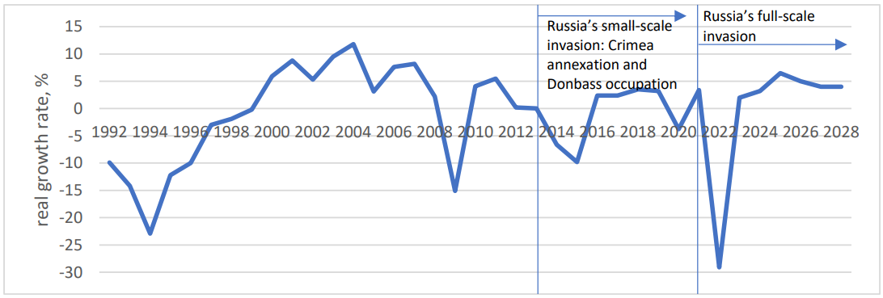
WAR – the LARGEST SHOCK since 1991
1. Introduction
Nivievskyi, Oleg and Goryunov, Dmytro and Nagurney, Anna, War-Induced Damages and Reconstruction in Ukraine (May 17, 2024). Available at SSRN: https://ssrn.com/abstract=4831914

Slide 4
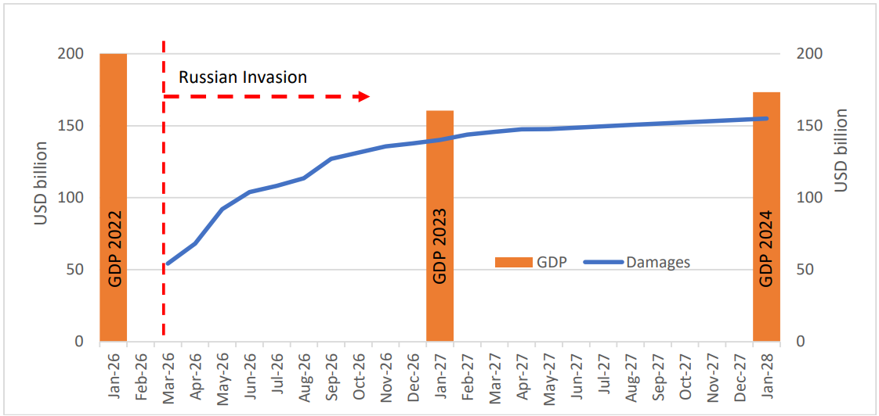
War Damages UNBEARABLE for Ukraine ALONE
1. Introduction
Nivievskyi, Oleg and Goryunov, Dmytro and Nagurney, Anna, War-Induced Damages and Reconstruction in Ukraine (May 17, 2024). Available at SSRN: https://ssrn.com/abstract=4831914

Slide 5
EU Accession of Ukraine: Trade Scenarios and Issues Beyond
1. Introduction
Political economy behind the EU enlargement inside the EU itself is very difficult
  Accession negotiations opened in December 2023
  May 2022: Solidarity Lanes and ATMs to facilitate exports from Ukraine
  Afterwards: imports to the EU surged and neighboring countries(farmers) protested quite heavily and put a pressure on the EU Commission
  This signals that the EU accession for Ukraine will not be easy
  June 2024: ATMs (with emergency clause for 7 products) for another year; Next decision on ATMs is in spring 2025
  Possible trade scenarios after the spring 2025?
Ukraine’s role as a global agricultural player and its contribution to global food security
  Issues beyond trade scenarios: Impact on Ukraine’s agricultural competitiveness

Slide 6
EU became a major trade partner of Ukraine
2. Trade Scenarios
Total export from Ukraine, bn USD
Export from Ukraine to the EU, bn USD
Total import to Ukraine, bn USD
Import in Ukraine from the EU, bn USD

Slide 7
Methods and data
2. Trade Scenarios
AGMEMOD model (also used by the EU Commission) | 2023 version with 2024 database Econometric dynamic partial equilibrium regional model Actively used in Ukraine since 2016 Data: State statistics service of Ukraine, FAO, USDA

Slide 8
Scenarios description
2. Trade Scenarios
 | Baseline | ATMs | Free Trade | EU membership
Trade with the EU | ATMs in 2025 DCFTA in 2026-2033 (with 40 TRQs) | ATMs in 2025 and until 2033 | ATMs in 2025 and Free Trade afterwards until 2033 | ATMs in 2025 and Free Trade afterwards until 2033 Additional compliance costs (up to 10%) for agricultural producers

Slide 9
Trade modelling results: wheat
2. Trade Scenarios
‘000 t
‘000 t

Slide 10
Trade modelling results: corn
2. Trade Scenarios
‘000 t
‘000 t

Slide 11
Trade modelling results: sunflower seed
2. Trade Scenarios
‘000 t
‘000 t

Slide 12
Trade modelling results: sunflower oil
2. Trade Scenarios
‘000 t
‘000 t

Slide 13
Trade modelling results: poultry meat
2. Trade Scenarios
‘000 t
‘000 t

Slide 14
Setting the Framework: Competitiveness
3. Issues beyond trade scenarios: competitiveness
%∆Competitiveness = %∆Productivity + %∆α*P_{output} - %∆β*P_{input} (Nivievskyi et al, 2010)
P_{output} – output prices
P_{input} – input prices
How the EU membership will affect agricultural competitiveness of Ukraine?
3 dimensions:
  Impact of the trade regime
  Impact of the EU acquis in agriculture and related areas
  Impact of the agricultural support (Common Agricultural Policy of the EU)

Slide 15
Trade policy regime is beneficial for Ukraine’s agricultural competitiveness
3. Issues beyond trade scenarios: competitiveness
Total export from Ukraine, bn USD
Export from Ukraine to the EU, bn USD
Total import to Ukraine, bn USD
Import in Ukraine from the EU, bn USD

Slide 16
State institutions lack capacity might hinder agricultural competitiveness
3. Issues beyond trade scenarios: competitiveness
Ukraine must be able to implement the extensive EU ‘agricultural acquis’ which, together with the CAP, includes regulation of markets and standards in the areas of farming practices, animal and plant health, food safety, and environmental and animal welfare.
Current bottleneck – technical and financial capacity of state institutions in Ukraine (Nivievskyi, 2024)
If they work efficiently, they can crowd in private investments 1 to 4
If not – additional burden for the business and drag on competitiveness

Slide 17
EU agricultural acquis compliance costs might hinder agricultural competitiveness
3. Issues beyond trade scenarios: competitiveness
EU agricultural acquis+ CAP is very demanding
Require additional private investments to comply with:
  Expect up to 10% of the total costs (EU Commission 2014)
Not critical to agricultural competitiveness of Ukraine
Moreover, there are studies (Halytsia et al, 2024) demonstrating that Ukrainian farms have a capacity to increase their output by almost 20% and simultaneously contract harmful environmental impact by 16%

Slide 18
CAP subsidies might hinder agricultural competitiveness
3. Issues beyond trade scenarios: competitiveness
TFP trends

Slide 19
CAP subsidies might hinder agricultural competitiveness
3. Issues beyond trade scenarios: competitiveness

Slide 20
CAP subsidies might hinder agricultural competitiveness
3. Issues beyond trade scenarios: competitiveness
Expected amount of CAP subsidies is 10-14 bn euros
Politics:
  CAP budget has been politically set to decrease
  If there no changes to CAP – other EU countries will get less
  This will not fly politically
Economics of subsidies: bad for efficiency and productivity
Conclusion: Ukraine has to suggest an option to the EU

Slide 21
Conclusions
EU-Ukraine trade scenarios look favorable for Ukraine, while the EU membership is expected to decrease to some extend production and exports
Further pressure is possible (if not properly addressed)
  Institutional and private capacity to comply with the demanding EU agricultural acquis
  EU agricultural support (might delay the accession and is negative for productivity)

