Slide 1
NEST Pension
UK experience of investment fund choice and default strategies

Slide 2



Workplace pension reforms
What’s changed?
Before auto enrolment
After auto enrolment
Employers have to
offer a contribution to certain jobholders
Do nothing
= save in a pension scheme
Auto enrolment
NEST is designed for everyone
Employers chose whether to contribute
Active
choice often needed from worker
Behavioural barriers to take-up
Not economical for existing providers to supply lower earners
Saving was a ‘minority sport’
Saving is
the norm
Notes:
Since the workplace pension reforms and the introduction of auto enrolment, there’s been a change in behaviour both among employers and workers.
Employers now have to offer a contribution to certain jobholders, and workers do not have to make an active choice to begin saving for their retirement.

Slide 3




NEST key statistics
442,000+
5.3m+
17,400+
Employers
Members with £2bn funds
under management
NEST Connectors
Notes:
[Statistics as of 20 August. Users of this slide deck must update these statistics from https://pigeonhole/workingatNEST/Pages/NEST-in-numbers.aspx]
We have over 5.3m members
Our opt out rate is 8 per cent on average, and it’s even lower among younger members
We have over 442,000 employers signed up to NEST, plus over 4,000 self-employed members.
There are around 17,400 NEST Connectors helping employers use NEST
Currently around £2 billion in assets under management.

Slide 4

Alternative fund choices – supporting decisions
NEST Pre-retirement Fund
NEST Lower Growth Fund
NEST Higher Risk Fund
diversified
lifestyled
low cost
NEST Ethical Fund
diversified
dynamic
lifecycled
NEST Sharia Fund
low cost
Notes:
NEST retirement funds – appropriate choice
Moving beyond the default strategy - the DWP guidance is specific about the need for there to be options beyond the default. Employers and providers will be keen to avoid accusations of discrimination if there aren’t reasonable attempts to allow individuals to invest in line with their beliefs or faith.
Equally, all the evidence tells us our members won’t respond well to be overwhelmed by choice.
The cost of providing fund choice is marginal in our approach and is far outweighed by the benefits to members. It’s common sense backed up by a wealth of evidence about the importance of providing choice and options, even if it’s not used by everyone who says they want them.
And as you can see from the fund names we’ve tried hard to make sure – as suggested in the DWP guidance – that the purpose of the fund choice is clear.
I’ll just touch on three of the five fund choices we have and give a few details about their features, which are again a little different from more traditional approaches.
ETHICAL
Our Ethical Fund choice offers members a fund that addresses concerns about what their money is supporting. Like our default, it’s lifestyled through Growth, Consolidation and Foundation phases to give members risk exposure appropriate to how many years they have until retirement.
As far as we know this is the only lifestyled ethical fund available for pension savers in the UK - just because a member has opted out of the default, doesn’t mean we shouldn’t try and manage risk for them throughout their time saving with us.
SHARIA
We want to make sure there’s a suitable fund for as many investors as possible. Islamic law has a number of restrictions on investment. Our sharia fund invests according to these principles so that there’s no barrier for Muslim savers who want to take part in their workplace pension.
HIGHER RISK FUND
And we know that we’re likely to see some members who are on higher earnings, or who have existing savings or who just want to take more risk. For these members we’ve created a higher risk fund that’s targeting equity-like returns at a lower volatility level.
And as you can see from the fund names we’ve tried hard to make sure – as suggested in the DWP guidance – that the purpose of the fund choice is clear.

Slide 5




How NEST delivers its default stratgey
Wide diversification – risk spread across different asset classes
Clear objectives and risk budgets
In-house expertise to blend funds from leading fund managers
Efficient delivery
through single year target date funds

Slide 6
Default fund usage and alternative fund options
82% is average percentage of membership invested in the default fund in the UK
  - DC Pension Plans in the UK; An Analysis, 2017; Pensions Insight & JP Morgan Asset Management

Slide 7
Default fund usage and alternative fund options
99.6% of NEST members are in the default NEST Retirement Date Funds range
Data at end of July 2017

Slide 8
Demand side
Low financial literacy and capability of long term savings vehicles (lower income highly sophisticated short term budgeters)
Procrastination – ongoing nature of investments
Naive diversification
Little understanding of fees and charges (even for well educated)
Brand recognition dominates decisions

Slide 9
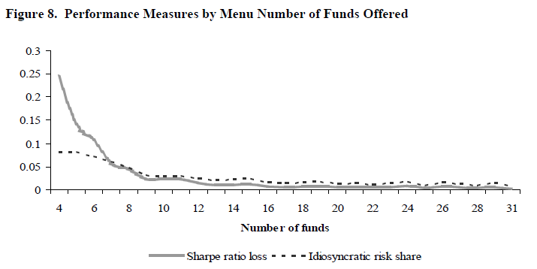
401(k) plans in USA
- The Efficiency of Sponsor and Participant Portfolio Choices in 401(k) Plans, 2009; Tang, Mitchell, Mottola, Utkus

Slide 10
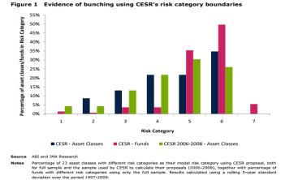
Supply side
Complex: multiplicity of products – is there genuine choice?
Charges: charges during accumulation are high and vary widely across providers
Intermediation - Financial advice: availability, cost

Slide 11

European guidance on fund risk categorisation
- Note on CESR’s recommendation for the calculation of synthetic risk reward indicator, Investment Management Association (now the Investment Association) UK; 2010
Notes:
NB. Sample size was ~ 420 funds

Slide 12
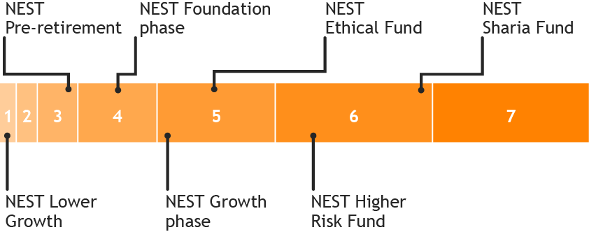
What sort of choice?
Risk category | Annualised volatility | Description of volatility (ESMA)
1 | 0-0.5% | Very low
2 | 0.5-2% | Low
3 | 2-5% | Medium
4 | 5-10% | Medium to high
5 | 10-15% | High
6 | 15-25% | Very high
7 | >25% | Very high

Slide 13
Do normal rules of supply and demand work?
Asymmetry of information
Mis-alignment of incentives / principle agent problems
‘There are three sources of market failure in superannuation: member inertia and disengagement; product complexity and low consumer financial literacy; and conflicted remuneration structures within the financial planning industry’
(Australia Industry Super Network 2010 – Cooper review)

Slide 14
Outcomes for members and wider implication for public policy and markets
Less confidence in system (mis-selling scandals in UK)
Lower savings rates leading to lower pots, more reliance on the state
High charges – capital spent on marketing and acquisition
Limited innovation
Inefficient allocation of capital to economy – insufficient scale to drive costs and reduce drag

Slide 15
NEST’s solution
Make the market work by being an informed customer on behalf of members
Provide benefits of scale and reduce admin burden
Introduce more competition between fund providers and support greater innovation
Encourage market to focus on key elements of investment (not marketing)
Encourage standardisation of cost and charge reporting to allow better comparisons
Develop long term relations with market providers

