Slide 1
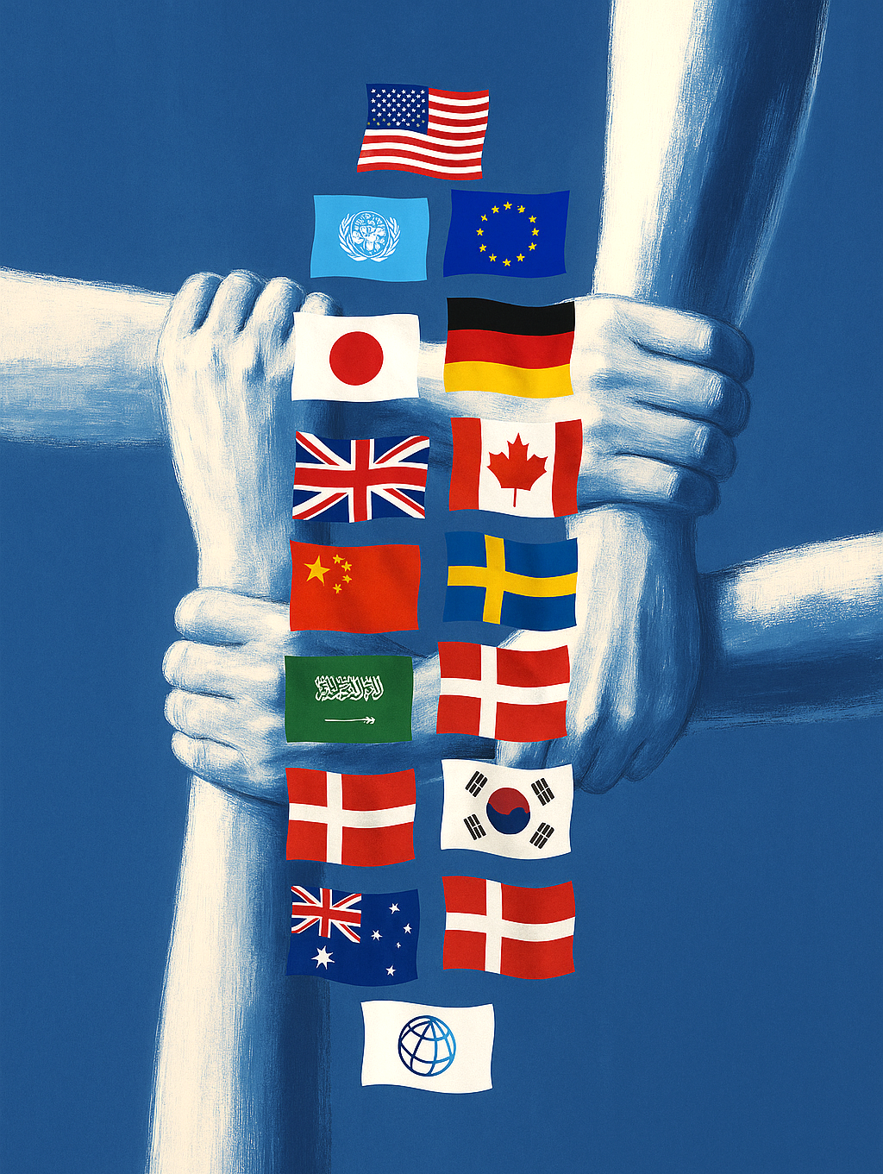





The future of development finance
Raj M. Desai
School of Foreign Service
SITE Development Day
Stockholm, December 5, 2025

Slide 2
Official development assistance (ODA)
OECD Development Assistance Committee (DAC) definition:
From official donors
Concessional
For economic development/humanitarian purposes
To low/middle-income countries

Slide 3
Official development assistance (ODA)
ALL DONORS
USA

Slide 4
US ODA
COVID pandemic
Global financial crisis
USAID established
Collapse of East Bloc Communism
9/11
East Asian crisis
Source: OECD Creditor Reporting System. 2025-26 estimates from ”Fiscal 2026 Discretionary Budget Request”

Slide 5
Source: OECD, Creditor Reporting System

Slide 6
Financial flows to Moldova, 1993 – 2023
Foreign aid

Slide 7
Financial flows to Moldova, 1993 – 2023
Private capital
Foreign aid

Slide 8
Financial flows to Moldova, 1993 – 2023
Remittances
Private capital
Foreign aid

Slide 9
Financial flows to Moldova, 1993 – 2023
Remittances
Private capital “mobilized” by foreign aid
Private capital
Foreign aid

Slide 10
ODA sources for Moldova (2023)
Multilateral
$423 million
38%
DAC Donors
$635 million
56%
Non-DAC Donors
$72 million
6%

Slide 11
Other Multilaterals
World Bank
USA
Multilateral
EU Institutions
DAC
Other G-7
Non-DAC
Other Non-DAC
Romania
Other DAC

Slide 12
Moldova’s changing aid landscape
Cuts in aid budgets of US, UK, Germany, France, Netherlands, Belgium, and Switzerland anticipated
If Moldova’s ODA receipts follow global trends → loss of $190 – $280 million in ODA flows is expected for 2026 relative to 2023
Future DAC priorities = Ukraine reconstruction, climate change, domestic refugee costs
Will affect budget support, infrastructure projects, social programs, and civil society funding in Moldova, unless alternative financing strategies are put in place

Slide 13
Four strategies
Leverage diaspora investment
Attract cross-border philanthropy
Mobilize private capital
Engage + align with newer donors

Slide 14
1. Moldovan diaspora
As % of total population (domestic and international):
Sources: UN DESA, Population Division; World Bank World Development Indicators

Slide 15
1. Moldovan diaspora
As % of total population (domestic and international):
Remittances received (% GDP)
Sources: UN DESA, Population Division; World Bank World Development Indicators

Slide 16



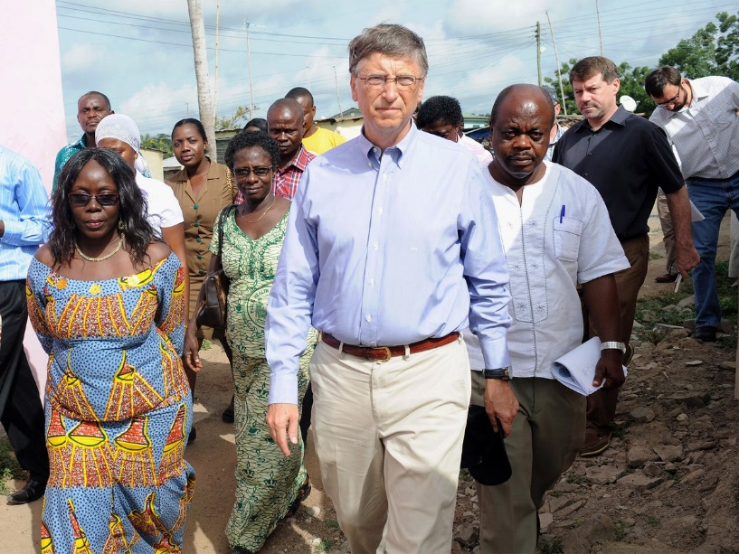





2. Private cross-border philanthropy

Slide 17
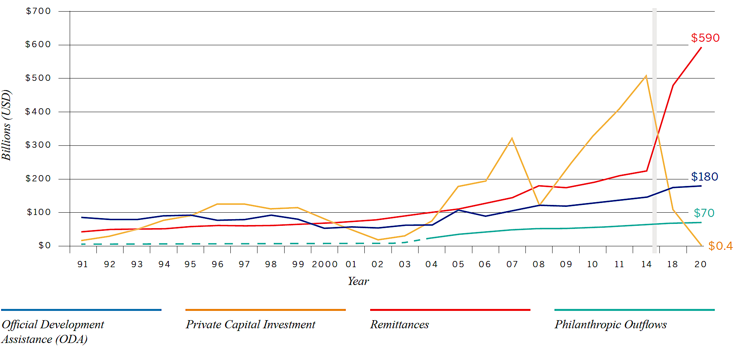
Private development assistance vs. ODA
2023 Disbursements
Source: Global Philanthropy Tracker, UN SDG Global Database, World Bank Int’l Debt Statistics, OECD Creditor Reporting System

Slide 18
3. Blended finance
Traditional Approach
DIRECT FINANCING
Multilateral & bilateral financing
DEBT
Assets & expenses
Recipient country
Blended-finance Approach
Capital mobilization
INVESTMENT
Assets & expenses
Private sector
Public sector
Private development finance (DFC, IFC)
“CROWDING IN”
DIRECT FINANCING
Multilateral & bilateral financing
DEBT
Recipient country
Risk capital solutions

Slide 19
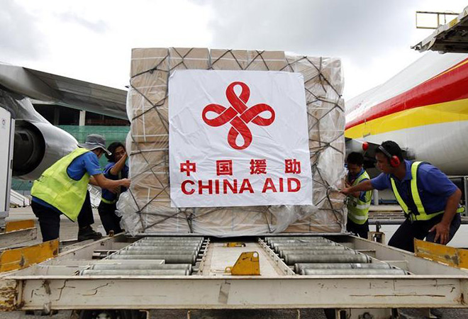
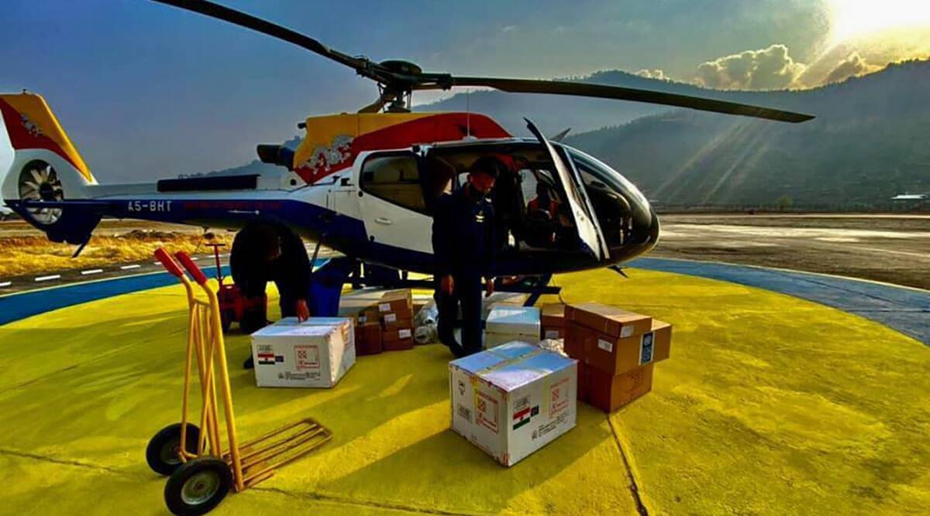
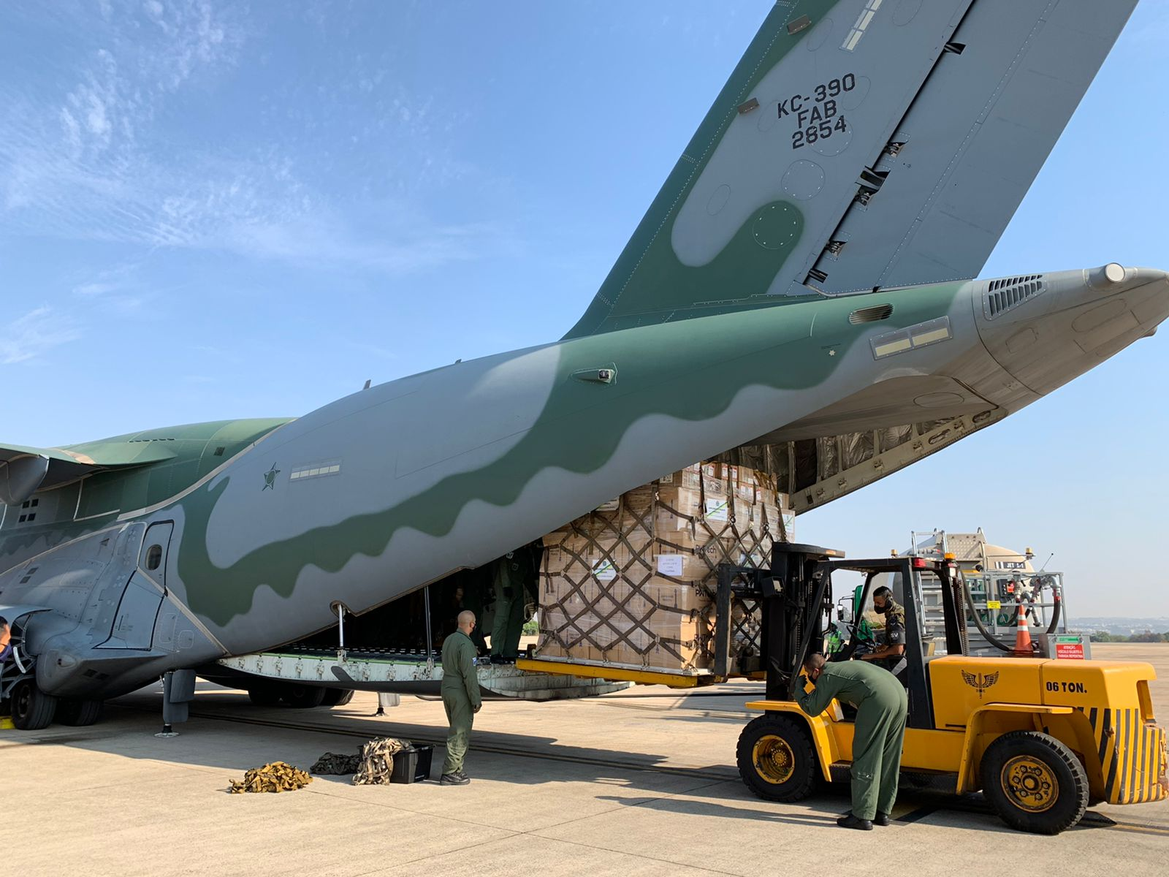
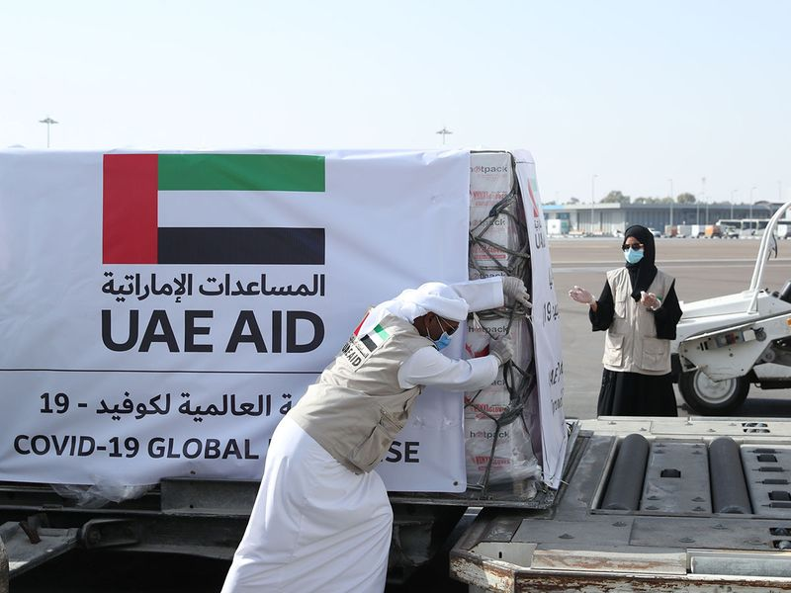
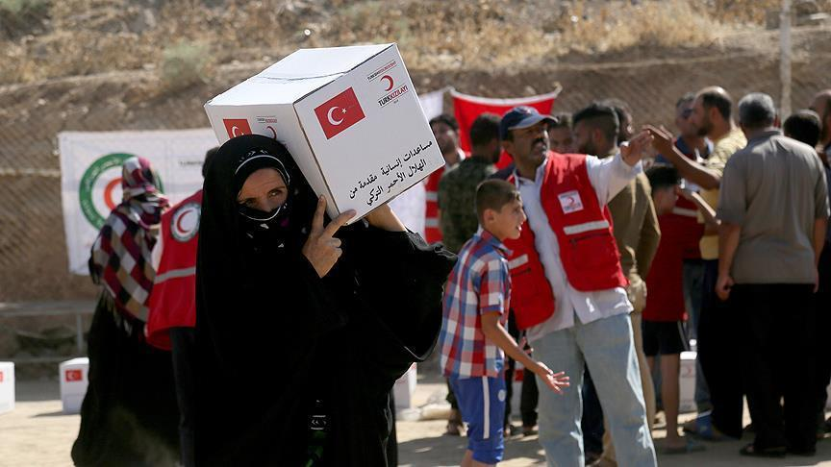
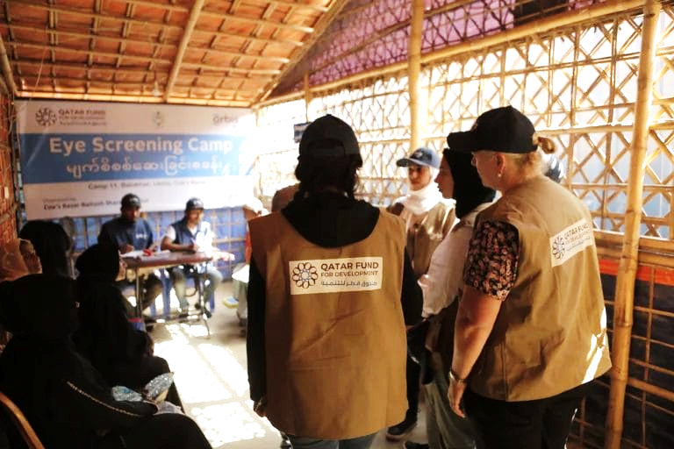
4. Non-Traditional Donors
Notes:
New bilateral partners (Korea, Gulf Cooperation Council) for specific areas
Triangular cooperation (co-financing by traditional + emerging donors)
Stronger aid coordination mechanisms
Non DAC assistance characteristics
More “programmable” aid
Foreign and commercial-policy driven
More tied aid without budget support
Less conditionality
Less transparency

Slide 20
~$280 million shortfall

Slide 21
Revenue mobilization (0.5% of GDP = $90m)

Slide 22
Diaspora financing
(0.3% of GDP = $55m)
Revenue mobilization (0.5% of GDP = $90m)

Slide 23
Cross-border private aid ($7.5m)
Diaspora financing
(0.3% of GDP = $55m)
Revenue mobilization (0.5% of GDP = $90m)

Slide 24
De-risked private investment ($60m)
Cross-border private aid ($7.5m)
Diaspora financing
(0.3% of GDP = $55m)
Revenue mobilization (0.5% of GDP = $90m)

Slide 25
New donor aid? ($70m)
De-risked private investment ($60m)
Cross-border private aid ($7.5m)
Diaspora financing
(0.3% of GDP = $55m)
Revenue mobilization (0.5% of GDP = $90m)

Slide 26
Thank you

