Slide 1

STRENGTHENING HUMAN CAPITAL:
SITE 2025 Development Day
HOW UKRAINE AND MOLDOVA CAN RETAIN AND RECONNECT THEIR STUDENTS
Anhelina Vaskovska

Slide 2
Student Emigration
Risk of “brain drain” and demographic decline
What drives students’ study-abroad choices, and what would motivate them to return home?
20%
Methodology
Survey with 236 respondents (118 each from Ukraine and Moldova)
Multiple-choice and open-ended questions
Interviews with students and academics
Moldovan higher education students abroad
10%
Ukrainian higher education students abroad
Notes:
Both countries are seeing increasing numbers of students pursuing higher education abroad. This trend brings opportunities but also risks, especially given labour shortages, ageing populations and long-term instability. I will present key findings from a policy brief exploring how Ukraine and Moldova can retain young talent and maintain meaningful connections with students who study abroad. The focus is on understanding what drives educational choices, what motivates young people to return, and how both states can turn potential brain drain into brain gain. The analysis is based on a survey of 234 young people who studied at home or abroad. The survey was enriched with interviews, allowing us to capture more personal experiences and motivations behind their choices.

Slide 3

Ukrainian Education in Wartime
38% of university infrastructure has been damaged
The “study–war balance” amid air raids, blackouts and insecurity
Despite these challenges, universities remain resilient and reform-oriented
International solidarity and partnerships: Erasmus+, Horizon Europe, UK–UA Twinning, European Universities Alliances
Students clearing debris after UAV damage at the Institute of International Relations, 3 November 2024.
Source: IIR Official
Notes:
Ukrainian students study in extremely challenging conditions. Despite heavy destruction, universities continue operating and even deepen cooperation with European partners. For many young people, the war shapes not only their education but also their worldview and sense of responsibility.
Foreign support is essential. European partners help universities modernise, connect internationally, and align with European standards.

Slide 4
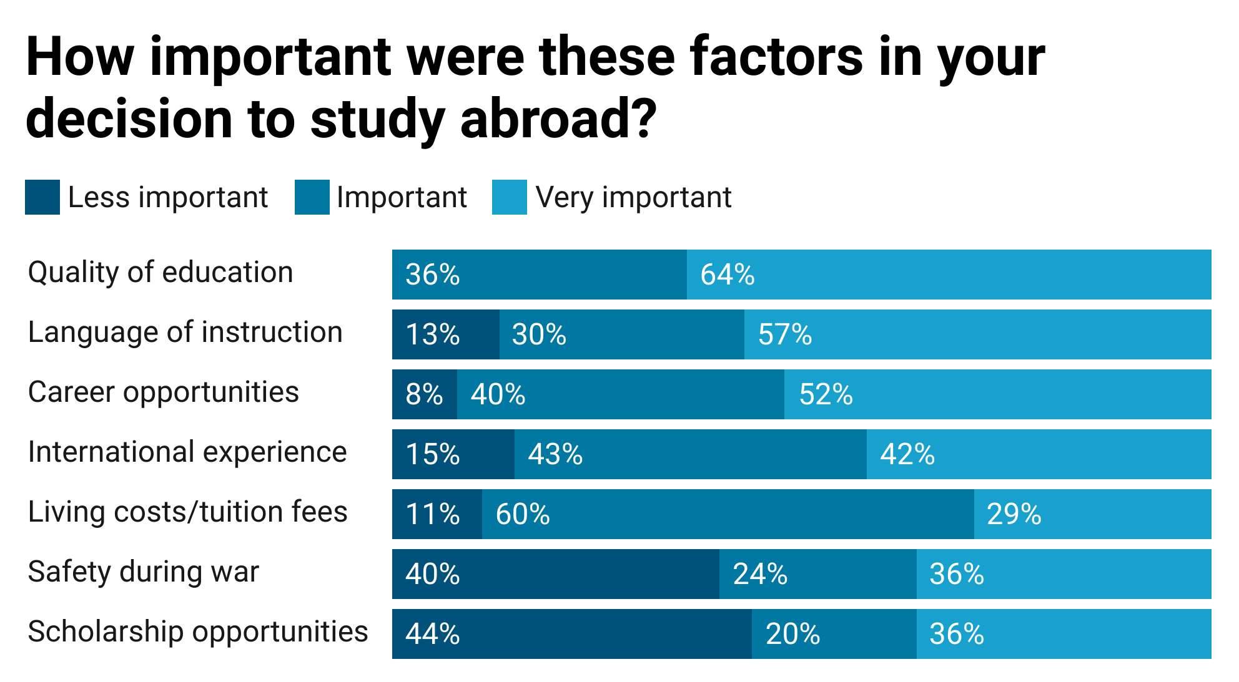
What Drives Students’ Choices
Ukraine
Safety concerns matter, but opportunities for growth and development remain the decisive factor.
Moldova
Low wages and limited career pathways push students abroad in search of better opportunities.
Both countries
The perceived quality and relevance of education strongly influence whether students stay or leave.
Respondents from Ukraine
Notes:
Across both countries, the main factor shaping decisions is opportunity. Safety matters, especially for Ukrainians, but long-term development and prospects carry more weight.
In Moldova, structural economic challenges are the primary drivers of student migration. Many leave simply because they do not see viable, well-paid opportunities at home.
Students with experience abroad emphasize the need for programmes that are more practical and aligned with the labour market. This includes stronger career services, better internships, and collaboration with private companies.

Slide 5

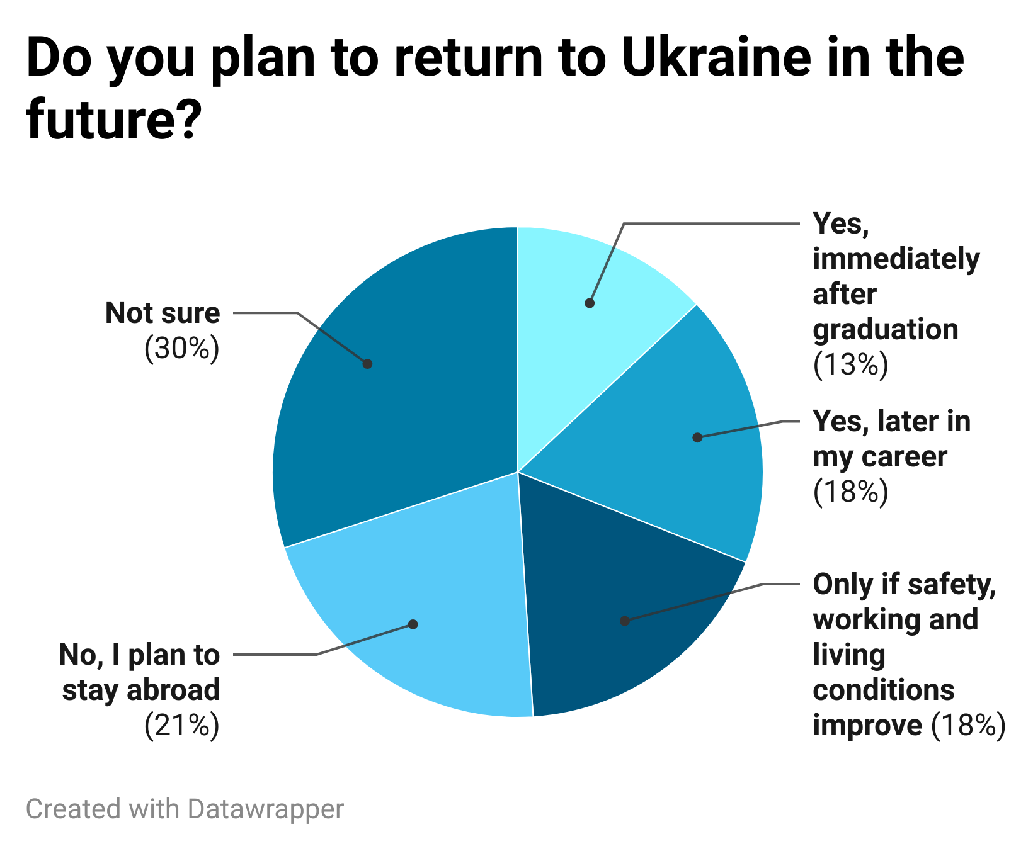
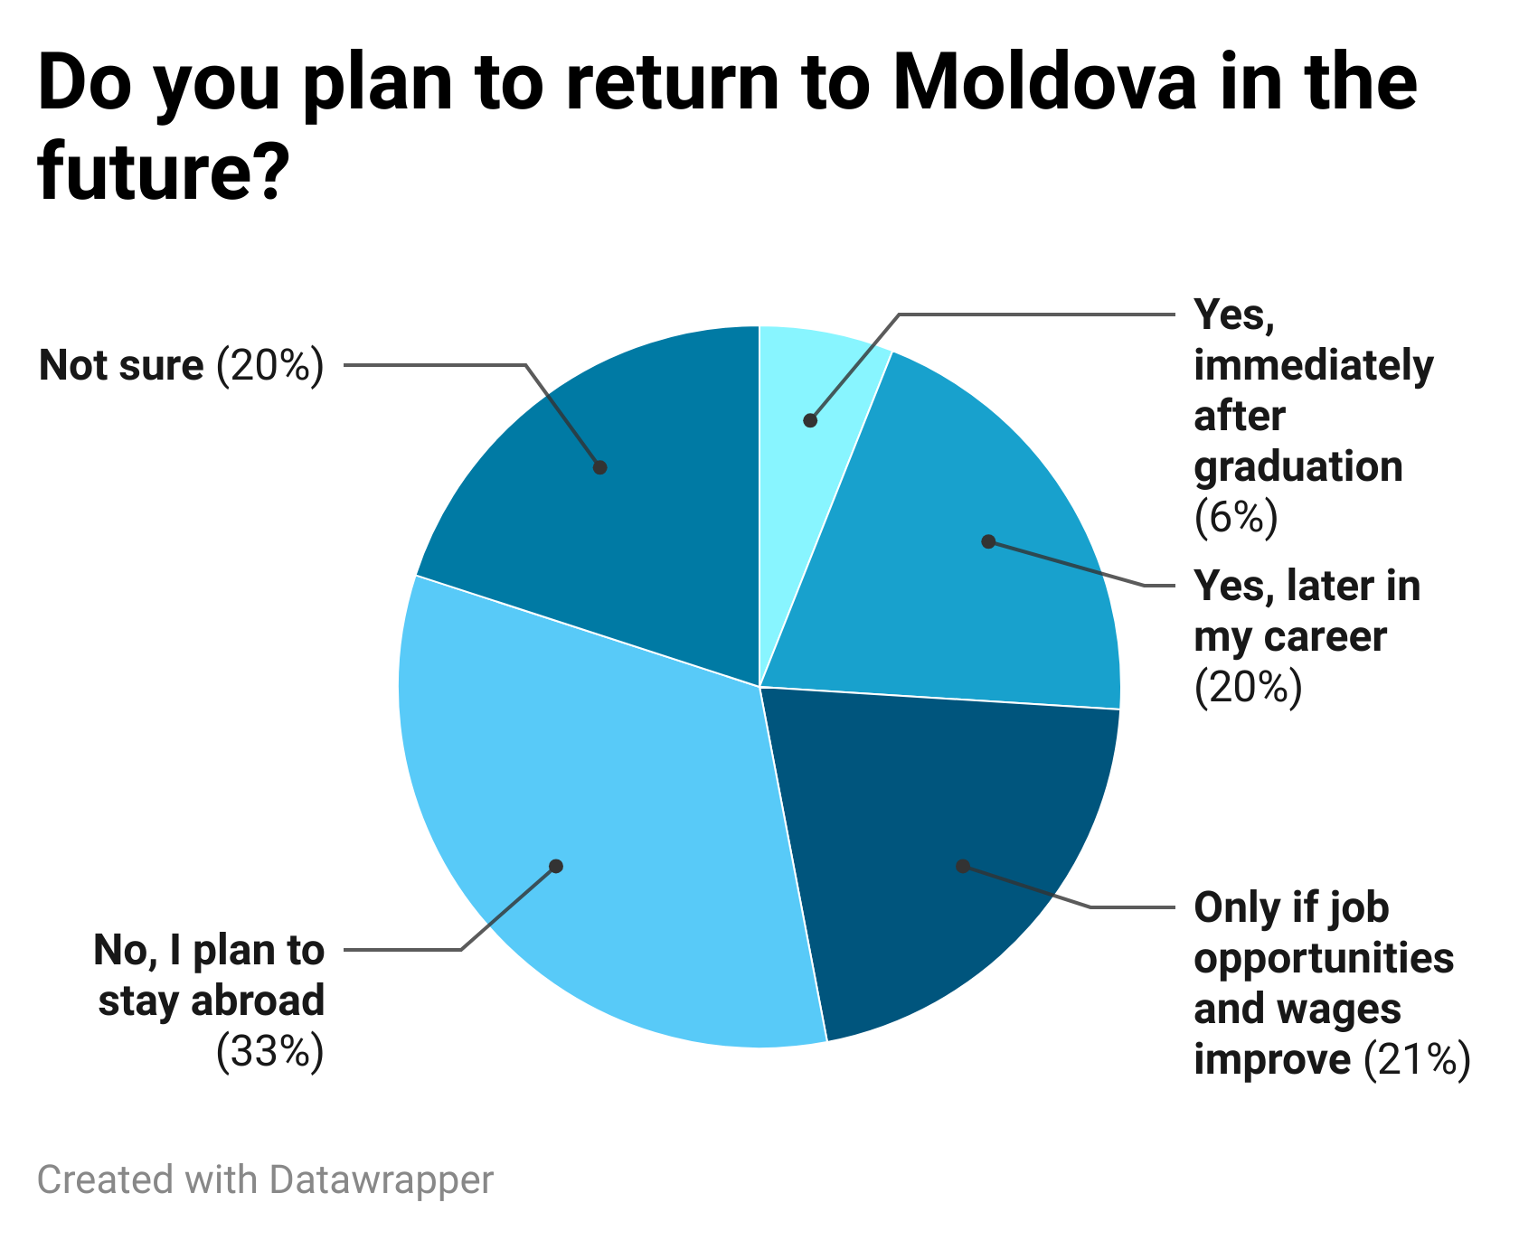
Return Plans
I know that in my home country I have the right and the duty to make positive changes. I feel my agency when I find something that can be improved.
Notes:
Both Ukrainian and Moldovan students are open to returning if wages rise and if institutions become more stable. Many Ukrainians say they would return if stability improves and if the labour market becomes more dynamic. Some return because of strong personal attachment and a desire to contribute.
Both countries must simultaneously strengthen the quality of education at home and maintain close ties with experts and graduates abroad

Slide 6
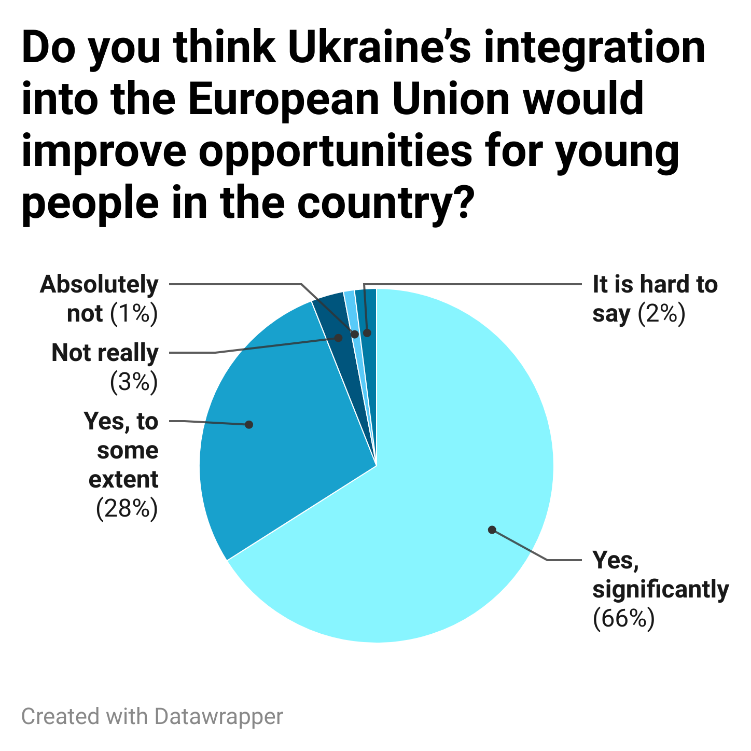

Perception of EU Integration
Over time, if we reach that standard of living in Moldova, I wouldn’t need to look for it elsewhere, because I would have it at home.
Notes:
EU membership is seen as a turning point that could dramatically expand opportunities and increase confidence in the country’s future.

Slide 7


Two-Pillar Strategy
Quality Education at Home
Modernise curricula to enhance analytical and critical-thinking competencies
Strengthen links between universities and employers (internships, joint projects)
Improve career services to support job readiness and labour-market integration
Diaspora Engagement
Diaspora networks connecting students abroad with universities and employers at home
Short-term exchanges: visiting fellowships, research collaborations, consultancy roles
Public and private-sector programmes supporting the reintegration of internationally trained young professionals

