Slide 1
A Gender Agenda or
From the Lab to the Field to Policy
Muriel Niederle
Stanford University, SIEPR and NBER

Slide 2
Vertical Gender Segregation
Gender differences in labor market outcomes persist despite significant female educational advances
Vertical segregation particularly striking with high-ranking positions primarily held by men
Corporate World
USA: Women hold in 2018
  S&P 1500 companies: top management positions: 10%
  S&P 1500 companies: board seats : 19%
  Fortune 500 CEO’s: 5%
EU: Women only hold in 2018:
  managerial positions: 36%
  board members: 27%
    Many countries implemented quotas
  senior executives: 17%

Slide 3
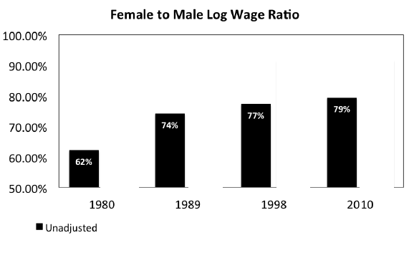
Earnings: Good news:
Overall Gap has decreased
(Blau and Kahn, 2016)

Slide 4
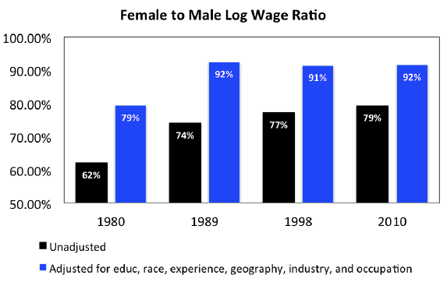
Earnings: Unclear news:
Unexplained Gap persists
(Blau and Kahn, 2016)

Slide 5
Horizontal Segregation: Education
Gender Differences in STEM education
Europe: When given a choice: Girls often opt for less math intensive study profiles (Austria, France, Netherlands…)
U.S. Schools: Girls take as many math classes as boys (Goldin et al, 2006) but underrepresented among high achieving math students (Ellison & Swanson, 2010).
College Level: Women in Science and Engineering (S&E) in US
  Women are less likely to receive a BA in S&E:
    29% of female BA are in S&E compared to 38% of males.
    Among equally gifted students girls are less likely to choose math heavy majors (Weinberger, 2005; for on schools see Favara, 2012).
  Percent of Women in S&E declines as degrees become more advanced
    BA: 50%, PhD: 41%, Top 50 PhD: 38%, Stanford: 32%

Slide 6
Horizontal Segregation: Education
Gender Differences in STEM education
Europe: When given a choice: Girls often opt for less math intensive study profiles (Austria, France, Netherlands…)
U.S. Schools: Girls take as many math classes as boys (Goldin et al, 2006) but underrepresented among high achieving math students (Ellison & Swanson, 2010).
College: Women in Science and Engineering (S&E) in US
  Women are less likely to receive a BA in S&E:
    29% of female BA are in S&E compared to 38% of males.
    Among equally gifted students, girls are less likely to choose math heavy majors (Weinberger, 2005; for schools see Favara, 2012).
  Percent of Women in S&E declines as degrees become more advanced
    BA: 50%, PhD: 41%, Top 50 PhD: 38%, Stanford: 32%

Slide 7
Explaining Vertical and Horizontal Gender Segregation
Standard Explanations for labor / education differences
Discrimination
Differences in abilities
Differences in preferences

Slide 8
Competitiveness
Competitiveness: new behavioral trait
  Design, Robustness
External Relevance of Competitiveness
  Can competitiveness predict education choices, gender differences?
  Competitiveness in a representative sample
Behavioral Market Design: Policy Implications
  Some institutional designs may reward competitiveness more than others
  Unintended consequences for the gender gap in education choices
  Reexamine effect of Quota-like Affirmative Actions
    Gender gap in competitiveness may be reduced in single sex tournaments, affecting the costs and benefits of implementing quotas
  Empirical Evidence of Trickle-Down Affirmative Action
    Case Study in France.

Slide 9
Competitiveness
Competitiveness: new behavioral trait
  Design, Robustness
External Relevance of Competitiveness
  Can competitiveness predict education choices, gender differences?
  Competitiveness in a representative sample
Behavioral Market Design: Policy Implications
  Some institutional designs may reward competitiveness more than others
  Unintended consequences for the gender gap in education choices
  Reexamine effect of Quota-like Affirmative Actions
    Gender gap in competitiveness may be reduced in single sex tournaments, affecting the costs and benefits of implementing quotas
  Empirical Evidence of Trickle-Down Affirmative Action
    Case Study in France

Slide 10
Gneezy, Uri, Muriel Niederle, Aldo Rustichini, “Performance in Competitive Environments: Gender Differences”, Quarterly Journal of Economics, 2003.
Niederle, Muriel, and Lise Vesterlund, “Do Women Shy away from Competition? Do Men Compete too Much?,” Quarterly Journal of Economics, August 2007, 1067-1101.
Niederle, Muriel and Alexandra H. Yestrumskas, “Gender Differences in Seeking Challenges: The Role of Institutions”, February 2008.
Niederle, Muriel, Carmit Segal, and Lise Vesterlund, “How Costly is Diversity? Affirmative Action in Light of Gender Differences in Competitiveness” Management Science, 2013.
Exley, Christine, Muriel Niederle, and Lise Vesterlund, “Knowing When to Ask: The Cost of Leaning In”, Journal of Political Economy, 2020.
Buser, Thomas, Muriel Niederle and Hessel Oosterbeek, “Gender, Competitiveness and Career Choices,” Quarterly Journal of Economics, August 2014, 129 (3): 1409-1447.
Buchmann Nina, Nicola, Fuchs-Schuendeln and Muriel Niederle, “The impact of Education Design on Gender Differences in Outcomes” (in progress)
De Sousa, Jose and Muriel Niederle “The Positive Effects of Affirmative Action: A Case Study in France” 2024
Buser, Thomas, Muriel Niederle and Hessel Oosterbeek, “Can Competitiveness Predict Education and Labor market outcomes?” Review of Economics and Statistics, forthcoming
Klinowski, David and Muriel Niederle, “Female empowerment and female competitiveness”, working paper.
Niederle, Muriel, “Gender” Handbook of Experimental Economics, second edition, Eds. John Kagel and Alvin E. Roth, 2016.
Niederle, Muriel and Lise Vesterlund, “Gender and Competition”, Annual Review in Economics, 2011, 601–30.

Slide 11
Establishing Gender Differences in Competitiveness
Psychology:
  Boys spend more time at competitive games than girls
  Men describe themselves to be more competitive.
Are there gender differences in a leveled playing field where choices have monetary consequences?
Advantages of experiments:
Control or use self selection issues.
Measure performance.
No issue of actual or believed discrimination.
No issue of “career concerns” or “time commitment”.
Easy to replicate and check for robustness
  Coffman and Niederle (2015)
  Coffman, Niederle and Wilson (2016)

Slide 12
Establishing Gender Differences in Competitiveness
Psychology:
  Boys spend more time at competitive games than girls
  Men describe themselves to be more competitive.
Are there gender differences in a leveled playing field where choices have monetary consequences?
Advantages of experiments:
Control or use self selection issues.
Measure performance precisely.
No issue of actual or believed discrimination.
No issue of “career concerns” or “time commitment”.
Easy to replicate and check for robustness
  Coffman and Niederle (2015)
  Coffman, Niederle and Wilson (2016)

Slide 13
“Do Women Shy Away From Competition? Do Men Compete Too Much?”
(Niederle and Vesterlund, 2007)
80 college students from U. of Pittsburgh and CMU
Task: Add up 5 two-digit numbers for 5 mn.
Task 1 – Piece Rate:
50 cents per correctly solved problem.
Task 2 – Tournament:
Groups of 2 men and 2 women (gender not mentioned)
The participant who solves the most (correct) problems in the group receives $ 2 per correct problem.
Other participants receive no payment.
Participants receive no feedback.
21 | 35 | 28 | 79 | 83

Slide 14
Task 3 Choice
Choose compensation scheme for the next 5-minute task:
Piece Rate:
  50 cents for each correctly solved problem
Tournament:
  Performance is compared to task-2 tournament performance of the other participants.
  If the participant has the highest performance, she or he receives $2 for each correct answer, otherwise no payment.
Individual decision making task: Choice of a participant does not impose externalities on any other participant.

Slide 15
Predicted Choices
In Task 3: participants decide whether to perform under a piece rate or under a tournament.
Given task 2 tournament performance:
30% of women and 30% of men could gain from entering the tournament.
Who enters?
35% of Women and 73% of Men

Slide 16
Predicted Choices
In Task 3: participants decide whether to perform under a piece rate or under a tournament.
Given task 2 tournament performance:
30% of women and 30% of men could gain from entering the tournament.
Who enters?
35% of Women and 73% of Men

Slide 17
Predicted Choices
In Task 3: participants decide whether to perform under a piece rate or under a tournament.
Given task 2 tournament performance:
30% of women and 30% of men could gain from entering the tournament.
Who enters?
35% of Women and 73% of Men

Slide 18
Does performance predict entry?
Proportion of participants who enter the tournament for each performance quartile
Performance does not predict entry for Women, weakly for Men
Significant gender difference in tournament entry

Slide 19
What can Account for Gender Differences in Competitiveness?
Gender Differences in Confidence:
Tournament decision is driven by relative performance, participants only know absolute performance.
Is the decision driven by participants’ beliefs about their relative performance?
Measure beliefs on relative performance in round 2 Tourn.
Gender Differences in Risk Aversion:
The tournament is not only more competitive but also more risky.
Can gender difference in risk aversion account for the gender gap in competitiveness?
Choice without performance, only risk & beliefs matter

Slide 20
What can Account for Gender Differences in Competitiveness?
Gender Differences in Confidence:
Tournament decision is driven by relative performance, participants only know absolute performance.
Is the decision driven by participants’ beliefs about their relative performance?
Measure beliefs on relative performance in round 2 Tourn.
Gender Differences in Risk Aversion:
The tournament is not only more competitive but also more risky.
Can gender difference in risk aversion account for the gender gap in competitiveness?
Choice without performance, only risk & beliefs matter

Slide 21
Why do Women Shy away from Competition?
Women decide not to enter tournaments because of
Gender differences in Competitiveness
Lack of confidence in one’s ability (accounts for about 1/3 of the total effect)
Only minor effect: Aversion to feedback about tournament performance and Risk aversion.

Slide 22
Robustness of the initial lab finding
Niederle and Vesterlund (2011)
Niederle (2016)
Lots of evidence: gender gap in tournament entry when controlling for performance, beliefs and risk aversion.
Replication:

Slide 23
Replications of NV 2007 (up to 2015)
Papers with minor modifications: similar results: 13 (+ 3)
  Cason, Masters, Sheremeta (2010), Healy and Pate (2011), Balafoutas and Sutter (2012), Balafoutas, Kerschbamer and Sutter (2012) Dargnies (2012), Kamas and Preston (2012) Mueller and Schwieren (2012) Price (2012), Cadsby, Servata and Song (2013), Niederle, Segal, Vesterlund (2013), Almas et al. (2014), Buser, Niederle and Osterbeek (2014), Dreber, von Essen and Ranehill (2014), Lee, Niederle and Kang (2014), Wozniak, Harbaugh and Mayr (2014) Sutter and Glaetzle-Ruetzler (2015).
  Exceptions:
    Price (2010): no gender difference in preference for competition, or beliefs in relative competitive performance.
Different designs, also have circumstances where Women enter Tournaments less than Men (12)
  Gneezy, Leonard and List (2009), Kamas & Preston (2009), Vandegrift and Yavas (2009), Ertac and Szentes (2010), Dohmen and Falk (2011), Booth and Nolen (2012), Cardenas et al (2012), Kamas and Preston (2012), Mayr et al (2012), Shurchkov (2012), Gupta, Poulsen and Villeval (2013), Andersen et al (2013).

Slide 24
Robustness of the initial lab finding
Niederle and Vesterlund (2011)
Niederle (2016)
Lots of evidence: gender gap in tournament entry when controlling for performance, beliefs and risk aversion.
Replication:
√

Slide 25
Gender Differences in Competitiveness:
A WEIRD phenomenon?
Programme for International Student Assessment (PISA)
Largest international standardized assessment of math, reading, and science attainment
Organized by the OECD
Latest wave: 2018
79 countries, each with a representative sample of 15-year-old students (15 3mths to 16 2mths), grade 7 or higher.
N > 5000 per country, N TOTAL about 600.000 representing about. 30 Million students

Slide 26
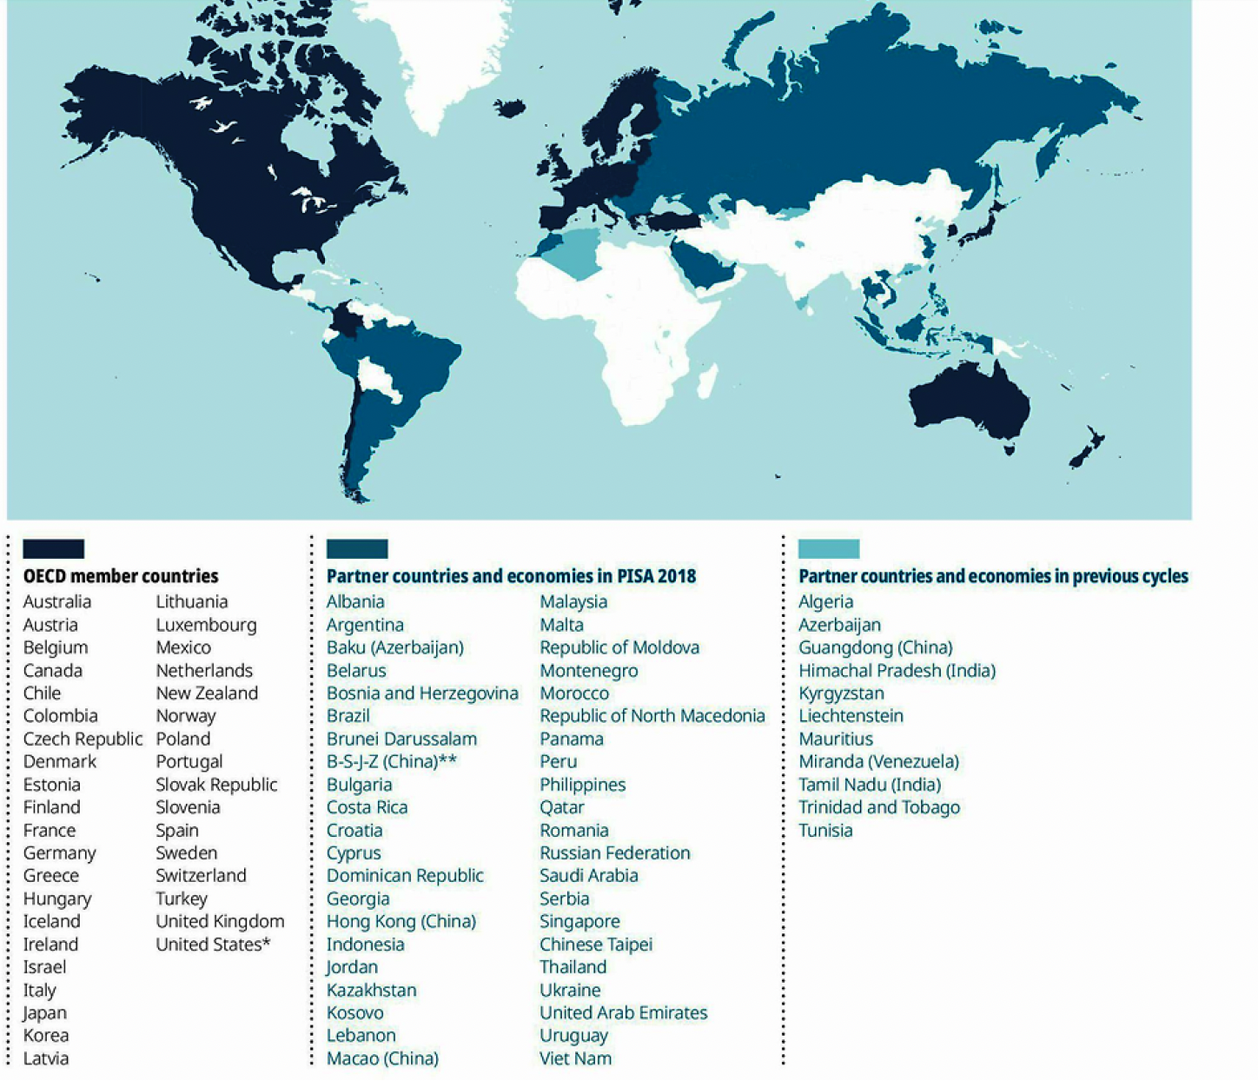
PISA 2018 coverage

Slide 27
Competitiveness: Pisa
After completing the tests, students complete a survey
The survey includes three competitiveness questions (likert 1-4)
“I enjoy working in situations involving competition with others”
  Somewhat akin to tournament entry (NV 2007)
“It is important for me to perform better than other people on a task”
“I try harder when I’m in competition with others”
  Somewhat akin to performance in a tournament (GNR 2003)

Slide 28
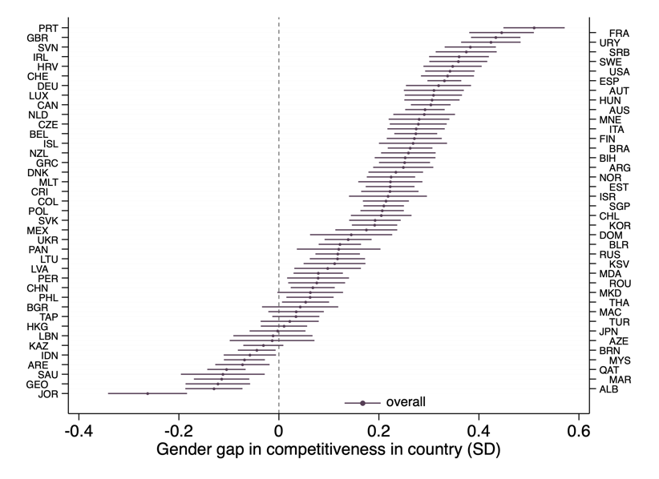
Gender Gap in Competitiveness
Overall: Boys much more competitive than girls
82% of countries: girls less competitive than boys
74% of countries: boys significantly more competitive than girls
  In only 10 countries, 13%, are girls significantly more competitive than boys.

Slide 29
Competitiveness & Gender Equity Paradox
Which countries have a large gender gap in Competitiveness?
  Order countries by gender equality
Do we observe the gender equity paradox:
  The more equal the country, the bigger the gender gap?

Slide 30
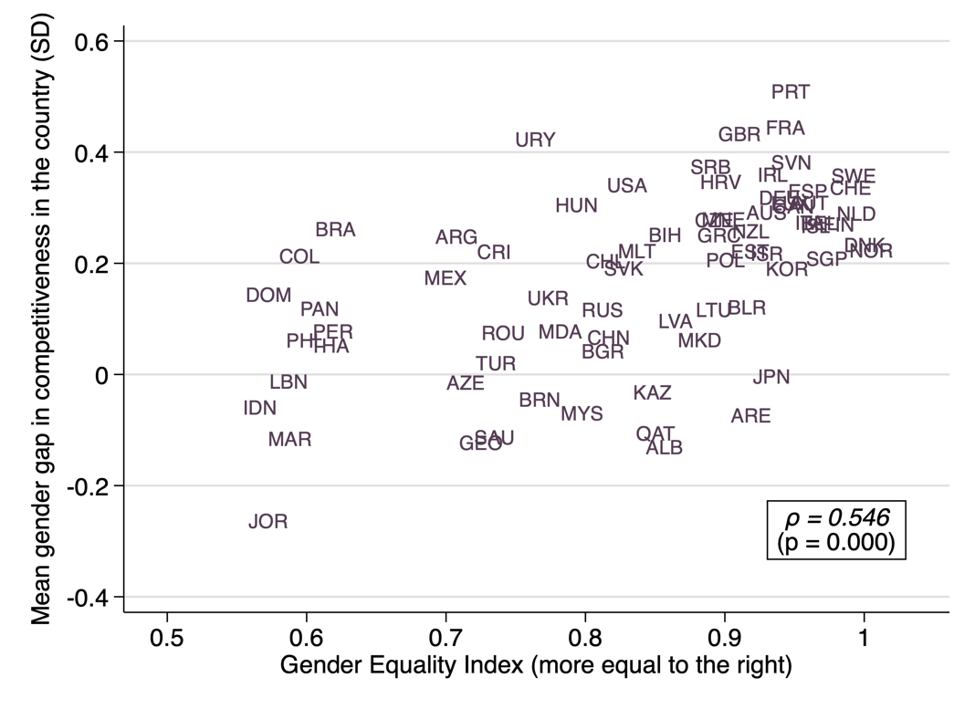

Gender Eq. Ind. & Gender Gap in Competitiveness
Linear correlation between the GG in Comp. and GEI is 0.546 (p<0.001).
Estimate random-effects meta-regression
$y_{c}=α{GEI}_{c}+v_{c}+ε_{c}$ (2)
  $y_{c}:$outcome of interest: ${\hat{β}}_{c}$
  $v_{c}\sim 𝒩(0,τ^{2})$ random effect capturing the country-specific deviation from the mean of the distribution of the outcome,
  $ε_{c}\sim 𝒩(0,{σ_{c}}^{2})$ is the within-country sampling error.
$\hat{α}$ = 0.689 (p<0.001)
More gender egalitarian societies exhibit larger gender gaps in competitiveness.

Slide 31
Gender Eq. Ind. & Gender Gap in Competitiveness
Linear correlation between the GG in Comp. and GEI is 0.546 (p<0.001).
Estimate random-effects meta-regression
$y_{c}=α{GEI}_{c}+v_{c}+ε_{c}$ (2)
  $y_{c}:$outcome of interest: ${\hat{β}}_{c}$
  $v_{c}\sim 𝒩(0,τ^{2})$ random effect capturing the country-specific deviation from the mean of the distribution of the outcome,
  $ε_{c}\sim 𝒩(0,{σ_{c}}^{2})$ is the within-country sampling error.
$\hat{α}$ = 0.689 (p<0.001)
More gender egalitarian societies exhibit larger gender gaps in competitiveness.

Slide 32
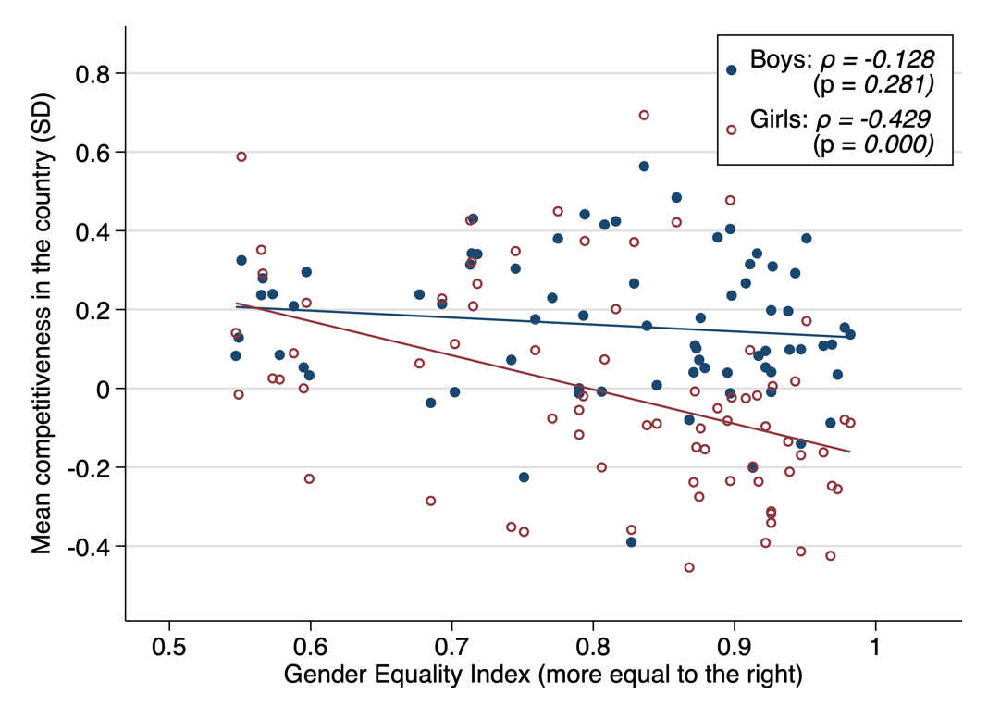
Which Gender drives Equity Paradox

Slide 33
Which Gender drives Equity Paradox

Slide 34
Gender Differences in Competitiveness
Robust phenomenon
Especially in Rich / Gender Equal / Individualistic Societies

Slide 35
Competitiveness
Competitiveness: new behavioral trait
  Design, Robustness
External Relevance of Competitiveness
  Can competitiveness predict education choices, gender differences?
  Competitiveness in a representative sample
Behavioral Market Design: Policy Implications
  Some institutional designs may reward competitiveness more than others
  Unintended consequences for the gender gap in education choices
  Reexamine effect of Quota-like Affirmative Actions
    Gender gap in competitiveness may be reduced in single sex tournaments, affecting the costs and benefits of implementing quotas
  Empirical Evidence of Trickle-Down Affirmative Action
    Case Study in France

Slide 36
Is Competitiveness Important?
Does competitiveness have external relevance?
Can competitiveness help account for vertical and horizontal job segregation?
Correlate laboratory measure with behavior outside of the laboratory:
Can competitiveness account for (gender differences in) choices of STEM/math?
Can competitiveness predict education and labor market outcomes in a representative sample?
  Role in accounting for gender differences?

Slide 37
The Environment: Dutch Schools System
Dutch pre-university track: 20% of kids.
After 3 years: (grade 9) kids choose one of 4 study profiles for the next 3 years.
  Nature and Technology: NT: MATH
  Nature and Health: NH: BIOLOGY
  Economics and Society: ES: ECONOMICS
  Culture and Society: CS: LITERATURE
The above is also the order of prestigiousness, math and science intensity.
Can Competitiveness predict streaming choice?

Slide 38
Gender, Competitiveness and Career Choices
Buser, Niederle and Oosterbeek, 2014
4 schools in Amsterdam; All 9th graders,
Experiments before May, streaming profile choice at the End of June
Competition Measure a la NV 2007:
Piece Rate, Tournament, Choice (Compete against 3 classmates)
Confidence: Guess Round 2 Tournament rank: € 1 if correct
Risk Assessment: Lottery & Survey
  € 2 for sure, of 50/50 gamble of: 3 or 1.5; 4 or 1; 5 or 0.5; 6 or 0.
  “How do you see yourself: Are you generally a person who is fully prepared to take risks?” 0 to 10
Subjective Mathematical ability: Survey: Rank and “how hard is math”?
What profile do you plan to select in June?
Which profile do the best students select?
Administrative data received in the summer:
Grades of Students
Study profiles of students.

Slide 39
Descriptive Statistics of Boys and Girls
 | Boys | Girls | Diff. p-value
GPA (1-10) | 6.76 | 6.97 | 0.01
Math grades (1-10) | 6.67 | 6.59 | 0.64
Math relative (0-1) | 0.38 | 0.37 | 0.88
Math difficulty (0-10) | 3.41 | 4.18 | 0.01
Math quartile (1-4) | 1.97 | 2.25 | 0.00
Profile Choices
Nature & Technology (NT) | 0.40 | 0.17
Nature & Health (NH) | 0.12 | 0.36
Economics & Society (ES) | 0.39 | 0.32
Culture & Society (CS) | 0.08 | 0.15 | 0.00
Number of Observations | 177 | 185
Boys and Girls: academically similar, different choices

Slide 40
Descriptive Statistics of Boys and Girls
 | Boys | Girls | Diff. p-value
GPA (1-10) | 6.76 | 6.97 | 0.01
Math grades (1-10) | 6.67 | 6.59 | 0.64
Math relative (0-1) | 0.38 | 0.37 | 0.88
Math difficulty (0-10) | 3.41 | 4.18 | 0.01
Math quartile (1-4) | 1.97 | 2.25 | 0.00
Profile Choices
Nature & Technology (NT) | 0.40 | 0.17
Nature & Health (NH) | 0.12 | 0.36
Economics & Society (ES) | 0.39 | 0.32
Culture & Society (CS) | 0.08 | 0.15 | 0.00
Number of Observations | 177 | 185
Boys and Girls: academically similar, different choices

Slide 41
Descriptive Statistics of Boys and Girls
 | Boys | Girls | Diff. p-value
GPA (1-10) | 6.76 | 6.97 | 0.01
Math grades (1-10) | 6.67 | 6.59 | 0.64
Math relative (0-1) | 0.38 | 0.37 | 0.88
Math difficulty (0-10) | 3.41 | 4.18 | 0.01
Math quartile (1-4) | 1.97 | 2.25 | 0.00
Profile Choices
Math (NT) | 0.40 | 0.17
Biology (NH) | 0.12 | 0.36
Economics (ES) | 0.39 | 0.32
Literature (CS) | 0.08 | 0.15 | 0.00
Number of Observations | 177 | 185
Boys and Girls: academically similar, different choices

Slide 42
Gender Differences
Academic Track Choice
Using ordered probit regressions:
Gender gap in profile choices (15 to 22%)
To overcome “female” effect, it requires more than a standard deviation increase in GPA

Slide 43
Gender Differences
Competitiveness
49% of boys and 23% of girls enter the tournament
One third is driven by gender differences in beliefs.
Another 20% by gender differences in risk attitudes.
Replicate gender gap in competitiveness from lab

Slide 44
External Relevance of Competitiveness
Competitiveness significantly correlates with study profile choices
  The coefficient is up to 130% of the size of gender coefficient
Can Gender Differences in Competitiveness help account for gender differences in educational choices?
  Accounts for 20% of gender gap in track choice
  16% when controlling for confidence & risk

Slide 45
Competitiveness in the Field
Competitiveness:
An important factor in educational choices
Can help account for the gender gap in choices
Bridge the gap between laboratory experiments and the field:
Use outcome measure of a lab experiment to predict outcomes outside of the laboratory.
Establish external relevance of competitiveness.

Slide 46
External Relevance of Competitiveness
Educational career choices at pre-academic level
Buser, Niederle and Oosterbeek 2014; Zhang 2014; Almas et al. 2016; Buser, Peter and Wolter 2017a, Buser, Peter and Wolter 2017b
Salaries and industry choice
Reuben, Sapienza and Zingales 2015; Buser, Geijtenbeek and Plug 2015; Flory, Leibbrandt and List 2015; Samek 2016 and: investment choices of entrepreneurs: Oppedal Berge et al 2015, Reuben, Wiswall and Zafar 2017;
Field Evidence
Ors, Palomino and Peyrache (2013), Morin (2015), Flory, Leibbrandt, and List (2015)

Slide 47
Competitiveness in a representative sample
Buser, Niederle and Oosterbeek, forthcoming
  Previous studies: mostly high end, small sample.
  What is the role of competitiveness in a representative sample?
Dutch LISS panel
Ongoing survey panel: representative of the Dutch population with Yearly “Core” Questionnaires
Detailed measures labor market outcomes including
Income,
Occupational level
Education level
College major …

Slide 48
Competitiveness in a representative sample
Buser, Niederle and Oosterbeek, WP 2020
  Previous studies: mostly high end, small sample.
  What is the role of competitiveness in a representative sample?
Dutch LISS panel
Ongoing survey panel: representative of the Dutch population with Yearly “Core” Questionnaires
Detailed measures labor market outcomes including
Income,
Occupational level
Education level
College major …

Slide 49
Competitiveness in a representative sample
The Niederle-Vesterlund experimental measure of willingness to compete strongly predicts career outcomes
  In a representative sample
  Conditional on range of other traits (Big 5, Confidence, Risk)
  Outperforms most other traits
We elicit & validate survey measure of competitiveness
  “How competitive do you consider yourself to be?” (0-10)
  Predicts incentivized choice
  Predicts same outcomes in same sample
Competitiveness is a relevant individual trait which is separate from risk preferences
Gender results
  Competitiveness alone explains 4-9% of gender differences in outcomes
  Competitiveness mostly outperforms other traits

Slide 50
Competitiveness in a representative sample
The Niederle-Vesterlund experimental measure of willingness to compete strongly predicts career outcomes
  In a representative sample
  Conditional on range of other traits (Big 5, Confidence, Risk)
  Outperforms most other traits
We elicit & validate survey measure of competitiveness
  “How competitive do you consider yourself to be?” (0-10)
  Predicts incentivized choice
  Predicts same outcomes in same sample
Competitiveness is a relevant individual trait which is separate from risk preferences
Gender results
  Competitiveness alone explains 4-9% of gender differences in outcomes
  Competitiveness mostly outperforms other traits

Slide 51
Competitiveness
Competitiveness: new behavioral trait
  Design, Robustness
Economic/External Relevance of Competitiveness
  Can competitiveness predict education choices, gender differences? YES
  Competitiveness in a representative sample IMPORTANT
Behavioral Market Design: Policy Implications
  Some institutional designs may reward competitiveness more than others
  Unintended consequences for the gender gap in education choices
  Reexamine effect of Quota-like Affirmative Actions
    Gender gap in competitiveness may be reduced in single sex tournaments, affecting the costs and benefits of implementing quotas
  Empirical Evidence of Positive Effect of Affirmative Action
    Case study in France.

Slide 52
Policy Implication:
Change the Women?
“Changing the Women” (Lean in)
Can we manipulate/affect competitiveness and would it change labor market or educational choices?
Three Problems
  How?
  What else does Competitiveness affect?
  Implications for Women.

Slide 53
Gender Views: Mission Impossible
Dean, Exley, Klinowski, Niederle and Sarson, 2024
In general, do you think people praise a woman who is competitive? In general:
  Yes, people praise a woman who is competitive
  No, I don't think so
In general, do you think people criticize a woman who is competitive? In general:
  Yes, people criticize a woman who is competitive
  No, I don't think so

Slide 54
Praise Women/Man who is/is not Competitive
Praise: Competitive:
Men: 93% and Women: 60%
Women receive less praise for being competitive.
Praise: Not Competitive
Men: 13% and Women: 42%
Men: Restricted Path: Need to be Competitive
Women: Mission impossible: No matter what they do, never reach male levels of Praise…

Slide 55
Praise Women/Man who is/is not Competitive
Praise: Competitive:
Men: 93% and Women: 60%
Women receive less praise for being competitive.
Praise: Not Competitive
Men: 13% and Women: 42%
Men: Restricted Path: Need to be Competitive
Women: Mission impossible: No matter what they do, never reach male levels of Praise…

Slide 56
Praise Women/Man who is/is not Competitive
Praise: Competitive:
Men: 93% and Women: 60%
Women receive less praise for being competitive (harder mission…)
Praise: Not Competitive
Men: 13% and Women: 42%
Men: Restricted Path: Need to be Competitive
Women: Mission impossible: No matter what they do, never reach male levels of Praise…

Slide 57
Praise Women/Man who is/is not Competitive
Praise: Competitive:
Men: 93% and Women: 60%
Women receive less praise for being competitive (harder mission…)
Praise: Not Competitive
Men: 13% and Women: 42%
Men: Restricted Path: Need to be Competitive
Women: Mission impossible: No matter what they do, never reach male levels of Praise…

Slide 58
Praise Women/Man who is/is not Competitive
Praise: Competitive:
Men: 93% and Women: 60%
Women receive less praise for being competitive (harder mission…)
Praise: Not Competitive
Men: 13% and Women: 42%
Men: Restricted Path: Need to be Competitive
Women: Mission impossible:
  No matter what they do, never reach male levels of praise…

Slide 59
Criticize and Praise for being competitive
Men: Restricted Path:
  Praised only when Competitive (93%)
  not criticized when competitive (20%), but criticized otherwise (62%)
Women: Mission impossible:
  Praised the most for being competitive (63%) – less than men
  Criticized the most for being competitive (!) (63%) -- else (23%)
  Damned if they do, damned if they don’t…

Slide 60
Policy Implication:
Change the Women?
Leaning in can Backfire
Society Views: Mission Impossible
  Women get also the most criticism for being competitive
Exley, Niederle and Vesterlund, 2020: Sometimes women made the correct selection, paternalism reduces their material payoffs

Slide 61
Change Women Institutions!
Behavioral Market Design
Institutions differ in how they reward competitiveness (Even when want to select on ability)
(Unintended) consequences on women
Different School Systems
Netherland School system: Large gender gap in math education
  Once-and-for-all choice: very inflexible
US School system: No gender gap in Math Education
  Flexible
Experiments: Gender gap in “unflexible” choice disappears when choices are flexible (Niederle & Yestrumskas)

Slide 62
Change Women Institutions!
Behavioral Market Design
Institutions differ in how they reward competitiveness (Even when want to select on ability)
(Unintended) consequences on women
Different School Systems
Dutch School system: Large gender gap in math education
  Once-and-for-all choice: very inflexible
US School system: No gender gap in Math Education
  Flexible
Experiments: Gender gap in “unflexible” choice disappears when choices are flexible (Niederle & Yestrumskas)

Slide 63
Policy Implication
What are the effects of rigid school choices?
Should we change school systems in Europe?
Buchmann, Fuchs-Schuendeln, Niederle, WiP:
What is the effect of introducing non-flexible choices?
Use staggered introduction of obligatory and elective courses “Leistungskurse” starting in 1972 in Germany

Slide 64
Policy Implication:
Preliminary Results
Rigid choices are correlated with
fewer women graduating in male and high income majors
women performing worse in the labor market
  Men: top 25th quartile improves outcomes, bottom 25th quartile loses.
Rigid choices: Large impact on the gender gap.
Changing School system: LARGE policy change…

Slide 65
Affirmative Action
Niederle Vesterlund: NV (2007): Tournament entry:
Women: suboptimal
No issue of discrimination
Niederle, Segal and Vesterlund, 2013
NV-style Tournament Entry with a Quota Affirmative Action (AA) when selecting winners
AA affects the decision to enter a tournament: more high performing women enter
Implies that Affirmative Action is less costly than predicted
Avoid doing AA secretly

Slide 66
From the Lab to the Field
Niederle, Segal Vesterlund: 2013
Laboratory
  Also a real world, just a different one: real money involved, real people…
No investment into skills
  This could magnify or reduce positive effects of announced affirmative action
No discrimination
Question: Would an affirmative action quota in the field deliver benefits mirroring those in the lab?

Slide 67
Effects of Affirmative Action Quota
Ideally, study effects on three levels
Direct Effect: Women selected by the quota
  Improve their performance?
Trickle-down and Spillover effects
  Are there now more women in the pool who are eligible for the quota?
  Are there now more high performing women?
Negative Externalities
  What are the costs on men?

Slide 68
Trickle-Down Affirmative Action
Can we find an environment:
Good measure of “ability” or performance
Assess the whole pool not just those directly affected
Sufficient time has passed for AA to have an impact on education and development.
Chess
Elo rating: predictive of performance,
Pool of chess players
(de Sousa and Niederle, in progress)

Slide 69
Trickle-Down Affirmative Action
Can we find an environment:
Good measure of “ability” or performance
Assess the whole pool not just those directly affected
Sufficient time has passed for AA to have an impact on education and development.
Chess
Elo rating: predictive of performance,
Pool of registered chess players
De Sousa and Niederle, in progress

Slide 70
Trickle-Down Affirmative Action
Can we find an environment:
Good measure of “ability” or performance
Assess the whole pool not just those directly affected
Sufficient time has passed for AA to have an impact on education and development.
Chess
Elo rating: predictive of performance,
Pool: registered chess players
De Sousa and Niederle, 2024

Slide 71
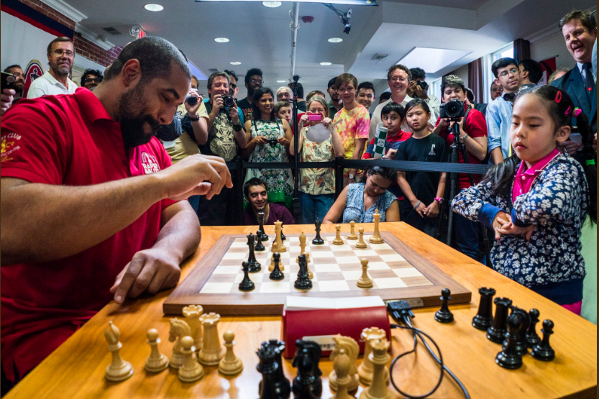
John Urshel vs. Rachael Li at the 2017 Ultimate Moves Match.
``This picture emphasizes that skill rather than age, size or gender is what counts in chess.’’
Former NFL player (Baltimore Ravens) and mathematician (MIT) John Urschel plays against seven-year-old Rachael Li in 2017 Ultimate Moves Match at St. Louis Chess Club.
Urschel, a US Chess-rated class B player (1723) was defeated by Li, who in January 2019, with a rating of 2079, is the top-rated eight-year-old player in the United States -girl or boy.'‘August 19, 2017 Photograph in the Collection of the World of Chess Hall of Fame by Lennart Ootes.

Slide 72
Trickle-Down Affirmative Action
Chess has a female “problem”
Female representation: April 2024: 10% of intl players
  2.3% of Grandmasters
  Best female chess player is # 115
  6 women in the top 500, 18 in top 1000
  Judit Polgar: Only woman to qualify for a World Championship tournament and enter the top 10

Slide 73
Attitudes towards female chess players
Kasparov about Judit Polgar “She has fantastic chess talent, but she is, after all, a woman. It all comes down to the imperfections of the feminine psyche. No woman can sustain a prolonged battle.”
“My sister Susan -- she was 16 or 17 -- said that she never won against a healthy man. After the game, there was always an excuse: 'I had a headache. I had a stomachache.' There is always something” Judit Polgar, 2001.

Slide 74
Attitudes in times of Queen’s Gambit
UK’s greatest player, Grandmaster Nigel Short (April 20, 2015)
“...Men are ‘hardwired’ to be better at the game than women.” He said “we should ‘gracefully accept it as a fact’ that men posses different skills to women, that make them better able to play chess at a high level’.”
Carlsen about attitudes towards women (Nov 21, 2020):
“This is a problem that’s been around in chess for a long time. Chess societies have not been very kind to women and girls over the years. Certainly there needs to be a bit of a change in culture.

Slide 75
Chess in France
Chess players: individual tournaments, and teams for clubs.
Club competitions: Play against each other once a year
  8 players of a club compete against 8 of another.
  Basically: Best plays against best etc…
In 1990: Introduced AA in division 1.
  Every club had to bring 9 players and at least one had to be a (French) female player.
in: division 2 in 1991, and division 3 in 1992.

Slide 76
Chess in France
Chess players: individual tournaments, club competitions.
Club Championship: Clubs play against each other once a year
  8 players of a club compete against 8 of another.
  Basically: Best plays against best etc…
In 1990: Introduced AA in division 1.
  Every club had to bring 9 players and at least one had to be a (French) female player.
division 2 in 1991, and division 3 in 1992.

Slide 77
Chess in France
Chess players: individual tournaments, club competitions
Club Championship: Clubs play against each other once a year
  8 players of a club compete against 8 of another.
  Basically: Best plays against best etc…
In 1990: Introduced AA in division 1.
  Every club had to bring 9 players and at least one had to be a (French) female player.
Division 2 in 1991, and division 3 in 1992.

Slide 78
Chess in France
Chess players: individual tournaments, club competitions
Club Championship: Clubs play against each other once a year
  8 players of a club compete against 8 of another.
  Basically: Best plays against best etc…
In 1990: Introduced AA in division 1.
  Every club had to bring 9 players and at least one had to be a (French) female player.
Division 2 in 1991, and division 3 in 1992.

Slide 79
Effects of Affirmative Action Quota
Direct Effect: Women selected by the quota
  Improve their performance – Elo rating?
Are the effects due to the quota?
Trickle-down and spillover effects
  More and better female chess players in France?
Are the effects due to the quota?
Are there negative externalities on men?
  Costs on French male chess players?

Slide 80
Effects of Affirmative Action Quota
Direct Effect: Women selected by the quota
  Improve their performance – Elo rating?
Are the effects due to the quota?
Trickle-down and spillover effects
  More and better female chess players in France?
Are the effects due to the quota?
Are there negative externalities on men?
  Costs on French male chess players?

Slide 81
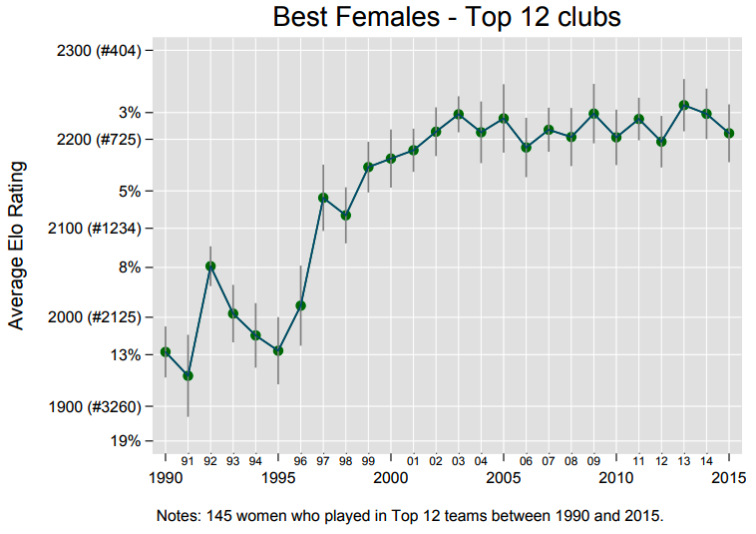
Best Woman – Top 12 Clubs

Slide 82
Best Woman – Top 12 Clubs

Slide 83
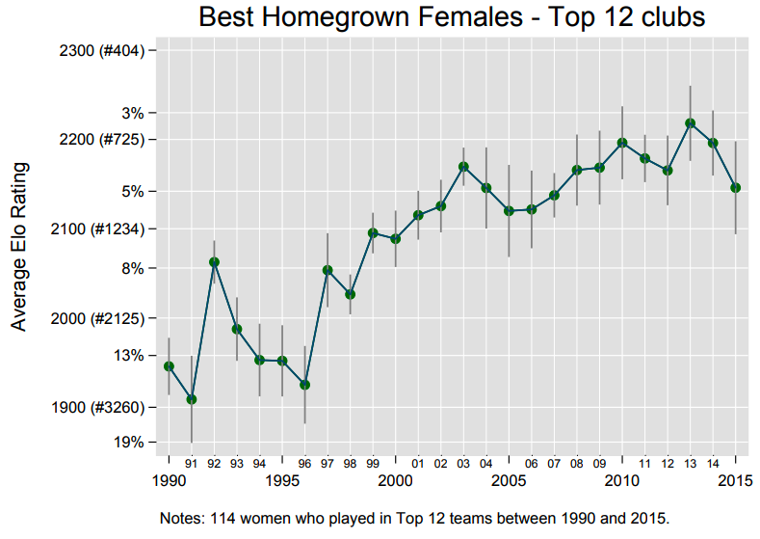
Best Homegrown Woman – Top 12 Clubs

Slide 84
Effects of Affirmative Action Quota
Direct Effect: Women selected by the quota
  Improve their performance – Elo rating? YES
Are the effects due to the quota? YES
Trickle-down and spillover effects
  More & better female chess players?
Are the effects due to the quota?
Are there negative externalities on men?
  Costs on French male chess players?

Slide 85
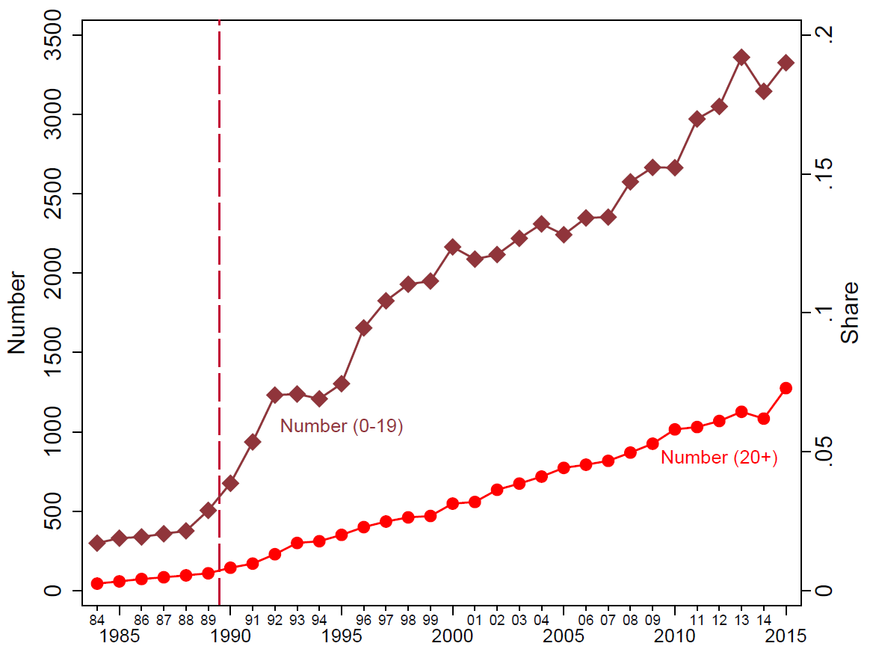
Number of female players

Slide 86
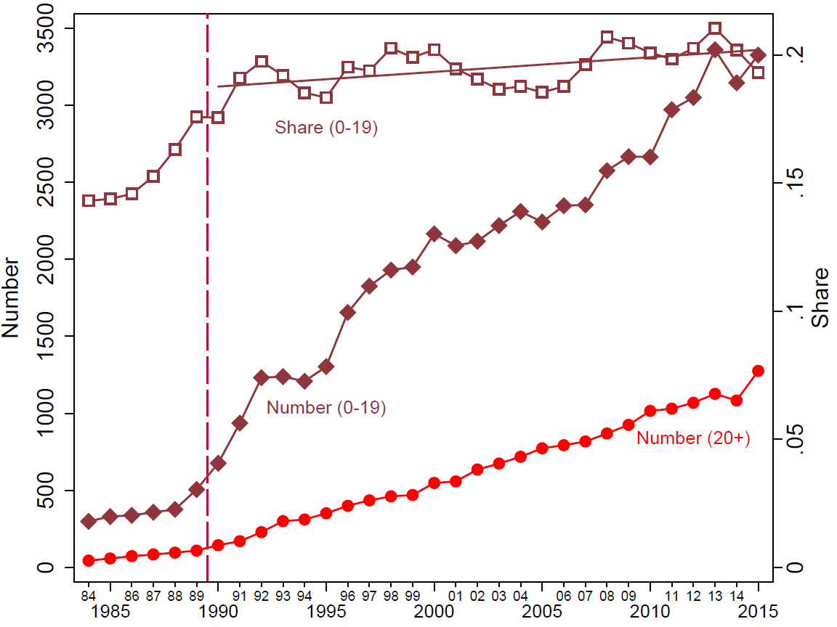
Number and Share of female players

Slide 87
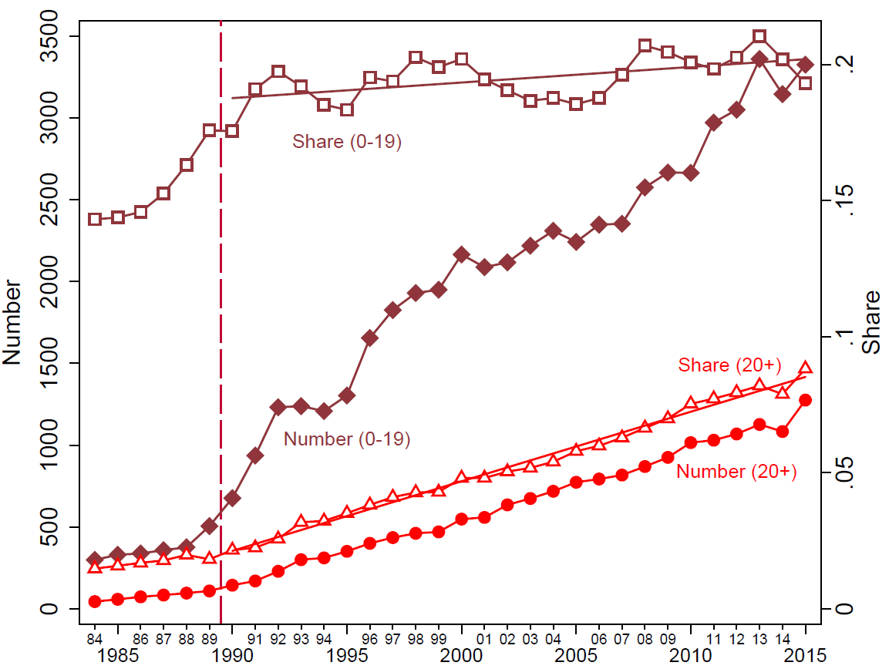
Number and Share of female players

Slide 88
Effects of Affirmative Action Quota
Direct Effect: Women selected by the quota
  Improve their performance – Elo rating? YES
Are the effects due to the quota? YES
Trickle-down and spillover effects
  More & better female chess players? YES
Are the effects due to the quota?
Are there negative externalities on men?
  Costs on French male chess players?

Slide 89
Did the Quota cause those effects?
Compare France to EU-15:
What fraction of elite EU-15 female chess players is French?
  If global effects drive French phenomenon:
  Share of French in EU-15 constant
  If AA quota drives French phenomenon:
  Share of French in EU-15 increasing

Slide 90
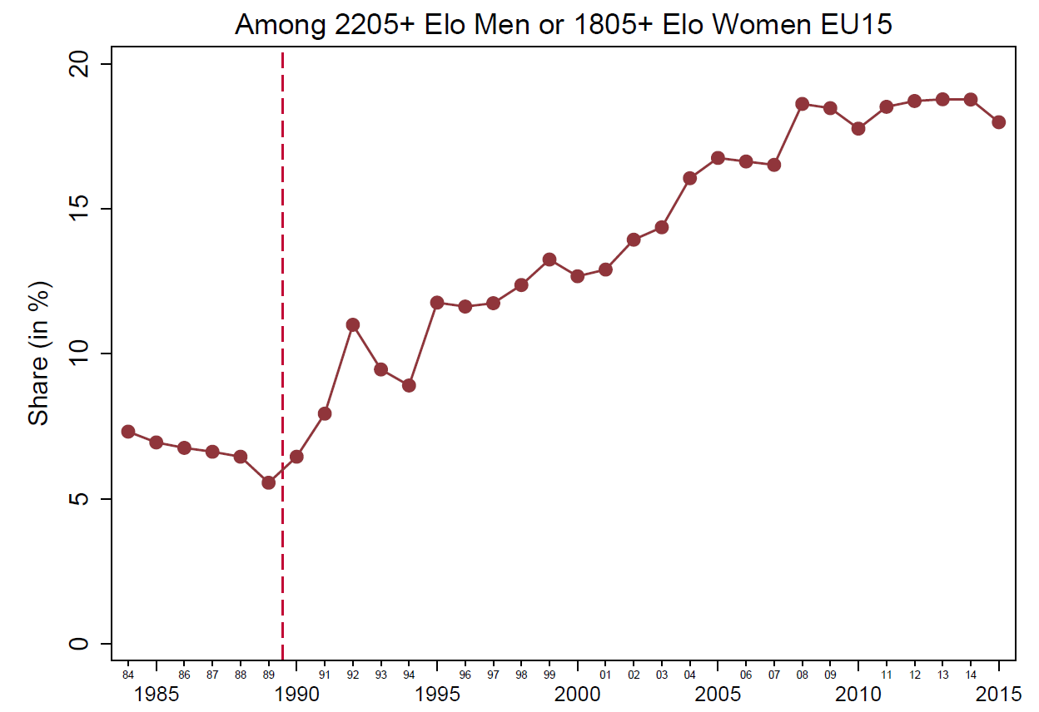
EU-15 FIDE data:
Share of French Women

Slide 91
EU-15 FIDE data:
Share of French Women

Slide 92
Did the Quota cause those effects?
What fraction of elite EU-15 female chess players is French?
  If global effects drive French phenomenon:
  Share of French in EU-15 constant
  AA quota drives French phenomenon!
  Share of French in EU-15 increasing

Slide 93
Effects of Affirmative Action Quota
Direct Effect: Women selected by the quota
  Improve their performance – Elo rating? YES
Are the effects due to the quota? YES
Trickle-down and spillover effects
  More & better female chess players? YES
Are the effects due to the quota? YES
Are there negative externalities on men?
  Costs on French male chess players?

Slide 94
EU 15 FIDE data:
Share of French Women & Men

Slide 95
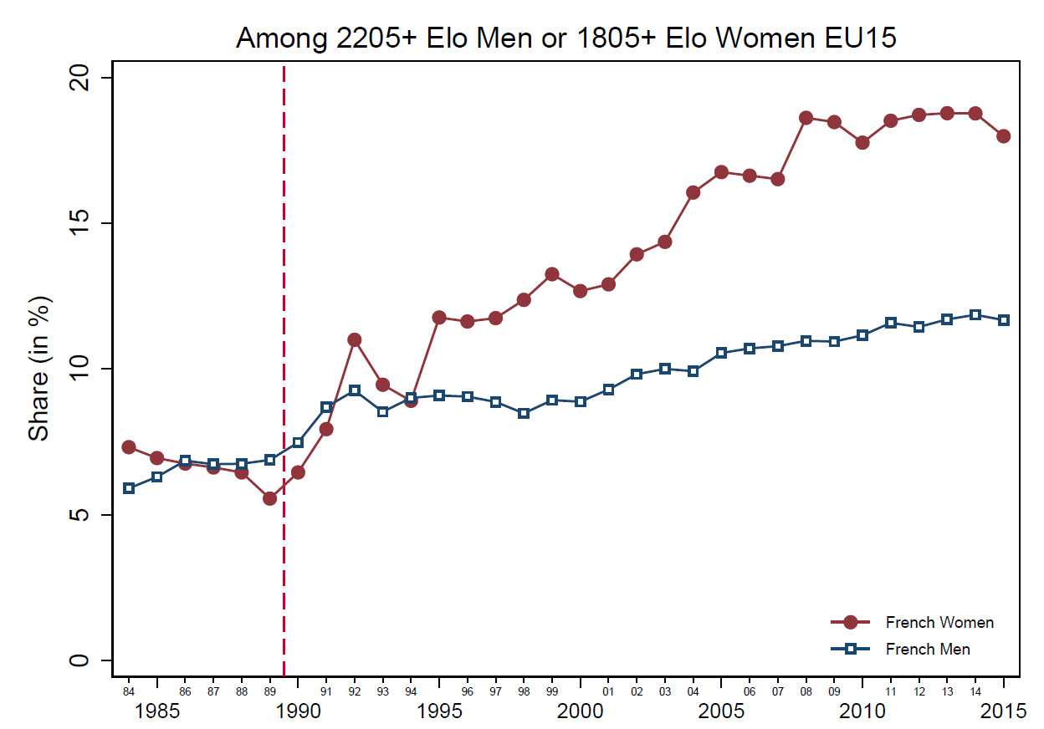
EU 15 FIDE data:
Share of French Women & Men

Slide 96
Effects of Affirmative Action Quota
Direct Effect: Women selected by the quota
  Improve their performance – Elo rating? YES
Are the effects due to the quota? YES
Trickle-down and spillover effects
  More & better female chess players? YES
Are the effects due to the quota? YES
Are there negative externalities on men? NO
  Costs on French male chess players?

Slide 97
Applications beyond Chess: Universities
Universities: What if ranking depended on output by female researchers?
UK: Research money based on ranking based on five year research output.
What if 15% of points that determine ranking depend only on female research?
Note that this is different from rewards for having a fraction of female (minority) faculty
It also matters that the female (minority) faculty are good researchers!

Slide 98
Competitiveness
From the Lab to the Field and to Policy
Competitiveness: new behavioral trait
  Design, Robustness
External Relevance of Competitiveness
  Competitiveness predicts education choices, gender differences?
  Competitiveness is important in a representative sample
Behavioral Market Design: Change Institutions not women!
  Some institutional designs may reward competitiveness more than others
  This could lead to unintended consequences for the gender gap in education choices
  Reexamine effect of Quota-like Affirmative Actions
    Gender gap in competitiveness is reduced in single sex tournaments, affecting the costs and benefits of implementing quotas
  Empirical Evidence of Trickle-Down Affirmative Action
    Case Study in France

Slide 99














