Slide 1

FROGEE 2024 Academic Conference
How does gender matter in the economy?
Stockholm School of Economics, 6 December, 2024
Introductory remarks by
Jesper Roine
Professor of Economics, Deputy Director of SITE

Slide 2
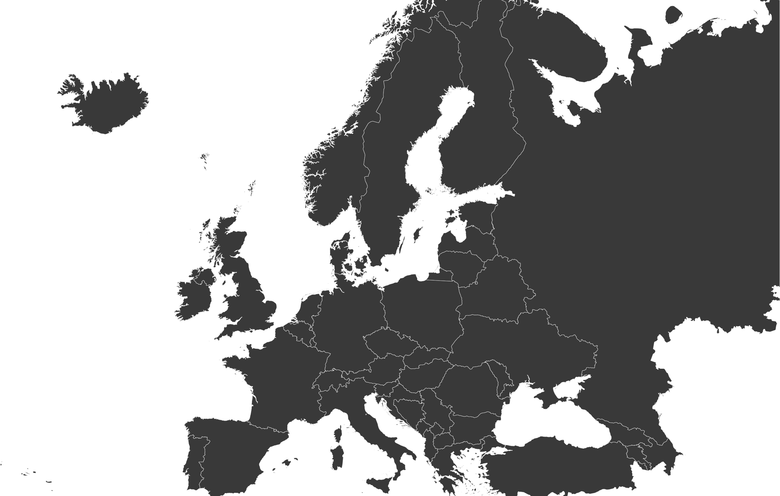
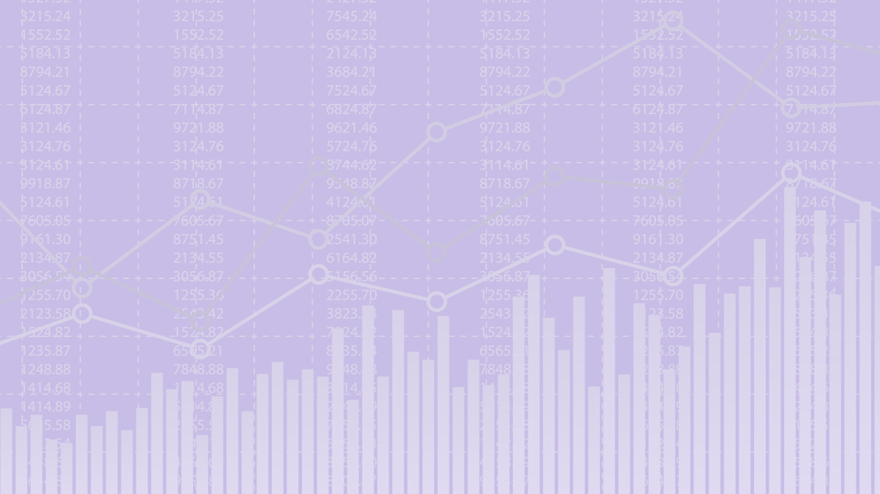


SITE
CEFIR/NES
BICEPS
BEROC
Forum for research on Eastern Europe and Emerging Economies
CenEA
KSE
Moldova
ISET
Armenia

Slide 3


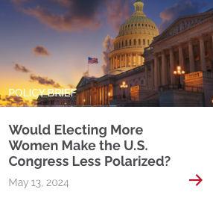
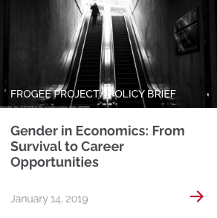

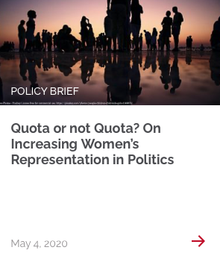
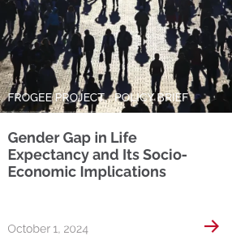
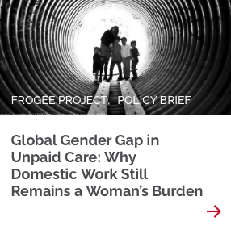
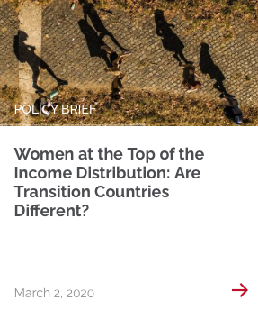
FROGEE started 2019

Slide 4
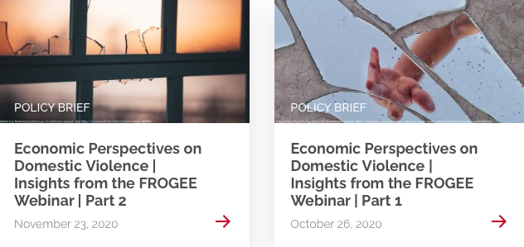

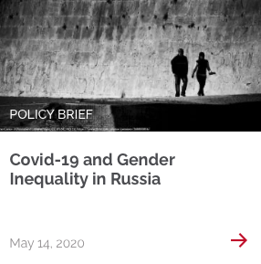
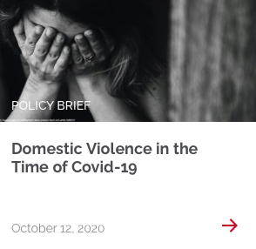
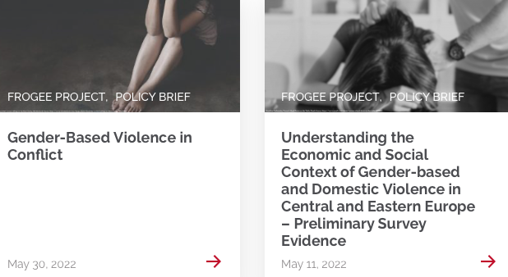
FROGEE through crises

Slide 5
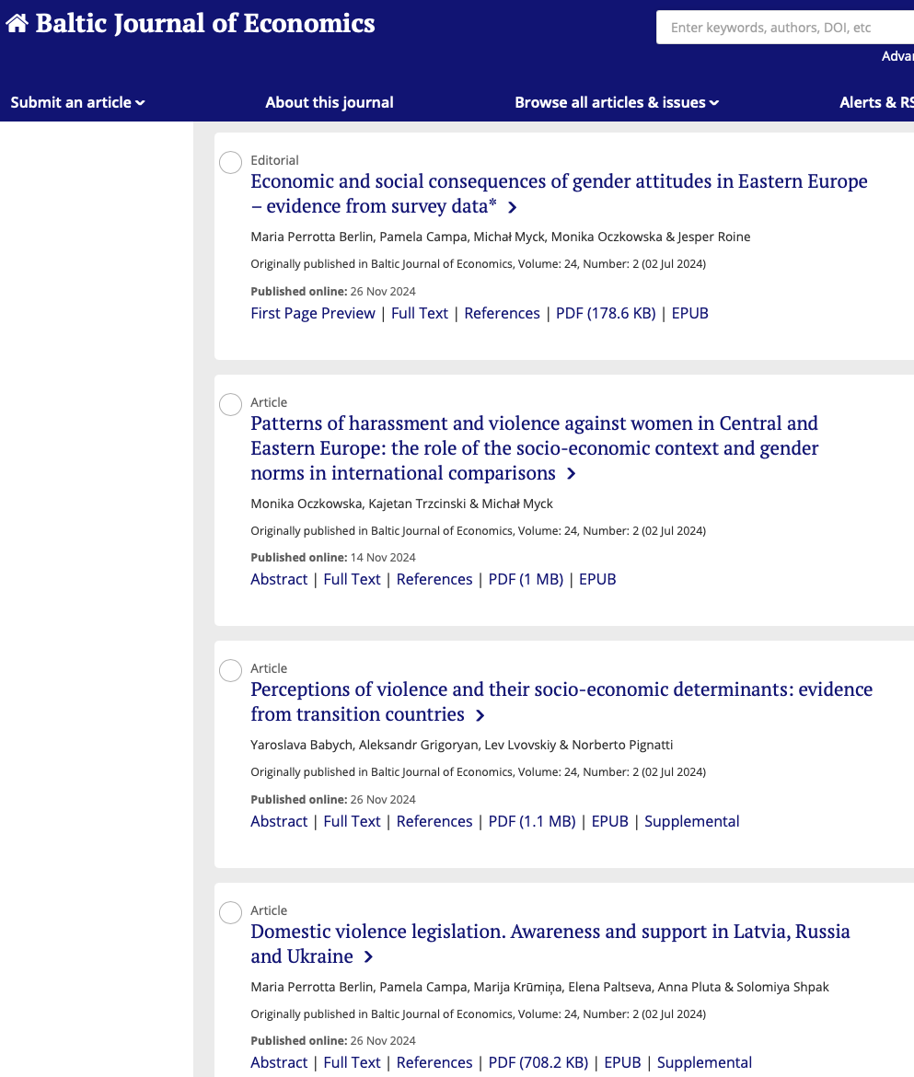


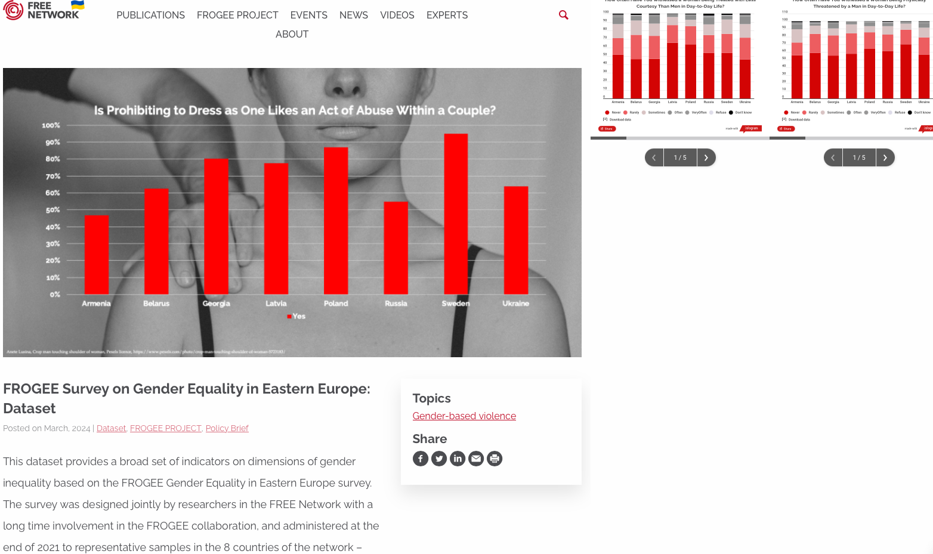
New data collection on gender-equality, violence and attitudes

Slide 6
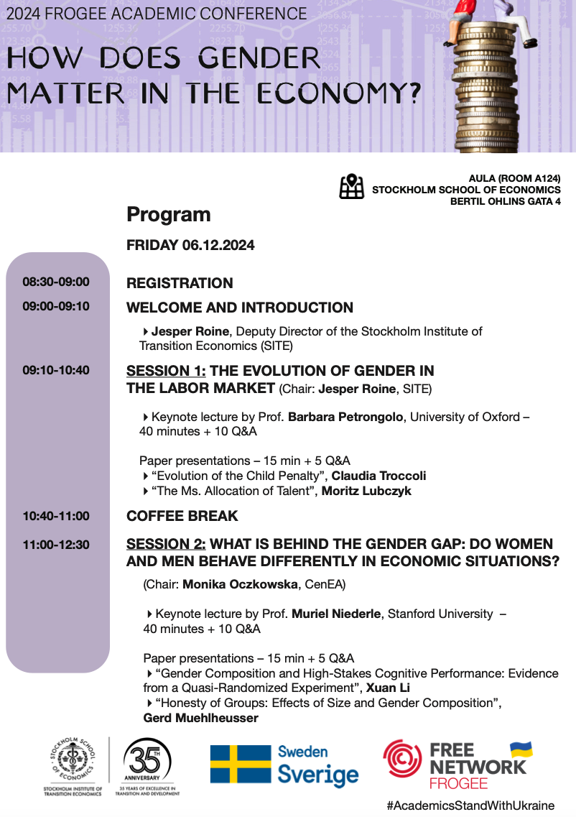
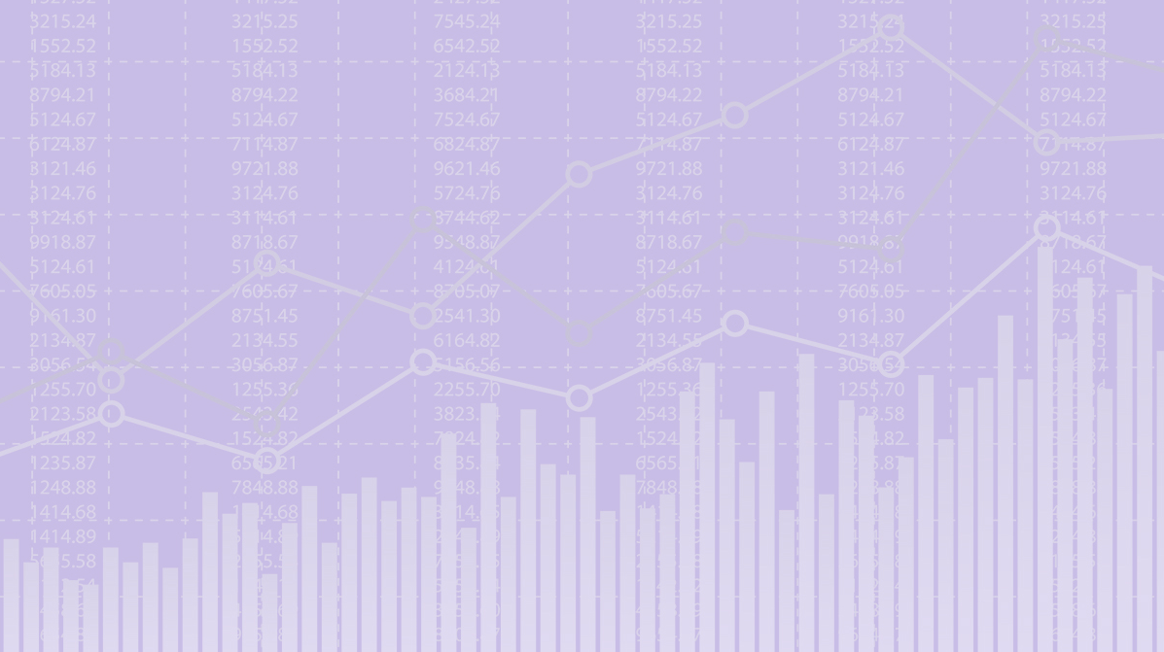
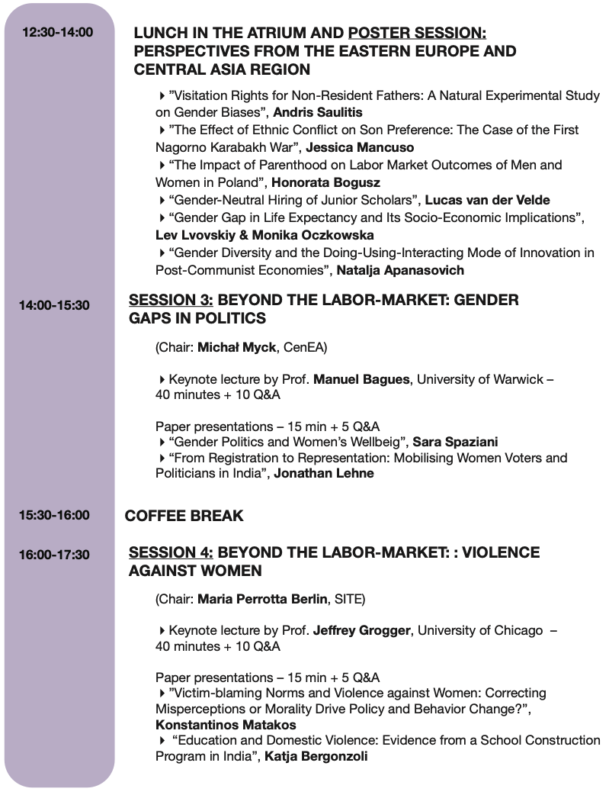
Today’s program organized around four themes
Labour
Behavioural differences
Politics
Violence against women
And a lunch session with contributions from the region

Slide 7
WELCOME!

